Slide 1
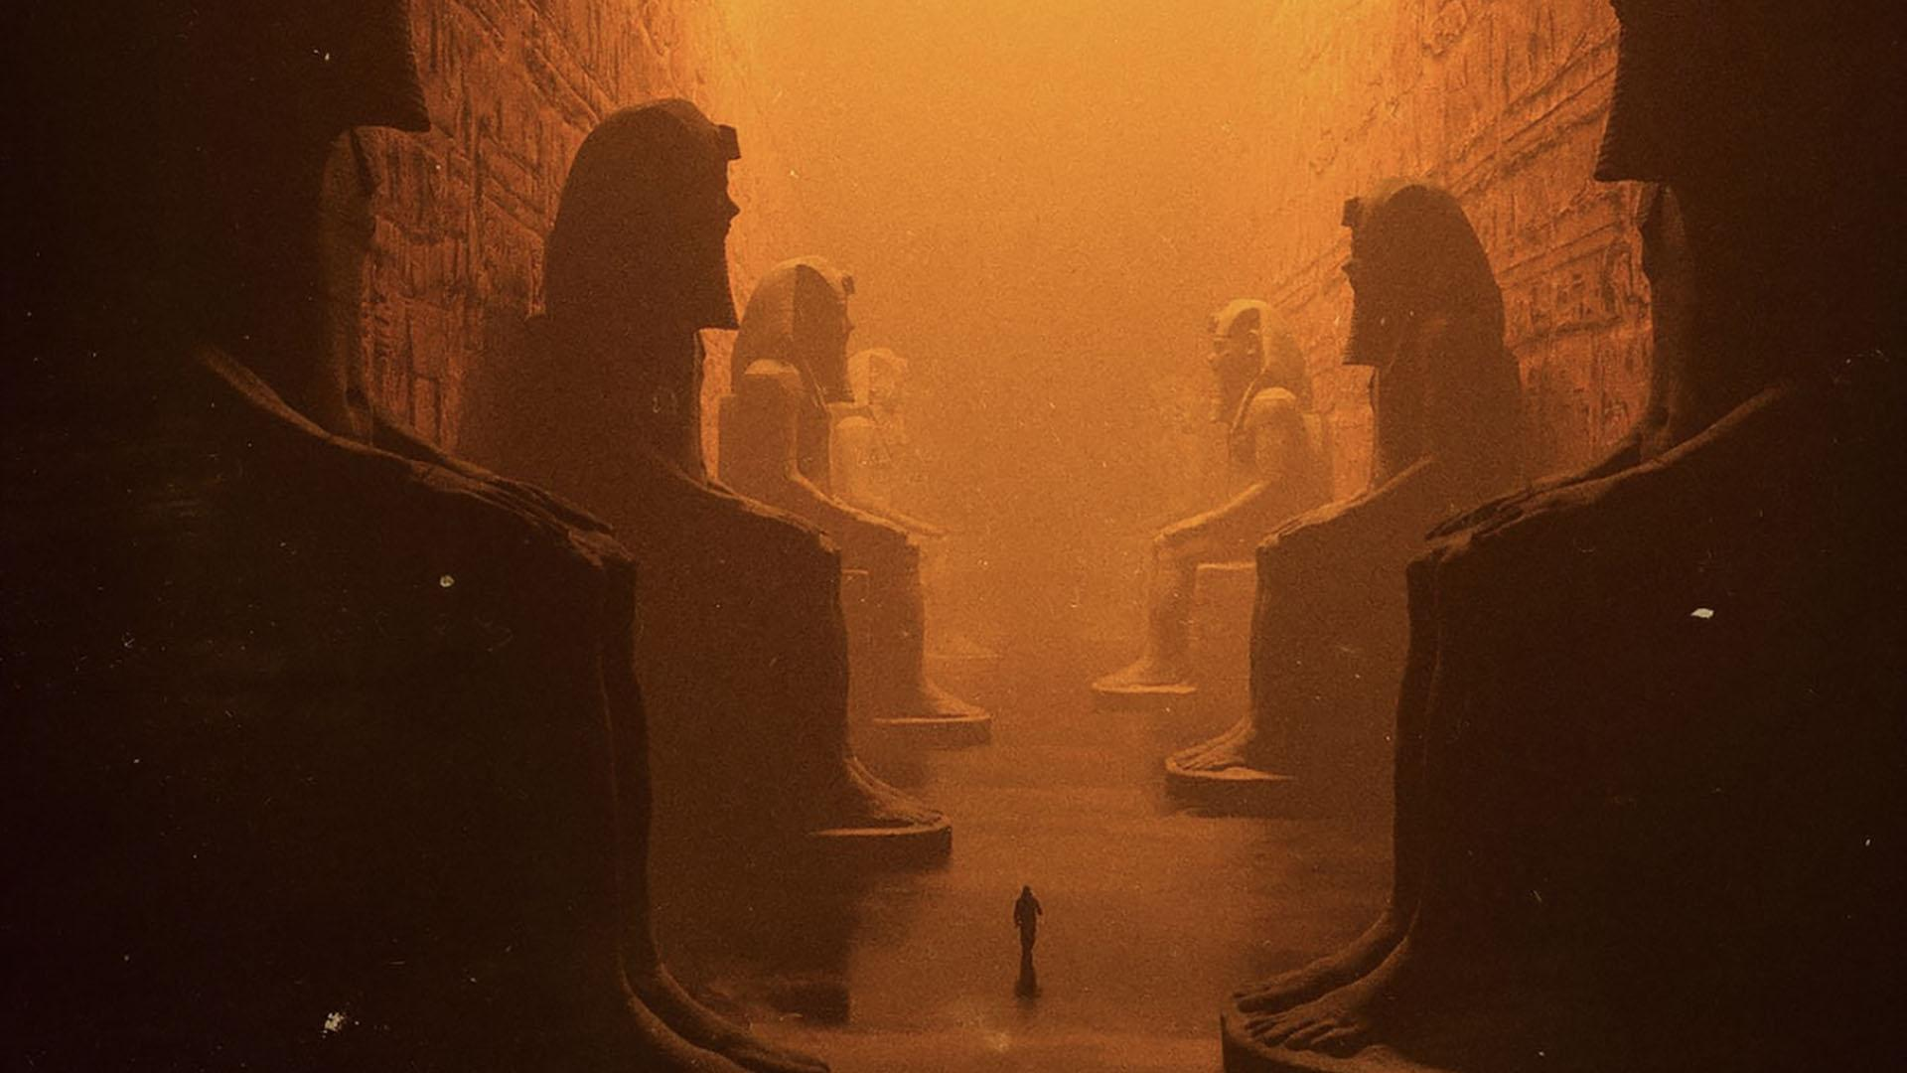
JAMES
TRUE
LIVE
You are here

Slide 2
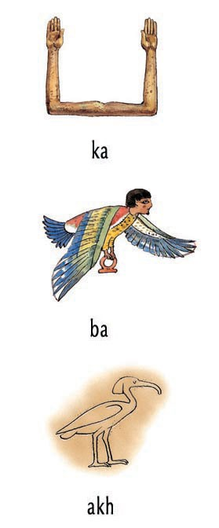
Notes:
Ka & Ba
(2960 BC)
We know from texts that the Egyptians believed once a burial was interred within its tomb, the structure formed both a repository for the body and a dwelling for two spiritual elements, the ka and the ba, which were integral to a human in life, but separated from it at death. The ka remained in the tomb, whereas the ba could leave during the day to join the world of the living, but had to return at night. However, both had to reunite daily with the body in the tomb to attain the highest spiritual state, which was an akh or 'effective' being, able to enjoy eternity on earth and amongst the gods.
Akh: The physical body was called the Akh. The Akh was most often used to mean a complete person, whether living or dead. While living, the Akh was composed of all five elements - your body, Ba, Ka, Name, and Shadow. When dead, the Akh referred to the reunion of the Ba and the Ka, which they believed happened each night.

Slide 3
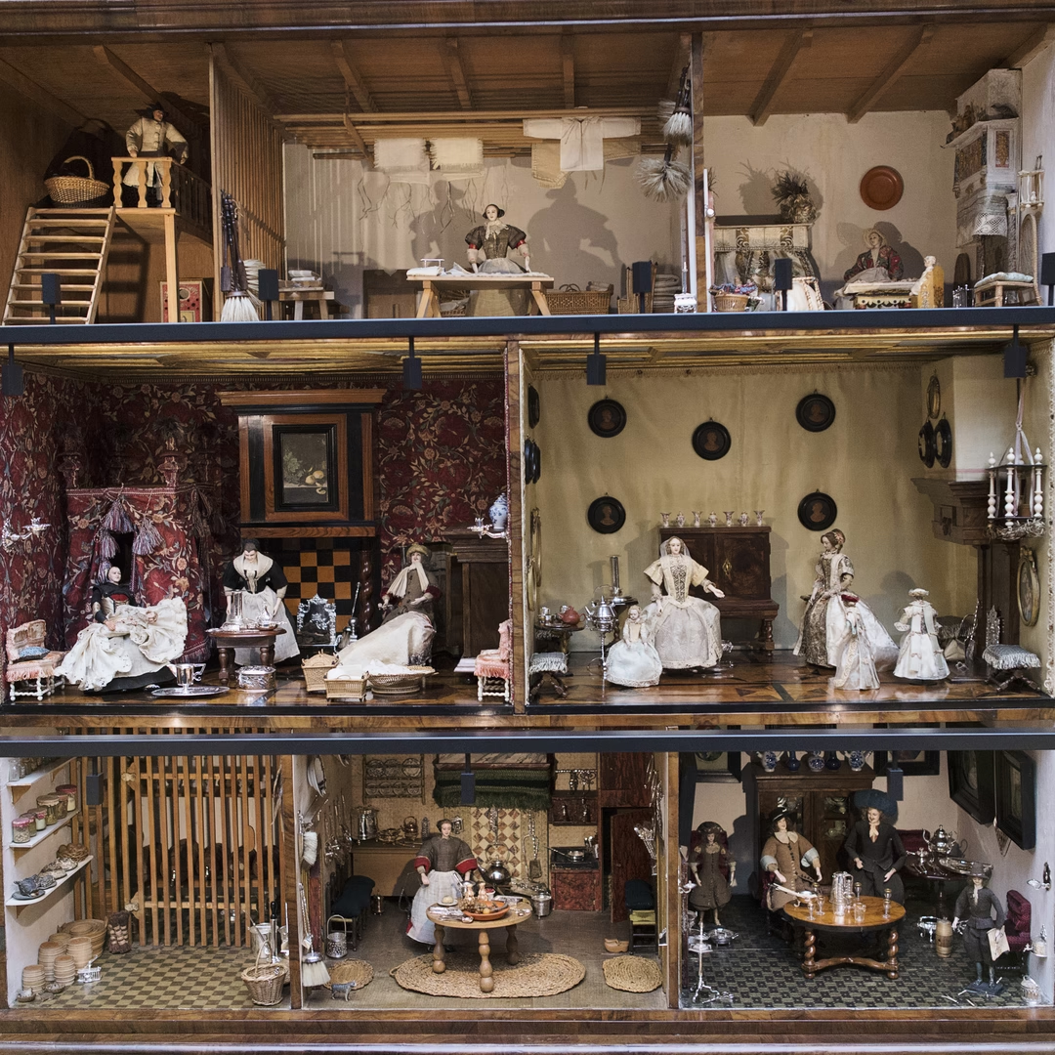
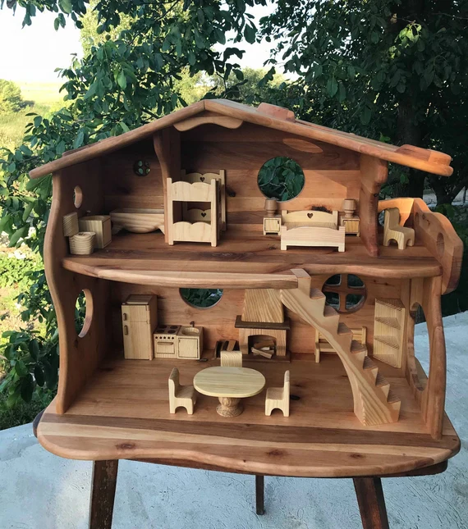

Slide 4
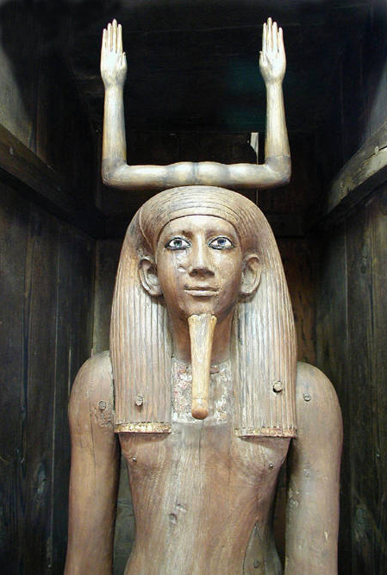
KA
After death, the ethereal aspects of the soul were believed to be released from the body, free to roam the earth, but required the physical body or a surrogate, such as the ka statue, to return to as a permanent home.
Ka statues could also be set up as a type of memorial for the deceased in absentia; for example in Abydos hundreds were set up to allow the dead to participate in the yearly festivals commemorating the resurrection of Osiris.
Shadow was shade from the sun was a sign of powerful protection
Notes:
A ka statue is a type of ancient Egyptian statue intended to provide a resting place for the ka (life-force or spirit) of the person after death. The ancient Egyptians believed the ka, along with the physical body, the name, the ba (personality or soul), and the šwt (shadow), made up the five aspects of a person.
Ka is the life force or spiritual double of the person. The royal Ka symbolized a pharaoh's right to rule, a universal force that passed from one pharaoh to the next.

Slide 5
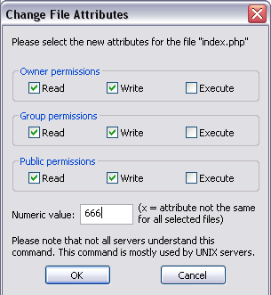
Ancient Egyptians believed in five aspects of a person:
Your Name (cartouche)
Soul or Ba (Application)
Spirit or Ka (PID)
Body (shell)
Shadow or Swt (Privileges)
KA
BODY
BA
CARTOUCHE
SHADOW
Notes:
A ka statue is a type of ancient Egyptian statue intended to provide a resting place for the ka (life-force or spirit) of the person after death. The ancient Egyptians believed the ka, along with the physical body, the name, the ba (personality or soul), and the šwt (shadow), made up the five aspects of a person.
Ka is the life force or spiritual double of the person. The royal Ka symbolized a pharaoh's right to rule, a universal force that passed from one pharaoh to the next.

Slide 6
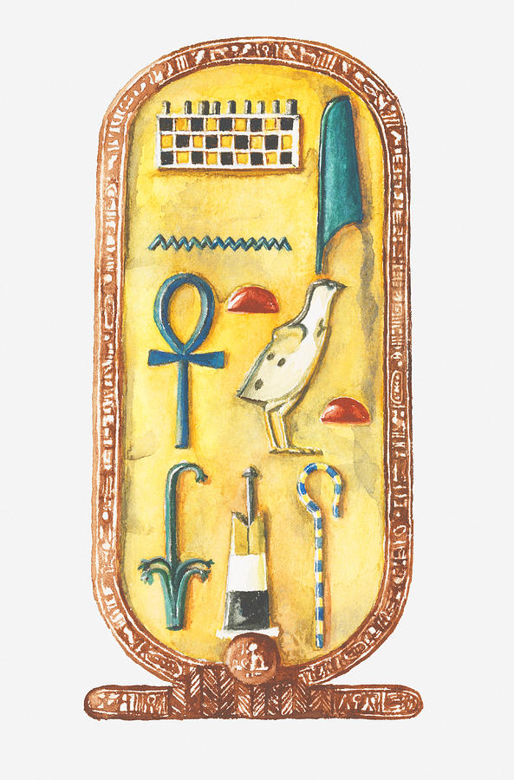
What’s in a Name
A person’s name was a sigil where Ka and Ba converge.
If something happened to your preserved body, or if your Name was not written down somewhere, the Ba and the Ka would get lost. They would not be able to find their way home to your tomb. You would disappear. Forever. You would not be able to watch over your family or to enjoy your afterlife.
And out of the ground the LORD God formed every beast of the field and every bird of the air, and He brought them to the man to see what he would name each one. And whatever the man called each living creature, that was its name. - Genesis 2:20
Notes:
A ka statue is a type of ancient Egyptian statue intended to provide a resting place for the ka (life-force or spirit) of the person after death. The ancient Egyptians believed the ka, along with the physical body, the name, the ba (personality or soul), and the šwt (shadow), made up the five aspects of a person.
Ka is the life force or spiritual double of the person. The royal Ka symbolized a pharaoh's right to rule, a universal force that passed from one pharaoh to the next.

Slide 7
“Valley of the Gates of Kings” - Wadi Abwab al-Muluk
Wadi means the channel of a watercourse that is dry except during periods of rainfall. Abwab al-Muluk means Gates of Kings.

Slide 8
Valley of the (Gates of) Kings
Why hide 62 dead Pharaoh in the exact same valley as the last guy?
Why not over the ridge farther away from the world’s most popular destination?
The distance from Karnak to the valley of the Kings is less than 10 kilometers.
Notes:
A∴A∴
Argenteum Astrum, which is Latin for Silver Star A variant on this Greek rendering of the words "Silver Star" is Aster Argos - also a correct Greek rendering of the word "Silver Star". The gematria of Aster Argos is 489, also the value of Sothis, the Greek name for the star Sirius. Eshelman states that "Sirius commonly is held to be the physical expression of that "Silver Star" after which the Order is named.

Slide 9
Wadi means the channel of a watercourse that is dry except during periods of rainfall.
The Valley of the Kings (Arabic: وادي الملوك Wādī al-Mulūk; Coptic: ϫⲏⲙⲉ, romanized: džēme[1] Late Coptic: [ˈʃɪ.mæ]), also known as the Valley of the Gates of the Kings (Arabic: وادي أبواب الملوك Wādī Abwāb al-Mulūk),[2] is a valley in Egypt where, for a period of nearly 500 years from the 16th to 11th century BC, rock-cut tombs were excavated for the pharaohs and powerful nobles of the New Kingdom (the Eighteenth to the Twentieth Dynasties of Ancient Egypt).[3][4]

Slide 10
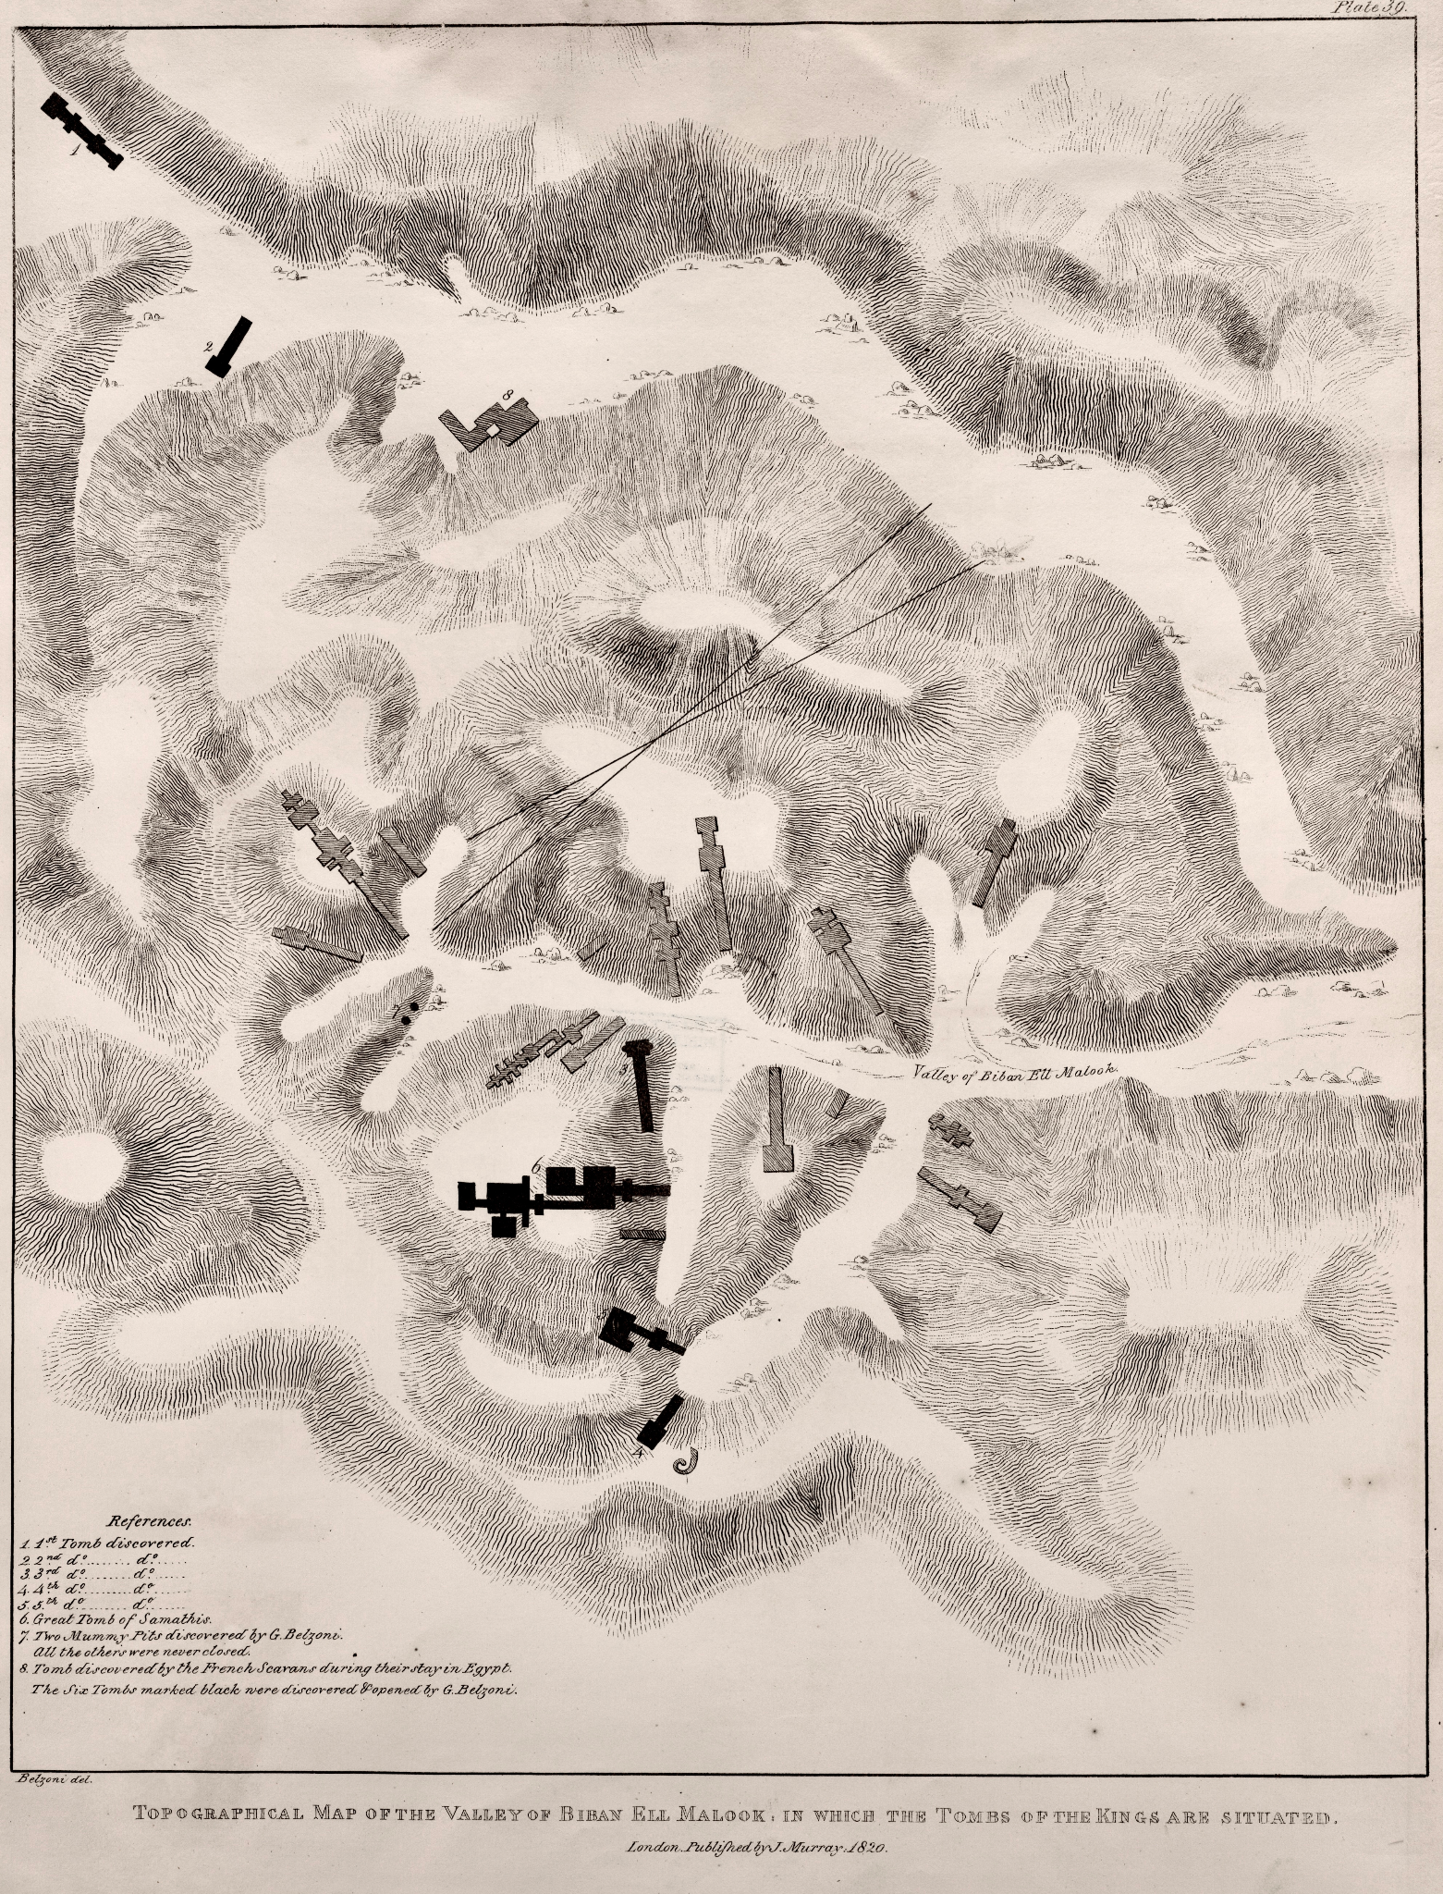
Tombs or Ka veins?

Slide 11
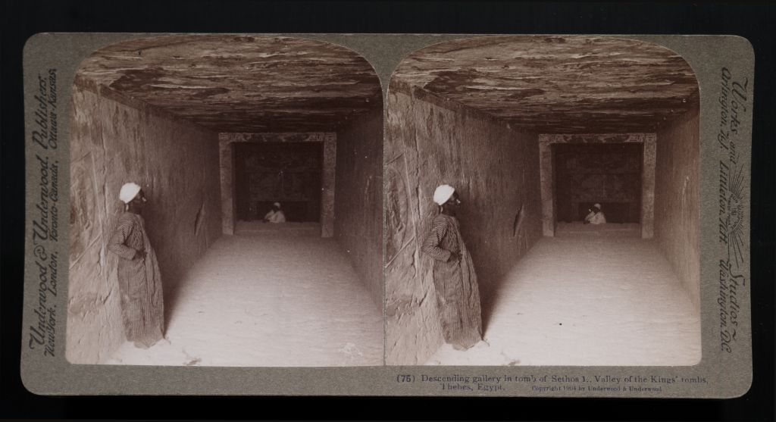
https://earth.google.com/web/@25.69902488,32.63758295,73.42123556a,3944.10872003d,35y,155.45650484h,0t,0r
Thebes (Waset) - sceptre
As early as Homer's Iliad,[9] the Greeks distinguished the Egyptian Thebes as "Thebes of the Hundred Gates"
Luxor Temple (Ipet resyt). Unlike the other temples in Thebes, it is not dedicated to a cult god or a deified version of the king in death. Instead, it is dedicated to the rejuvenation of kingship; it may have been where many of the pharaohs of Egypt were crowned. It is a centerpiece of the "Opet Festival", where the sacred barque of the Theban Triad travels from Karnak to Luxor temple highlighting the godly significance of the pharaoh's re-coronation .

Slide 12
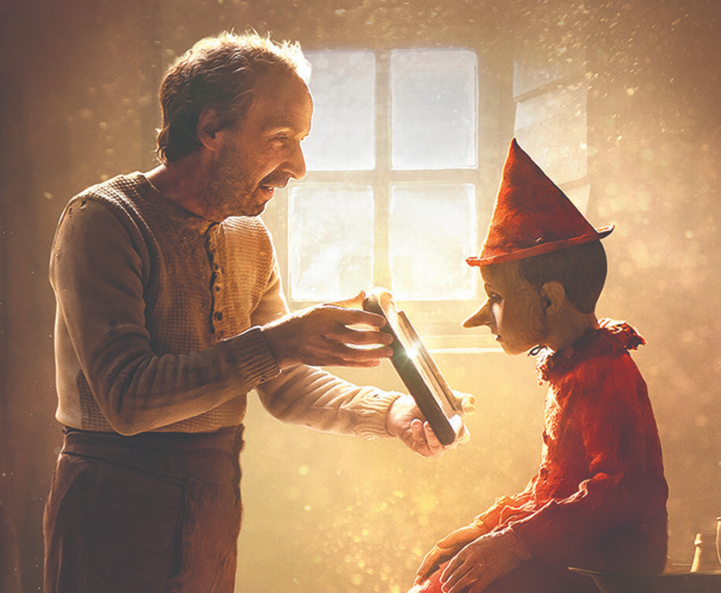
AwayKAning
Because the ancient Egyptians believed statues could magically perceive the world, they were ceremonially brought to life by priests in a special ritual called the opening of the mouth ceremony. In the full version of this ceremony, the mouth, eyes, nose, and ears could be touched with ritual implements to give the statue the power of breath, sight, smell, and hearing.
Notes:
A ka statue is a type of ancient Egyptian statue intended to provide a resting place for the ka (life-force or spirit) of the person after death. The ancient Egyptians believed the ka, along with the physical body, the name, the ba (personality or soul), and the šwt (shadow), made up the five aspects of a person.

Slide 13
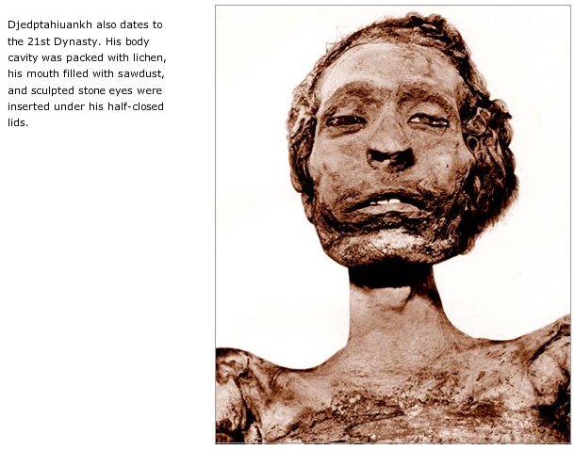
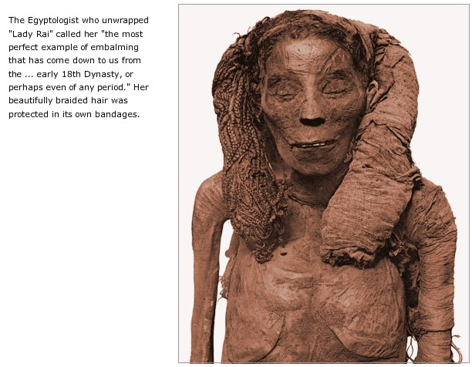
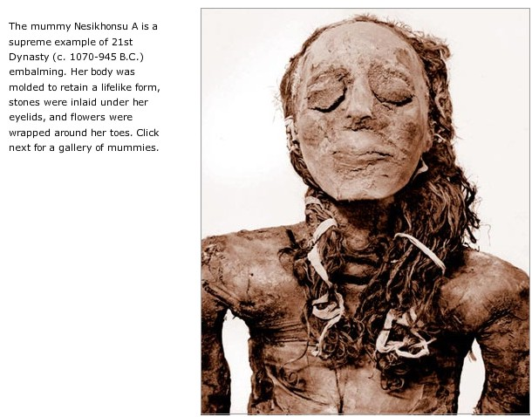

Slide 14
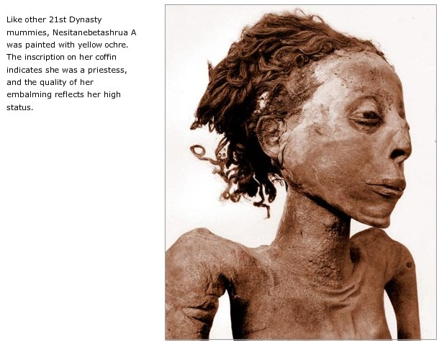
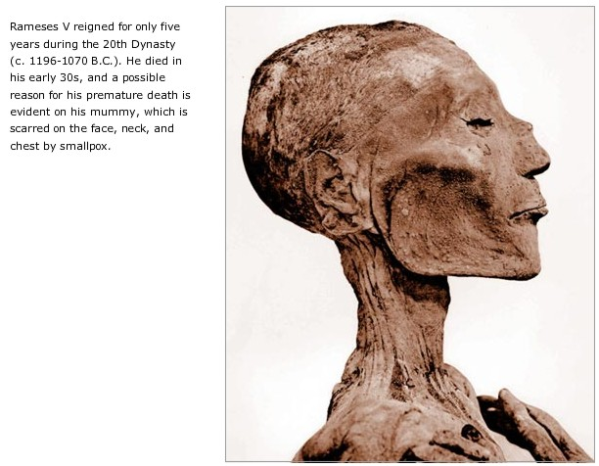
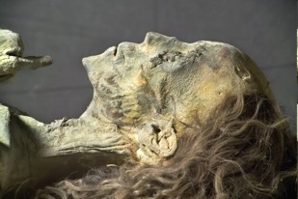

Slide 15
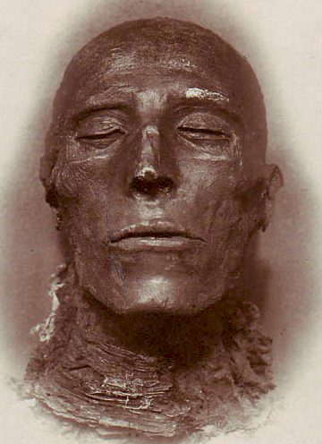
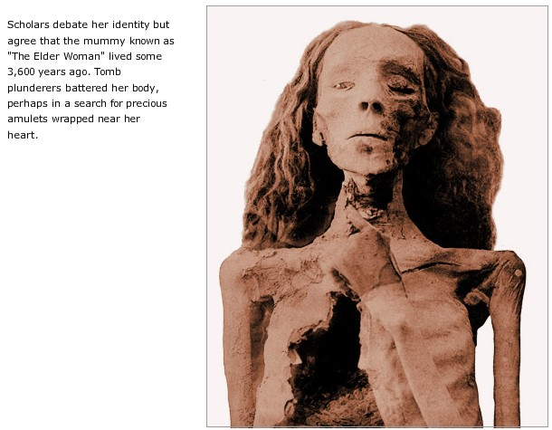
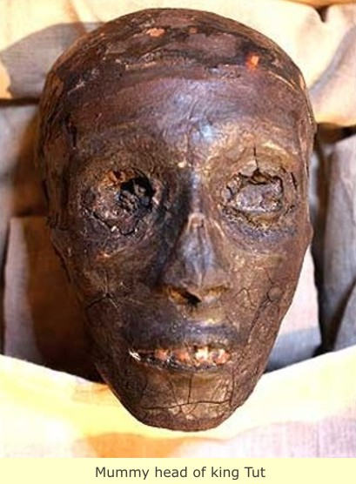

Slide 16
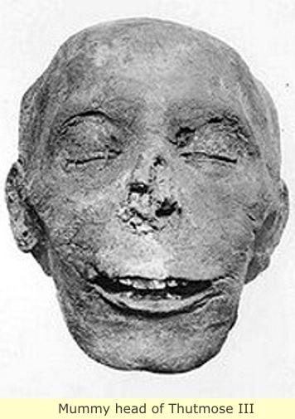
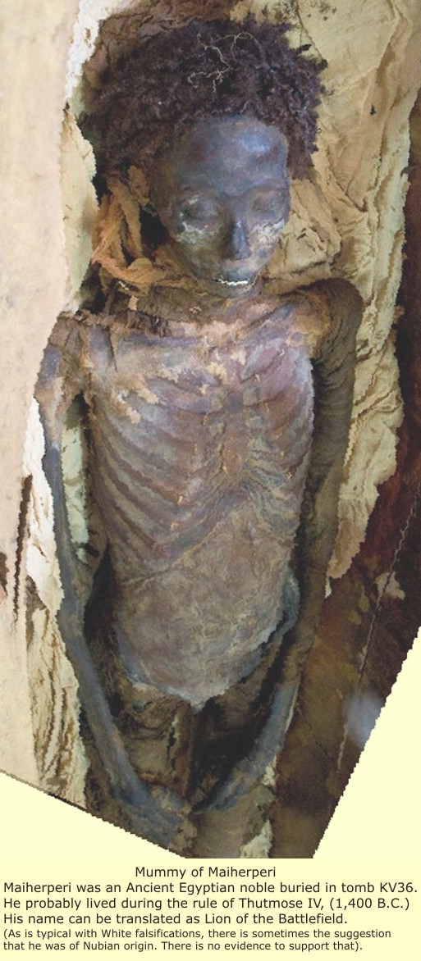
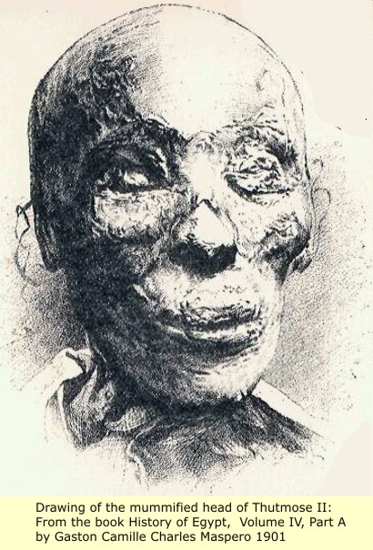

Slide 17
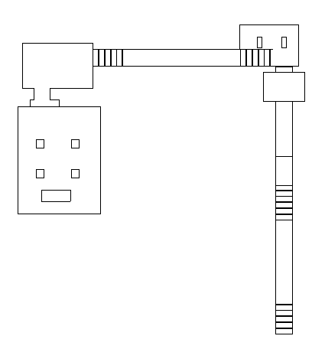
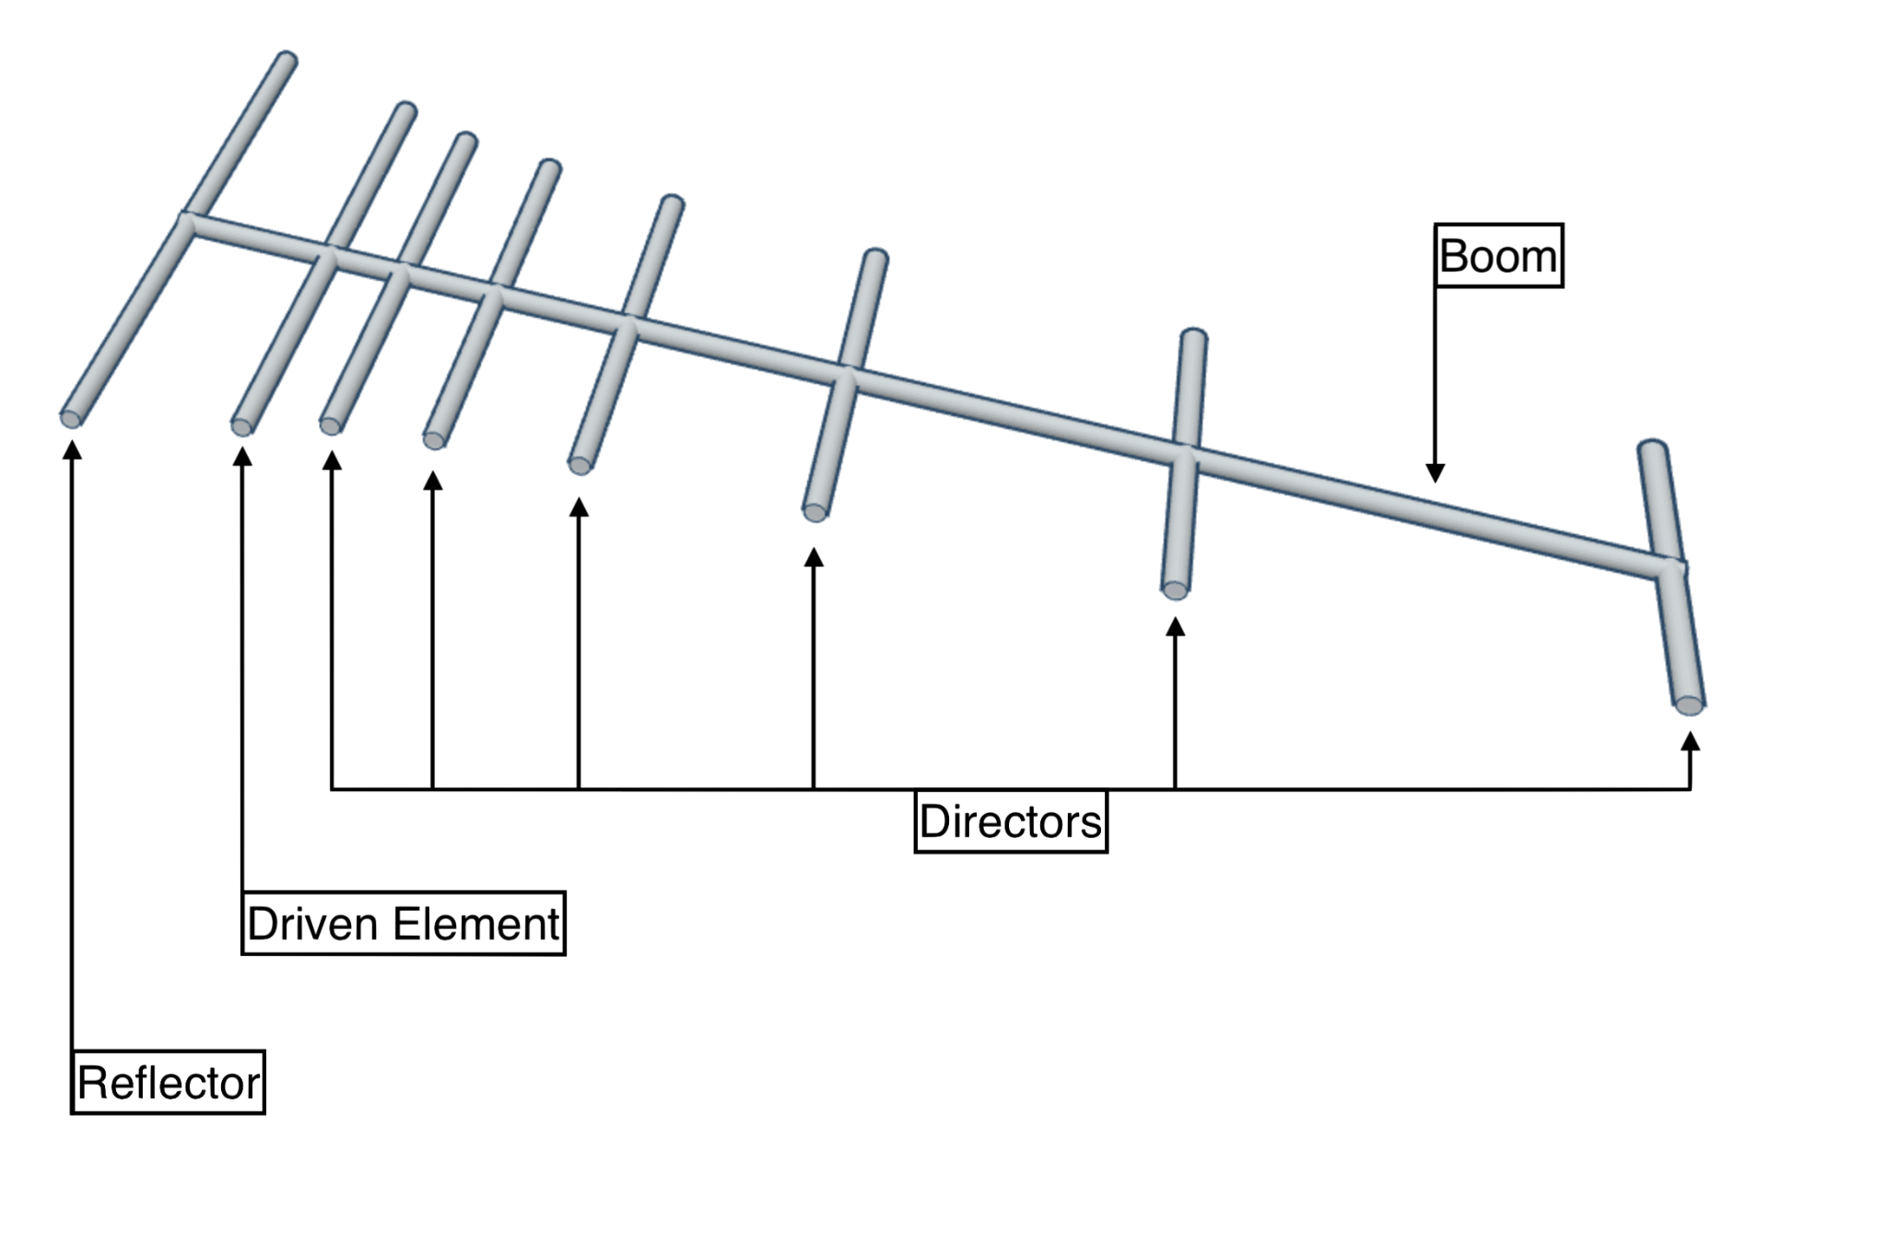
Why do these “tombs” have long hallways?

Slide 18
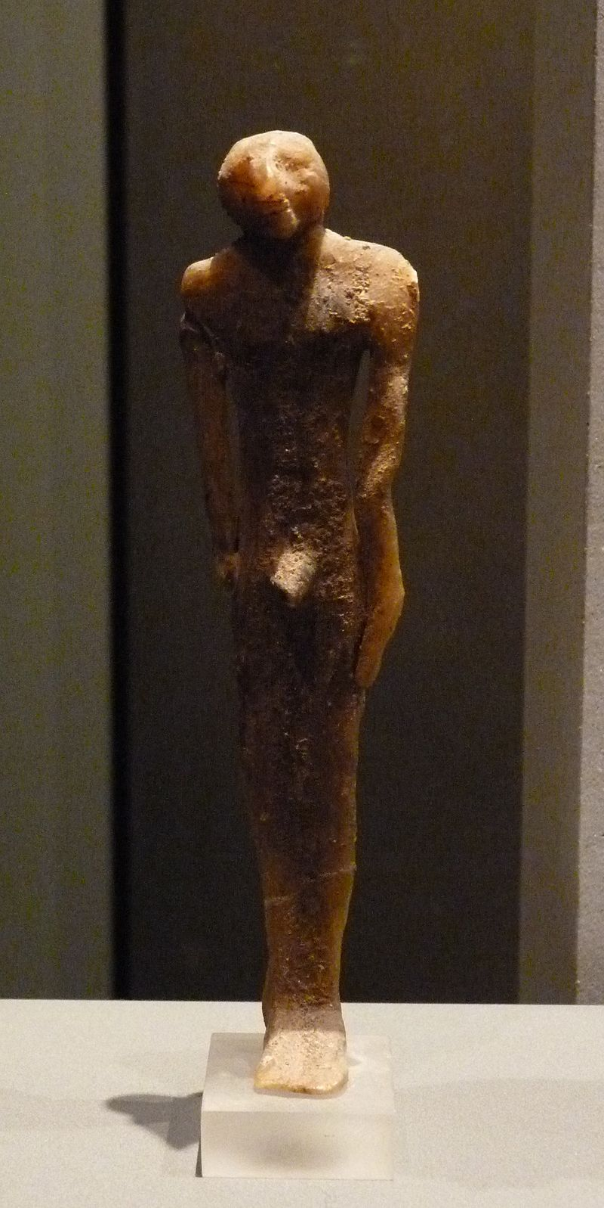
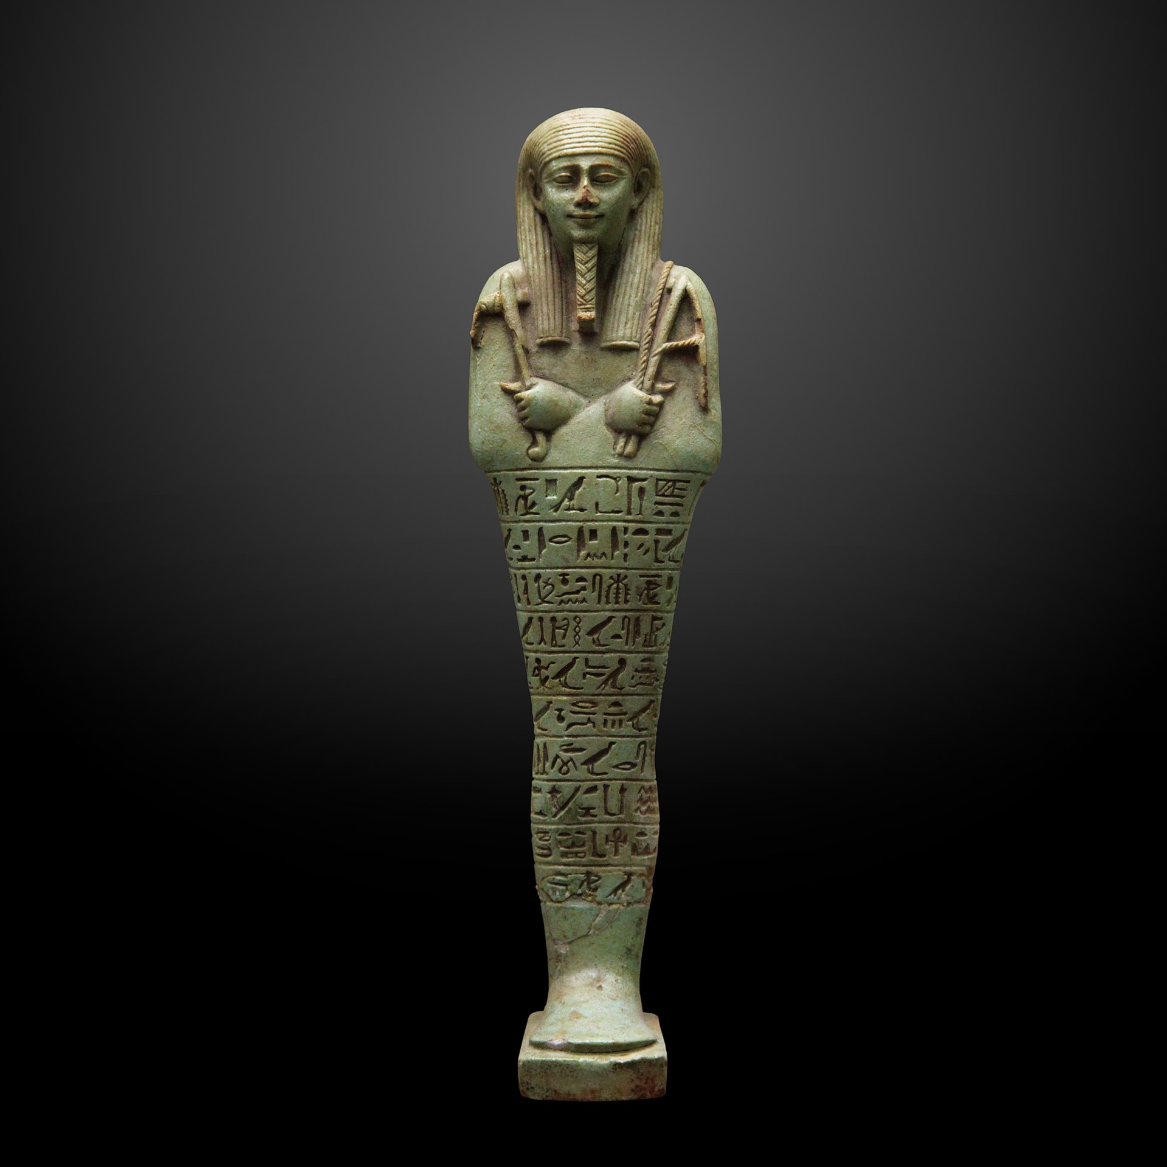
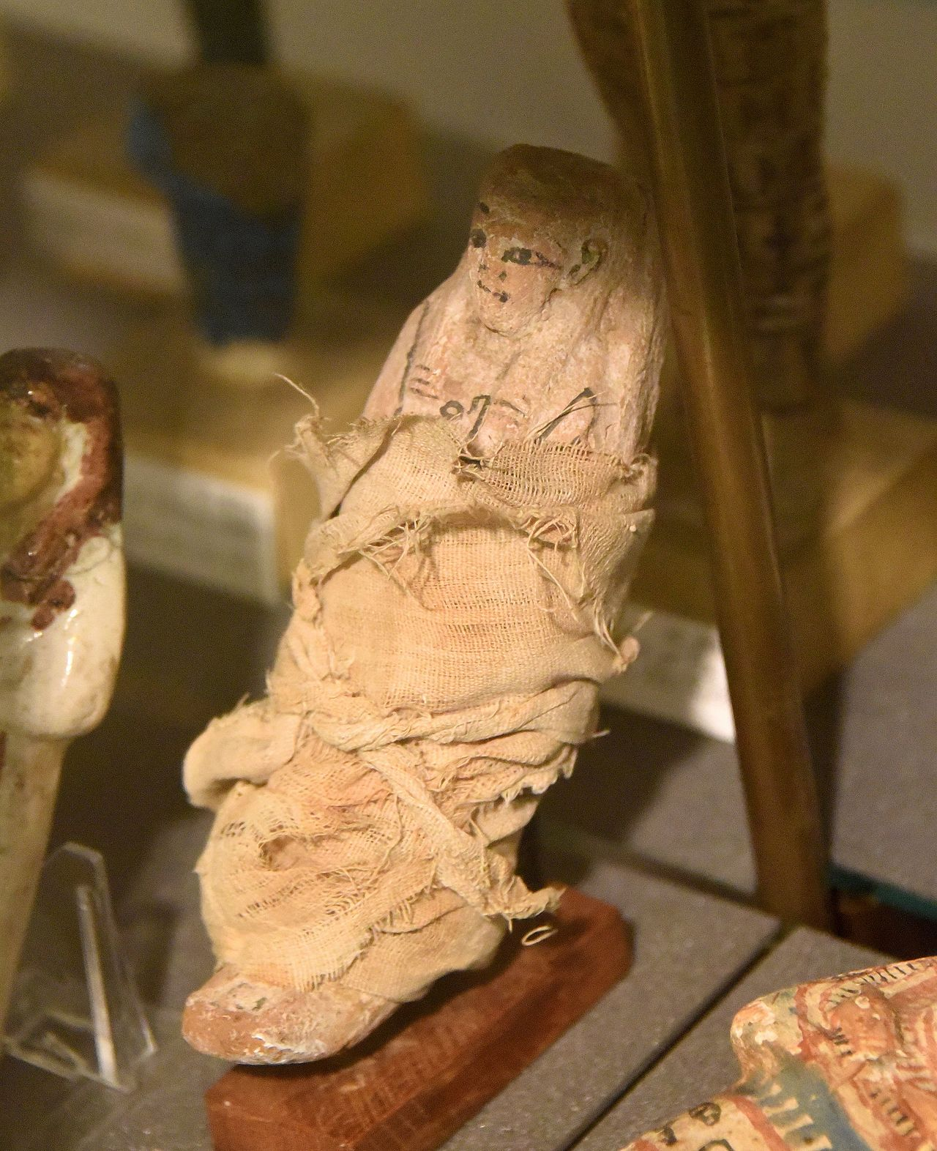
Early ushabti made from wax

Slide 19
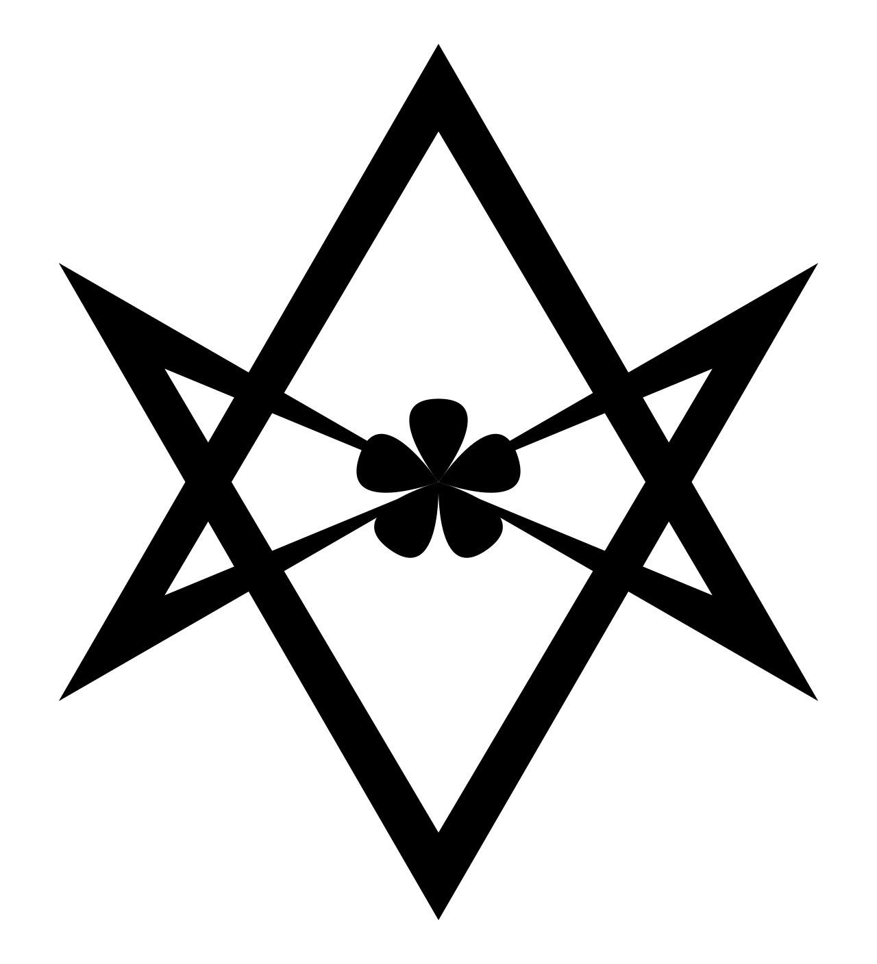
A∴A∴ The Silver Star of Sirius is encoded in the ushabti dolls buried in the Valley of the (Gates of) Kings.
Was Crowley punking us from the afterlife?
12 gates/hours of travel in the underworld.
Notes:
A∴A∴
Argenteum Astrum, which is Latin for Silver Star A variant on this Greek rendering of the words "Silver Star" is Aster Argos - also a correct Greek rendering of the word "Silver Star". The gematria of Aster Argos is 489, also the value of Sothis, the Greek name for the star Sirius. Eshelman states that "Sirius commonly is held to be the physical expression of that "Silver Star" after which the Order is named.

Slide 20
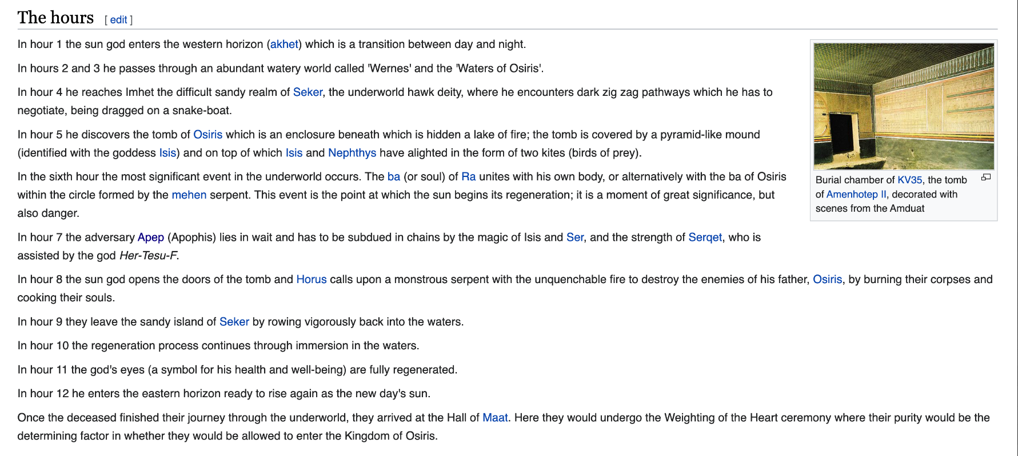

Slide 21
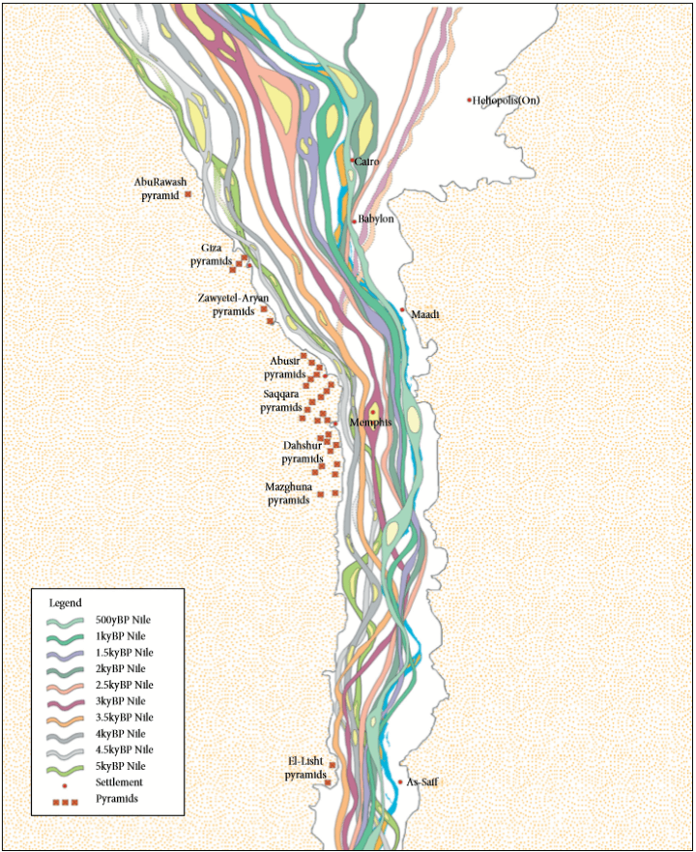
how the course of the Nile river in Egypt has changed over the past 5,000 years

Slide 22
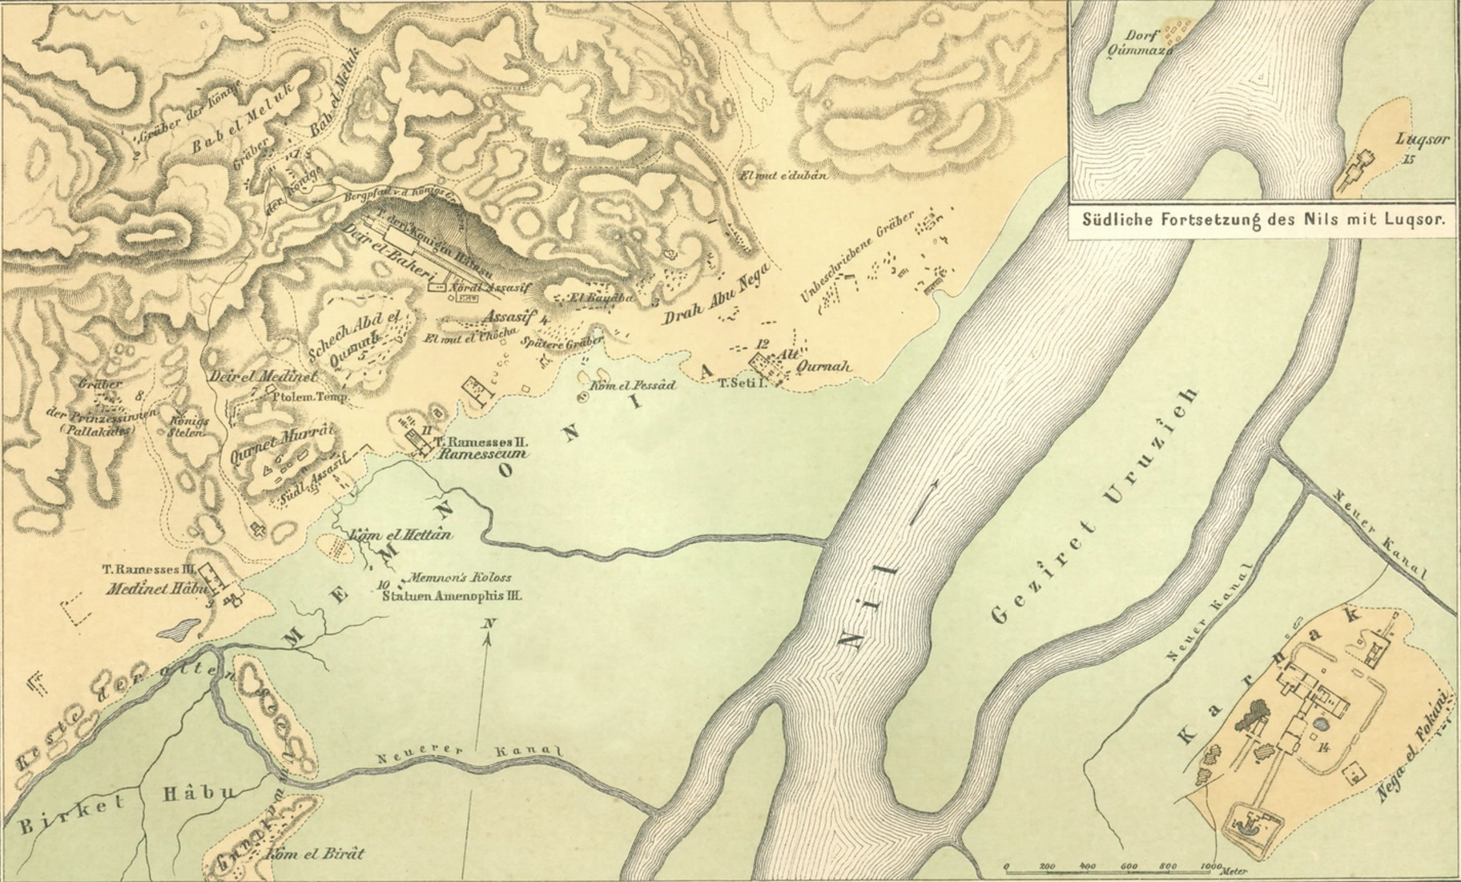
Valley of the Kings
Sandy island of Seker
KA
BA
Karnak

Slide 23
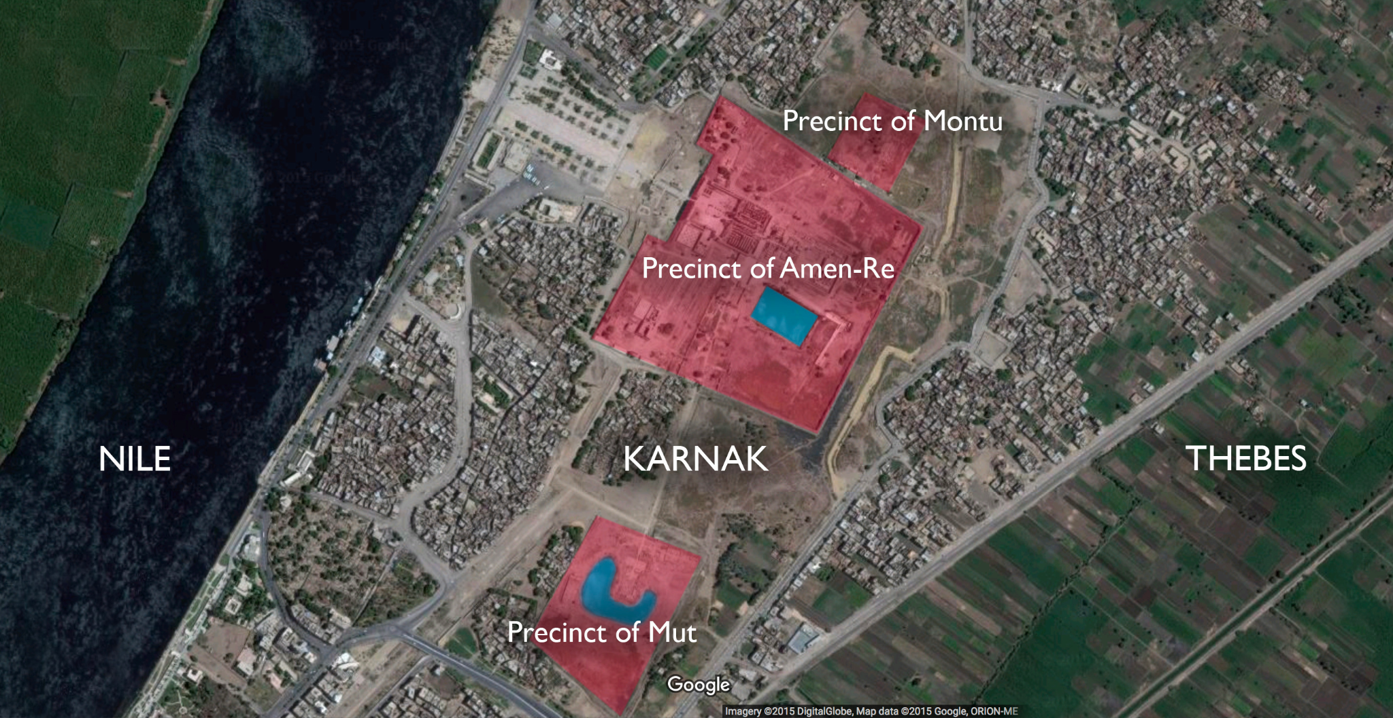
Luxor was named Waset and Thebes to the greeks
The Karnak Temple Complex houses the Precinct of Amun-Ra, is open to tourists. Three other sections—the Precinct of Mut, the Precinct of Montu, and the Temple of Amenhotep IV—are also part of Karnak.
Precinct of Akhenaten (Amenhotep IV) Intentionally dismantled

Slide 24
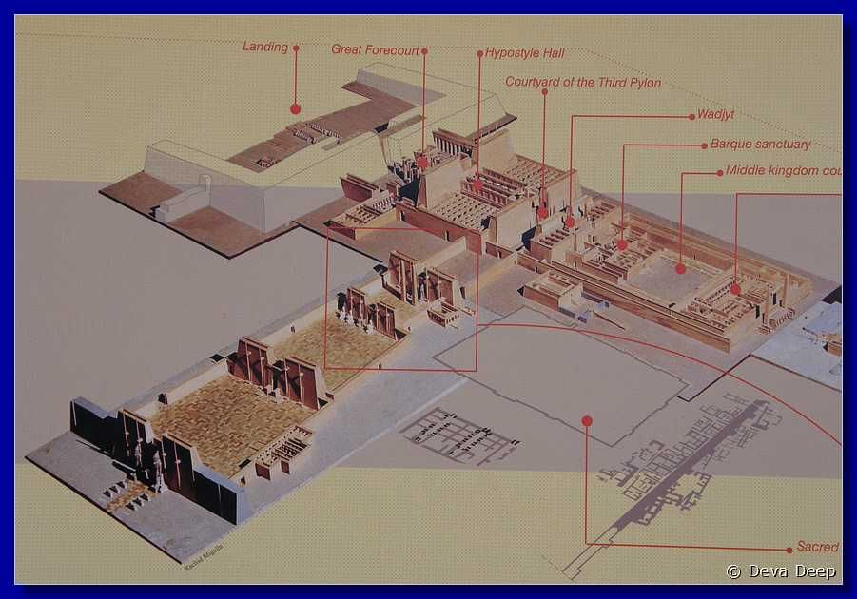
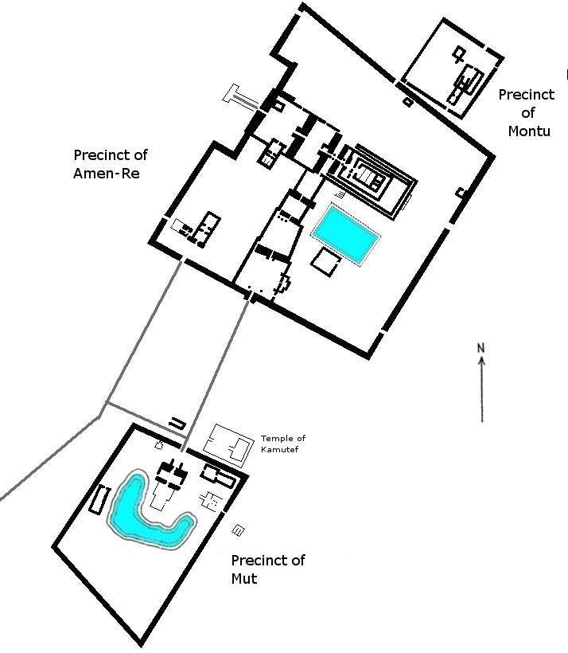
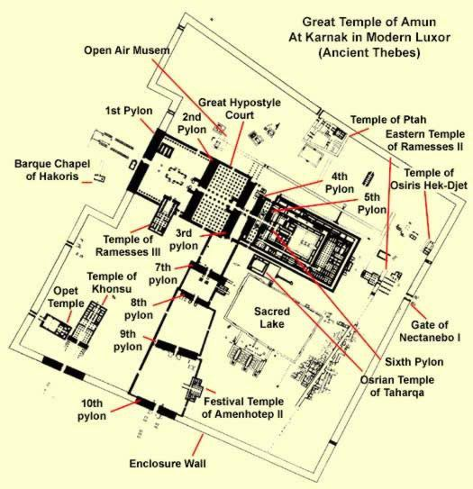
Gates of the Kings

Slide 25
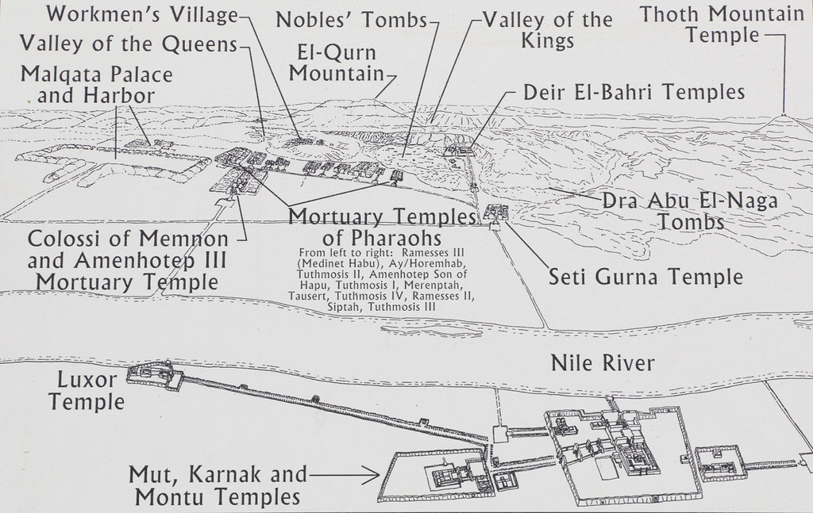

Slide 26
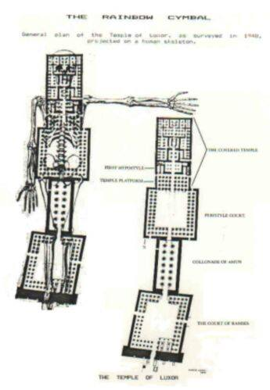
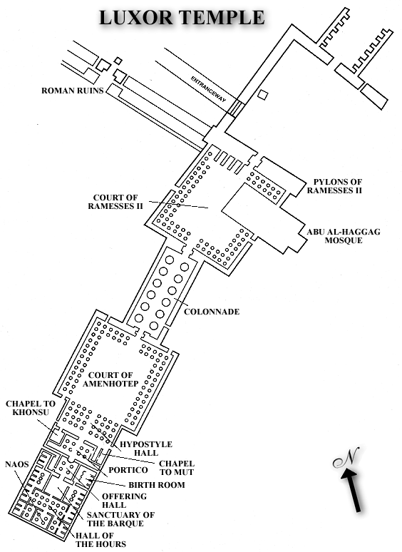
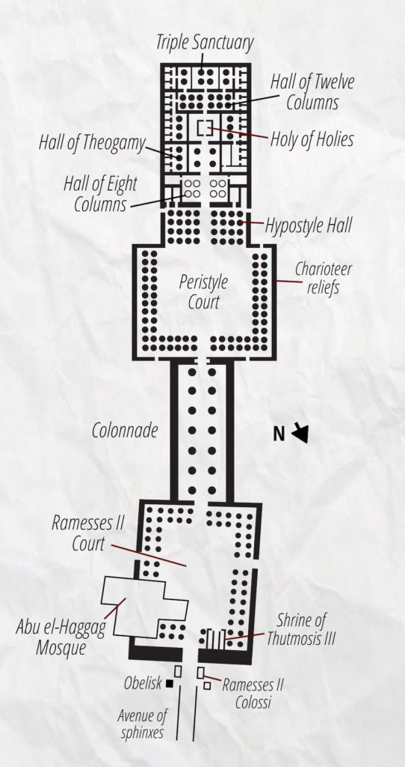

Slide 27
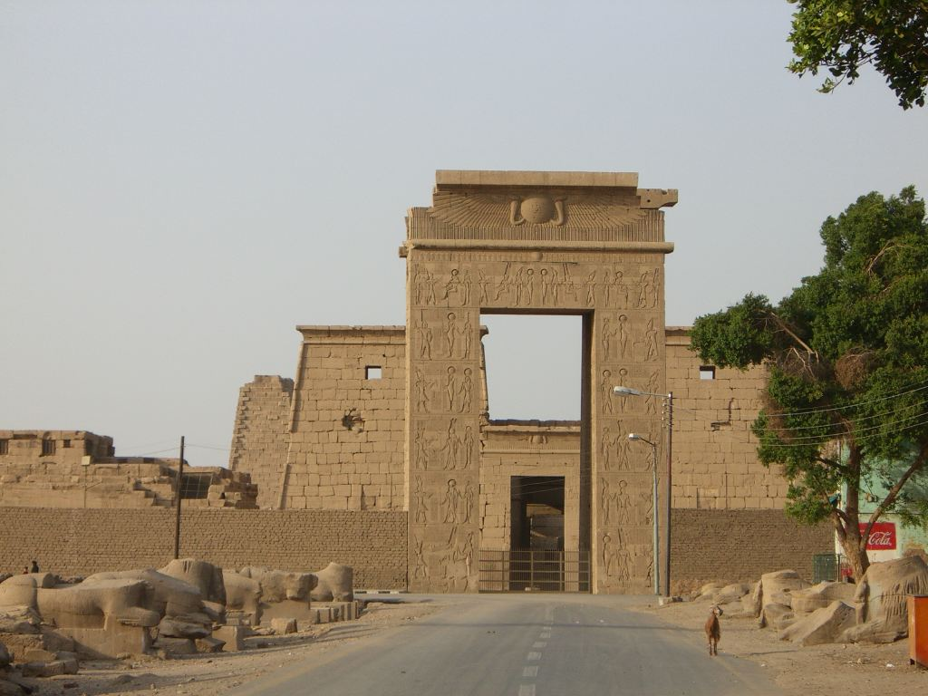
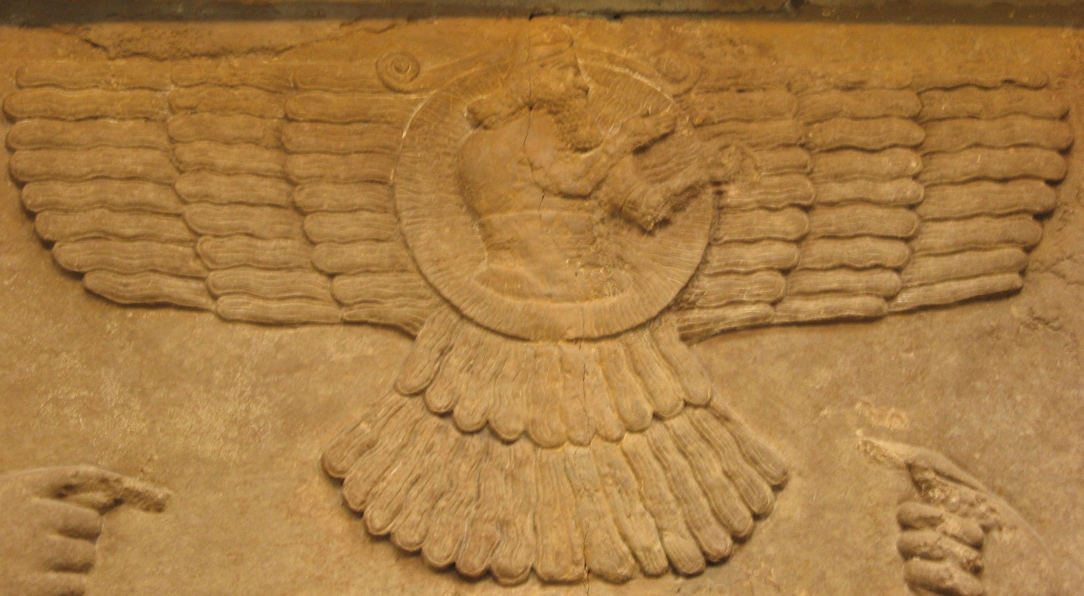
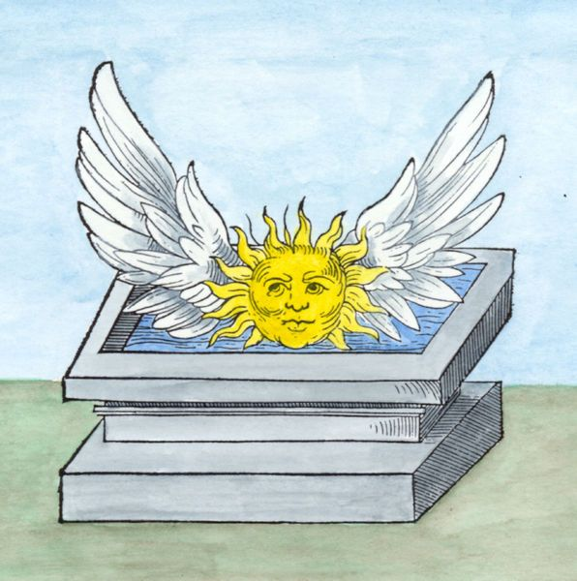
The Temple of Amenhotep IV was constructed outside the boundaries of the Precinct of Amon-Re, to its east. The main temple in the complex was named Gm–p3–itn (Gempaaten), which means "The Sun Disc is Found in the Estate of the God Aten". The other monuments were named Hwt–bnbn (Hwt benben / "The Mansion of the Benben stone"), Rwd–mnw–n–itn–r–nḥḥ (Rud-menu / "Sturdy are the Monuments of the Sun Disc Forever"), and Tni–mnw–n–itn–r–nḥḥ (Teni–menu / "Exalted are the Monuments of the Sun Disc Forever").

Slide 28
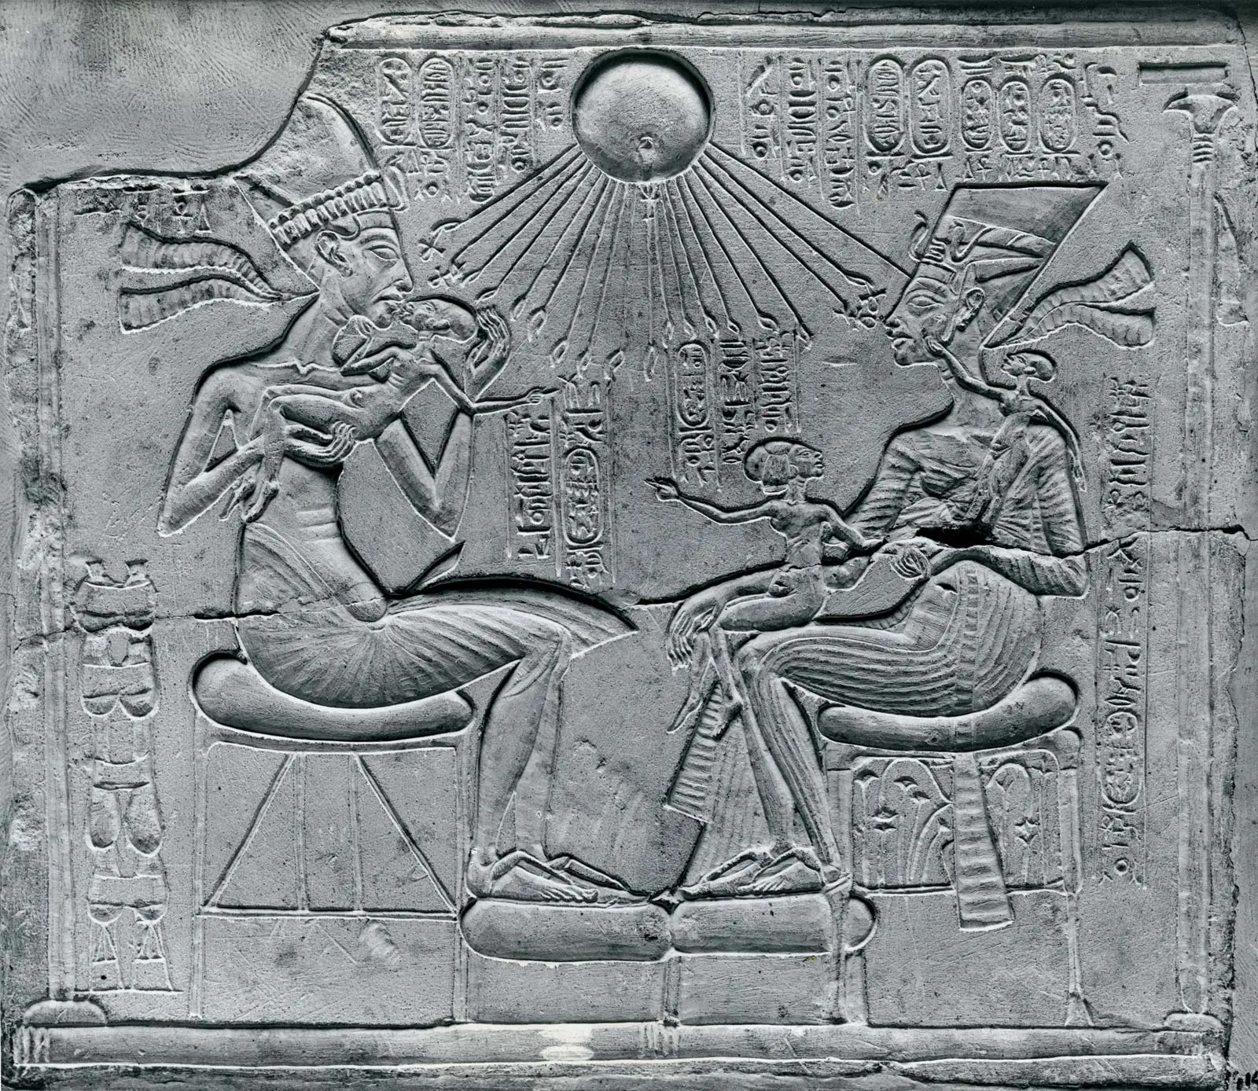
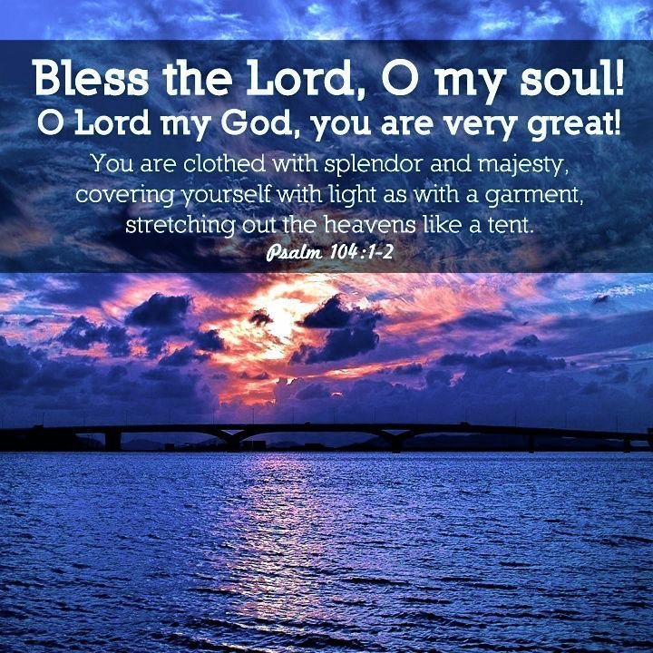
Hymn to Aton/Aten
Men had slept like the dead; now they lift their arms in praise, birds fly, fish leap, plants bloom, and work begins. Aton creates the son in the mother’s womb, the seed in men, and has generated all life. He has distinguished the races, their natures, tongues, and skins, and fulfills the needs of all. Aton made the Nile in Egypt and rain, like a heavenly Nile, in foreign countries. He has a million forms according to the time of day and from where he is seen; yet he is always the same.
Akhenaton devoted himself to the worship of the Aton, erasing all images of Amon and all writings of his name and sometimes even writings containing the word gods. But the new religion was rejected by the Egyptian elite after Akhenaton’s death, and the general populace had probably never adopted it in the first place. After Akhenaton’s death, the old gods were reestablished and the new city abandoned.

Slide 29
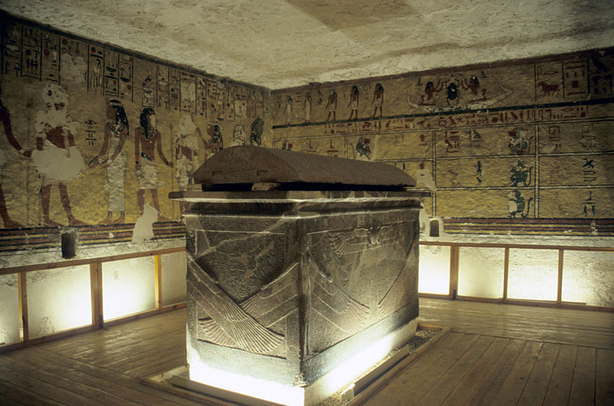
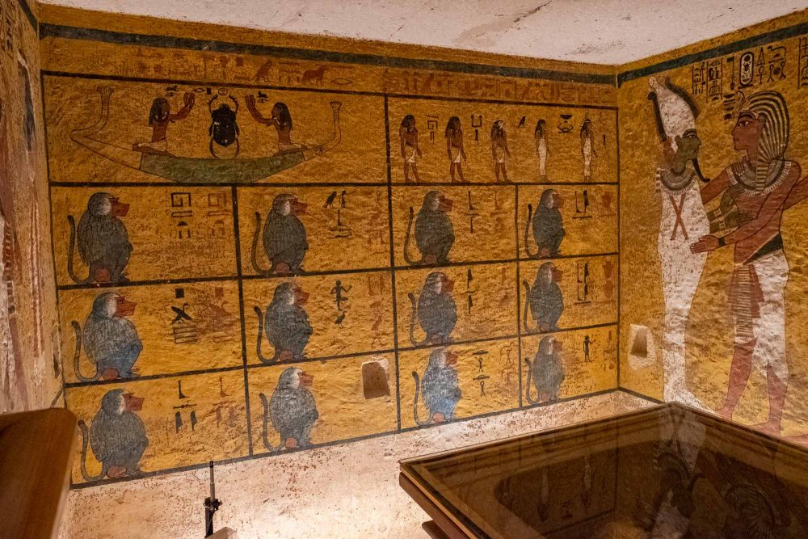
Western Valley on the Monkeys

Slide 30
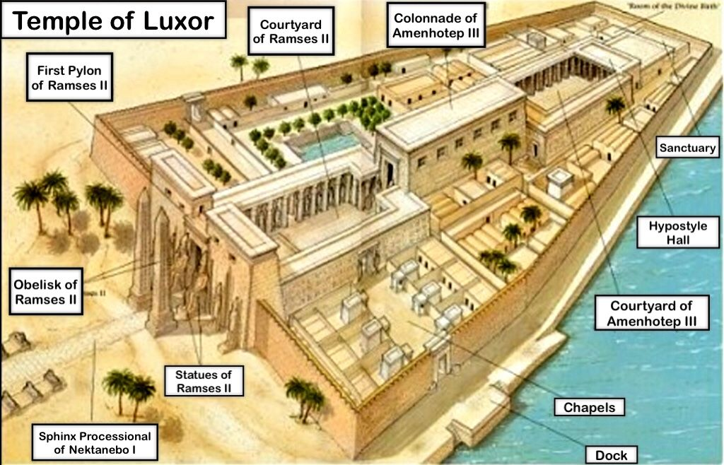
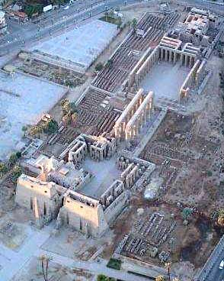
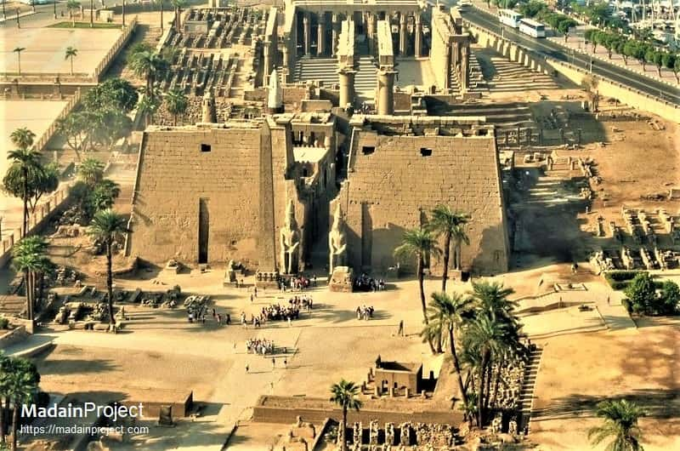
The opposite of Tomb raiding is Tomb offering

Slide 31
The longest river in the world never changes because of Sheol.

Slide 32
KA BA RA
Notes:
A ka statue is a type of ancient Egyptian statue intended to provide a resting place for the ka (life-force or spirit) of the person after death. The ancient Egyptians believed the ka, along with the physical body, the name, the ba (personality or soul), and the šwt (shadow), made up the five aspects of a person.
Ka is the life force or spiritual double of the person. The royal Ka symbolized a pharaoh's right to rule, a universal force that passed from one pharaoh to the next.

