Slide 1
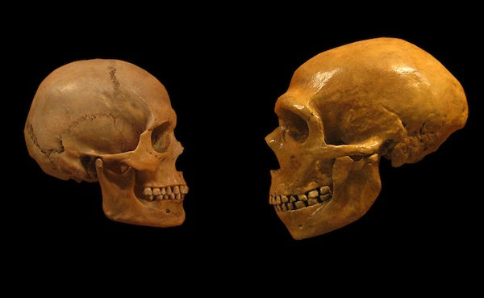
JAMES
TRUE
LIVE

Slide 2
Things that are allowed to be Giant:
Birds
Bats
Mice
Cats
Lizards
Marsupials
Elephants
Crocodiles
Fish
Sharks
Insects
Plants
Trees
Things that are NOT allowed to be Giant:
Man
Notes:
When Captain John Smith first met the Iroquoian-speaking Susquehannock Indians on his 1608 voyage up the Chesapeake Bay, he described them as giants. Smith claimed one warrior’s calf measured 27 inches in circumference.

Slide 3
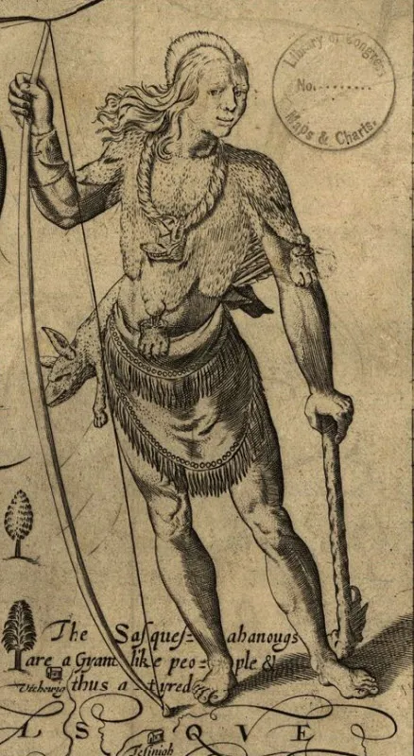
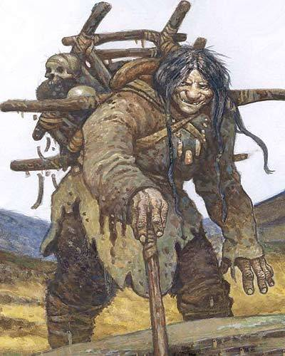
Native American Giants
Akaguagankak (Yup'ik Indian giant)
Asin (Alsea Indian giant)
Basket Ogress (Northwest Coast Indian giantess)
Big Owl Man (Apache Indian giant)
Caddaja (Caddo Indian giant)
Cenu (Micmac Indian giant)
Cheveyo Kachina (Hopi Indian ogre)
Gray Giant (Navajo Indian giant)
Ice Giants (Algonquian Indian giants)
Kee-Wakw (Wabanaki Indian giant)
Kolowa (Creek Indian ogre)
Kuku (Wabanaki Indian giant)
Kukwes (Micmac Indian ogre)
Lofa (Chickasaw Indian ogre)
Maushop (Wampanoag Indian giant)
Mhwee (Lenape Indian giant)
Shampe (Choctaw Indian monster)
Stoneclad (Cherokee Indian giant)
Stonecoat (Iroquois Indian giant)
Wetucks (Narragansett Indian giant)
Windego (Anishinabe Indian giant)
Winpe (Mi'kmaq Indian giant)
Witiko (Cree Indian giant)
Notes:
When Captain John Smith first met the Iroquoian-speaking Susquehannock Indians on his 1608 voyage up the Chesapeake Bay, he described them as giants. Smith claimed one warrior’s calf measured 27 inches in circumference.

Slide 4
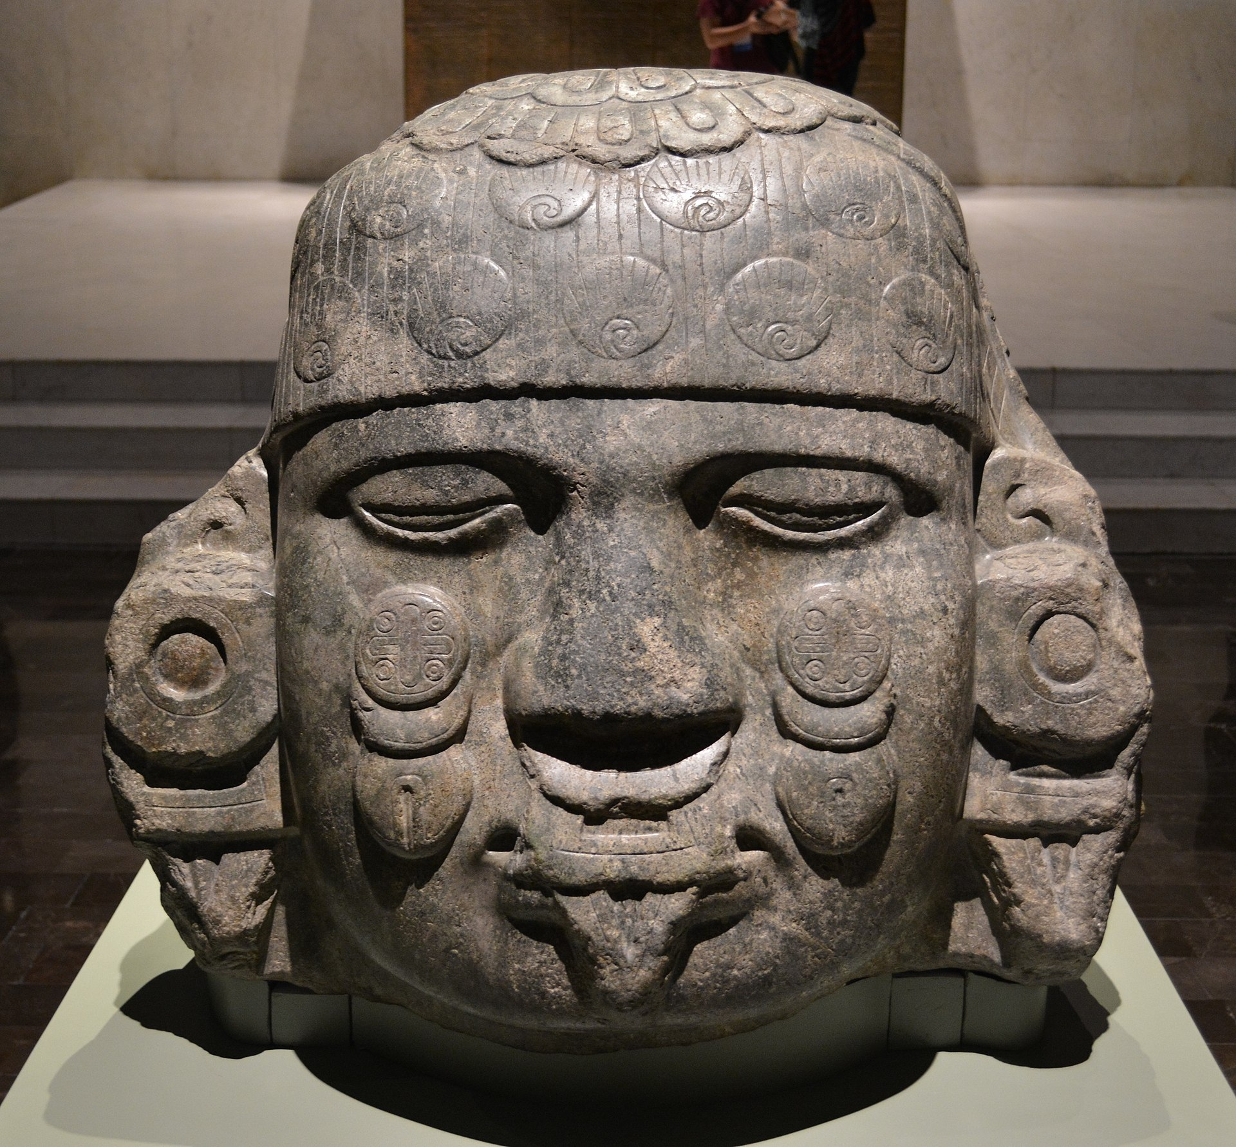
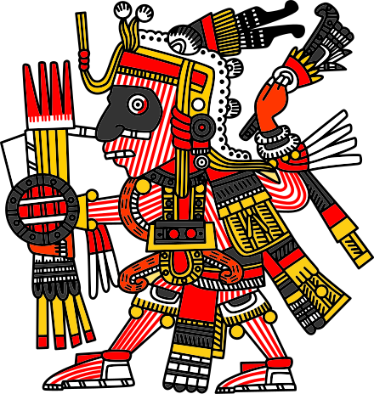
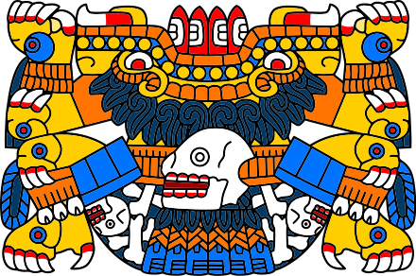
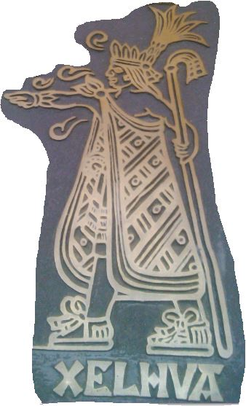
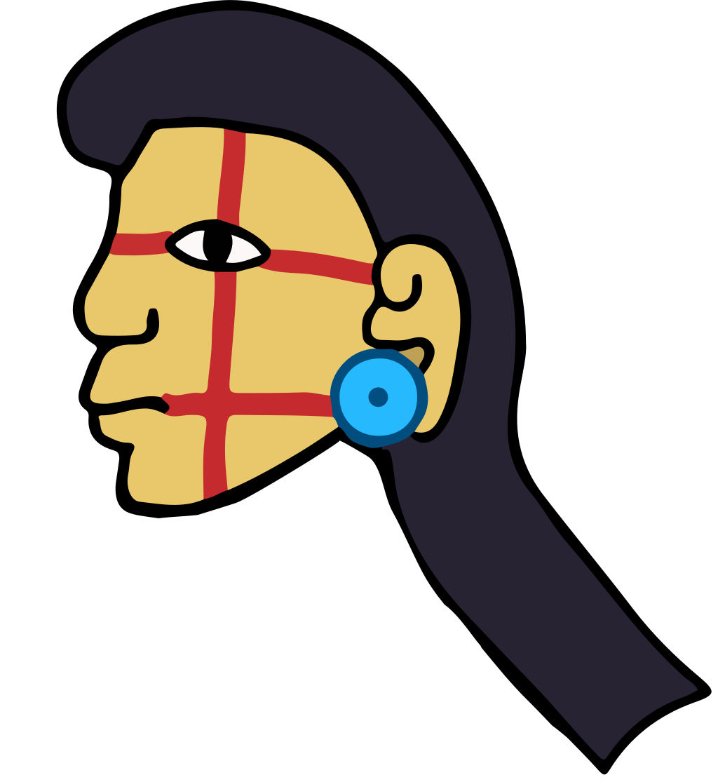
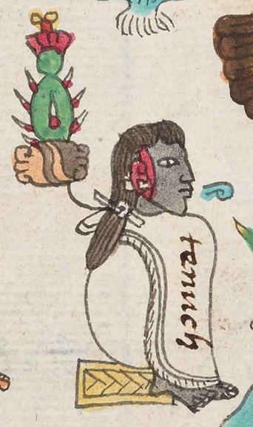
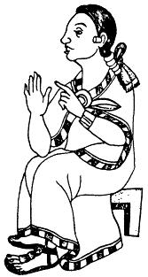
Quinametzin Aztec Giants
The six giants sons of Mixcoatl and Tlaltecuhtli that populated the Earth after the Great Flood during the Fifth Sun in Aztec Mythology:
Xelhua
Otomitl
Tenoch
Ulmecatl
Xicalancatl
Mixtecatl
Iztac-Mixcoatl
Tlaltecuhtli
Xelhua
Architect
Otomitl
Mountains
Tenoch
Chief
Ulmecatl
RubberisBorn
Xicalancatl
Teacup Serpent
Mixtecatl
Inhabitant of the land of clouds'
Notes:
In the Codex Zumarraga explains that for the indigenous people, the giants were created by the gods and perished in the catastrophe of Atonatiuh, a supposed great flood in the mountainous area of Tlaxcala.
In Aztec mythology, the Quinametzin populated the world during the previous era of the Sun of Rain (Nahui-Quiahuitl). They were punished by the gods because they did not venerate them, and their peak-civilization came to an end as a result of great calamities and as a punishment from the heavens for grave sins they had committed. The construction of the pyramid of Cholula and the City of Teotihuacan (The Place Where Men Become Gods) was attributed to the Quinametzin Giants.
With Ilancueye: the giants Xelhua, Tenoch, Ulmecatl, Xicalancatl, Mixtecatl, Otomitl

Slide 5
Aztec Nephilim
In Aztec mythology, the Quinametzin populated the world during the previous era of the Sun of Rain. They were punished by the gods because they did not venerate them, and their peak-civilization came to an end as a result of great calamities and as a punishment from the heavens for grave sins they had committed.
Notes:
In Aztec mythology, the Quinametzin populated the world during the previous era of the Sun of Rain (Nahui-Quiahuitl). They were punished by the gods because they did not venerate them, and their peak-civilization came to an end as a result of great calamities and as a punishment from the heavens for grave sins they had committed. The construction of the pyramid of Cholula and the City of Teotihuacan (The Place Where Men Become Gods) was attributed to the Quinametzin Giants.

Slide 6
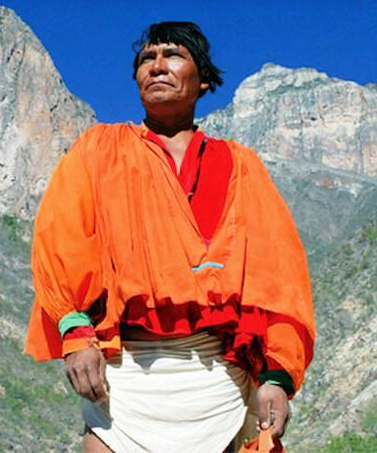
Tarahumara
On the heights once lived giants. They were as big as pine-trees and had heads as big as boulders. They taught the Tarahumaras how to plant corn, by cutting down trees and burning them, but they ate children.
From Wasivori (near Cusarare) came giants to Nararachic to ask alms. Tesvino [a kind of beer made from corn] they liked very much. They worked very fast, and the Tarahumaras put them to hoe and weed the corn, and gave them food and tesvino. But the giants were fierce, and ravished the women while the latter were under the influence of the Moon; therefore the Tarahumaras got very angry and they mixed a decoction made from the chilicote-tree with the corn that they gave the giants to eat, and the giants died.
Notes:
A giant stone Chichimeca head overlooking the the valley in between Aguascalientes and Calvillo

Slide 7
Chichimecas and Quiname were the giants before the Aztecs/Mexicas arrived from Aztlan
Notes:
A giant stone Chichimeca head overlooking the the valley in between Aguascalientes and Calvillo
as
Puebla, Cholula, Cocopa, and Seri

Slide 8
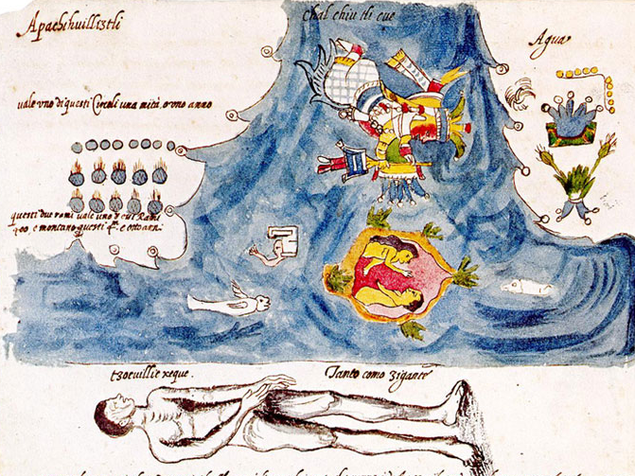
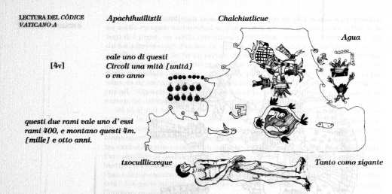
Nahua Flood Story with Giants, the Tower of Babel, and an Ark all in one Codex.
Codex Vaticanus 3738, fol. 4v
Notes:
The text says he was told that only a couple could escape from the deluge. It moreover states that other Nahua believed that some others survived, amongst whom there was one who built a tower to prevent a future flood, a tower that was later destroyed when it had reached a great height.

Slide 9
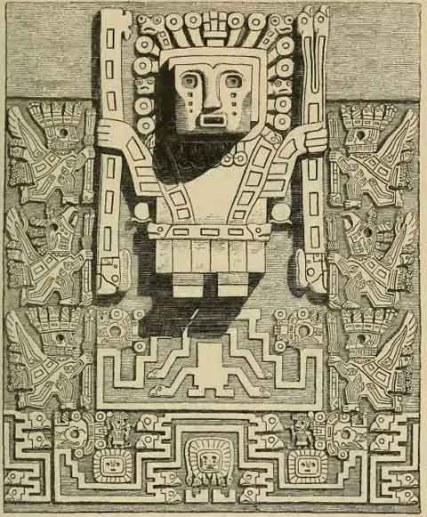
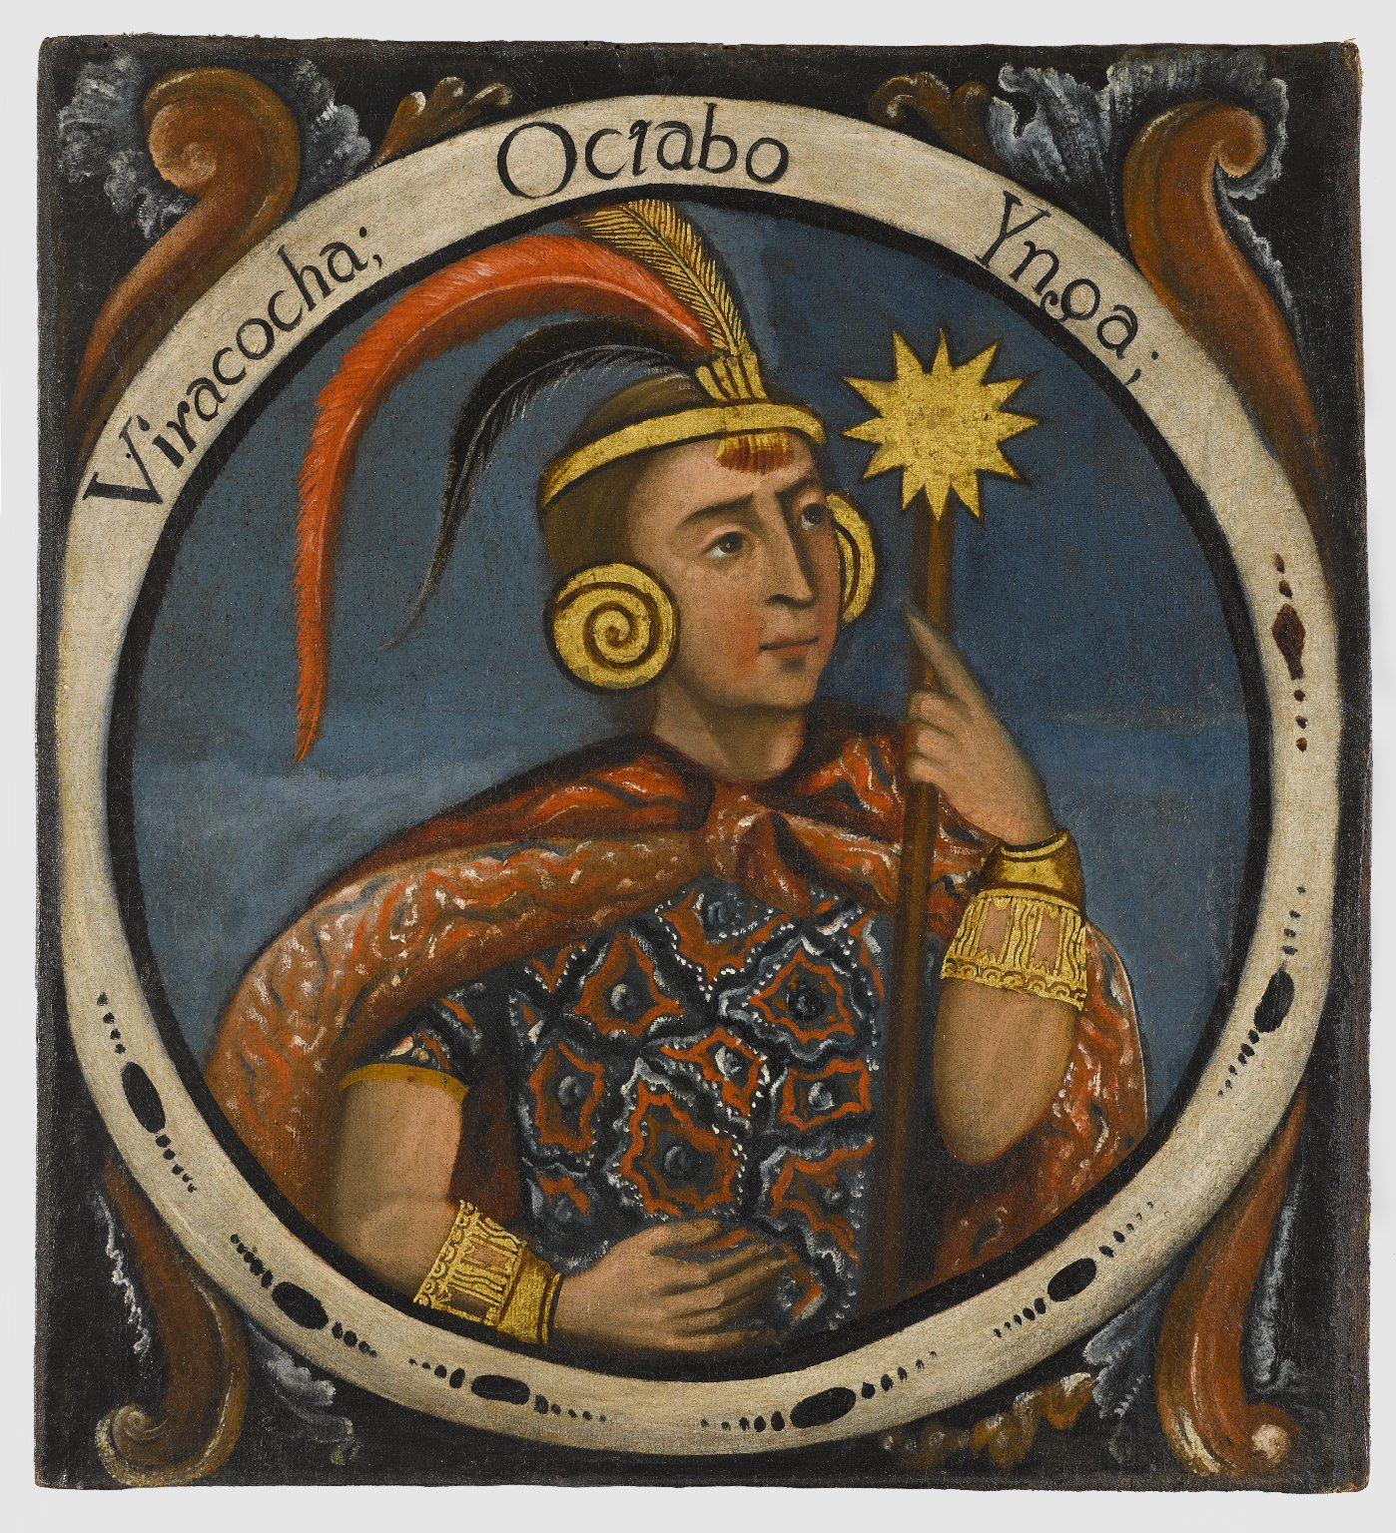
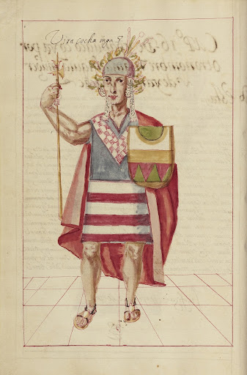
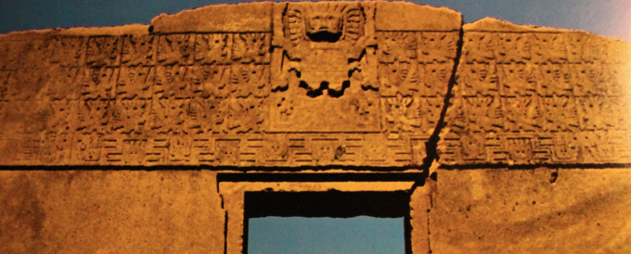
Viracocha
rose from Lake Titicaca during the time of darkness to bring forth light. He made the sun, moon, and the stars. He made mankind by breathing into stones, but his first creation were brainless giants that displeased him. So, he destroyed them with a flood and made humans, beings who were better than the giants, from smaller stones. After creating them, they were scattered all over the world.
He had one son, Inti, and two daughters, Mama Killa and Pachamama, He destroyed the people around Lake Titicaca with a Great Flood called Unu Pachakuti, lasting 60 days and 60 nights, saving two to bring civilization to the rest of the world. These two beings are Manco Cápac, the son of Inti (sometimes taken as the son of Viracocha), which name means "splendid foundation", and Mama Uqllu, which means "mother fertility". After the Great Flood, Viracocha’s sons Imaymana and Tocapo gave names to all the trees, flowers, fruits, and herbs.
The word "Viracocha" literally means "Sea Foam."
Notes:
The text says he was told that only a couple could escape from the deluge. It moreover states that other Nahua believed that some others survived, amongst whom there was one who built a tower to prevent a future flood, a tower that was later destroyed when it had reached a great height.

Slide 10
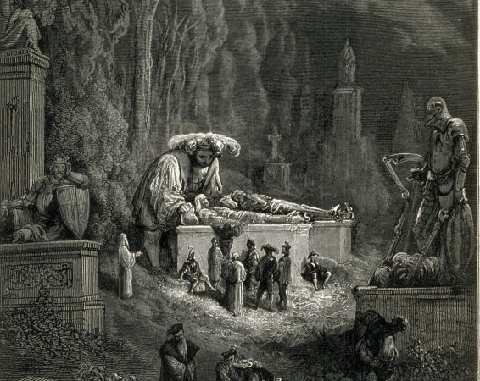
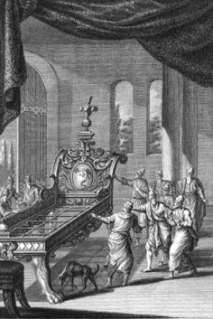
Gianticide for Zion
King Og of Bashan was the last survivor of the giant Rephaites
His bed was decorated with iron and was more than nine cubits long and four cubits wide. It is still in Rabbah of the Ammonites.) - Deuteronomy 3:11
Nephilim, Emim, Rephaim, Giborim, Zamzumim, Anakim and Avim

Slide 11
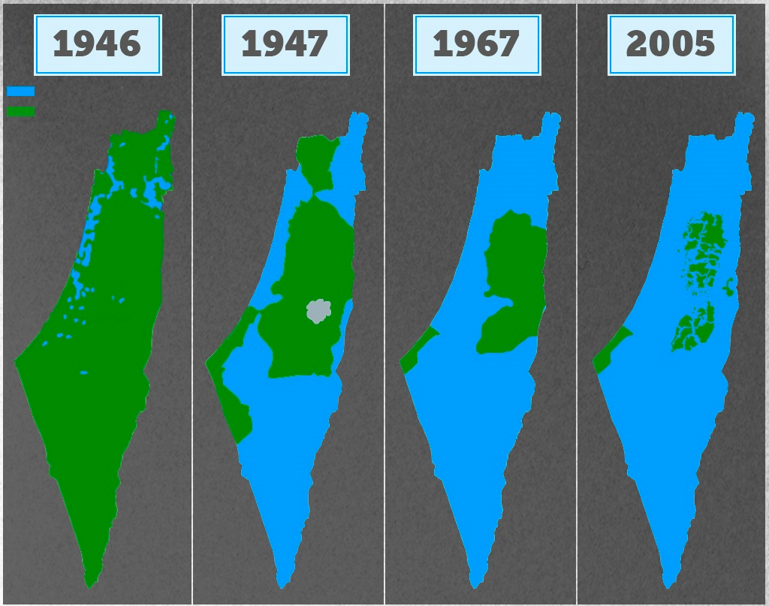
The War on Giants is the War on Terrorists
Herem is a type of dedicatory vow, it is irrevocable and unredeemable (Leviticus. 27:28a), but herem can also mean total destruction, usually in the context. of war or the annihilation of idolaters.
Herem is the highest ecclesiastical censure in the Jewish community. It is the total exclusion of a person from the Jewish community. It is a form of shunning and is similar to vitandus "excommunication" in the Catholic Church.
Then Israel made this vow to the Lord: “If you will deliver these people into our hands, we will totally destroy their cities.”
The Hebrew term refers to the irrevocable giving over of things or persons to the Lord, often by totally destroying them
The herem is therefore meant to ensure that the people will not be lured into worshipping the Canaanite gods.
Land of YHWH
Land of Giants

Slide 12
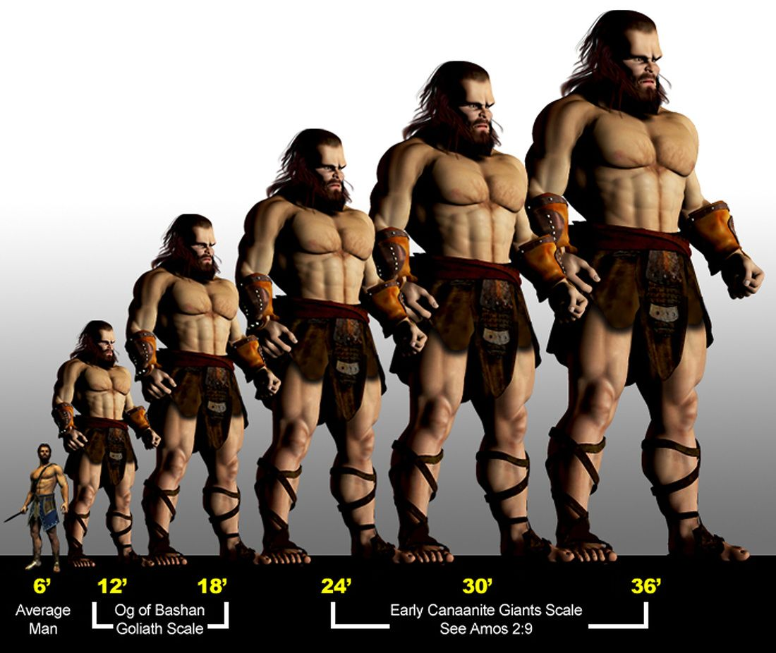
Proud Boys
ISIS
The size of the giant is directly proportional to the marketing of its threat
Al Qaida
Hezbollah
Al-Shabaab
Notes:
Goliath’s large stature also makes sense—he was likely a “son of Anak,” a clan of very large people known as Anakims. When Israel defeated them, “none of the Anakim were left in the land of the children of Israel; they remained only in Gaza, in Gath, and in Ashdod” (Joshua 11:22). Goliath’s height is given as six “cubits” and a “span.” A cubit generally refers to a length of about 18 inches, and a span is half a cubit. This places Goliath and presumably his relatives in the range of around nine to ten feet tall. Goliath was possibly a larger giant, since he was a champion warrior.
“Yet I destroyed the Amorites before them,
though they were tall as the cedars
and strong as the oaks.
I destroyed their fruit above
and their roots below.
Amos 2:9

Slide 13
Giants disguised as Neanderthals
In Greek and Roman mythology, the Giants, also called Gigantes were a race of great strength and aggression, though not necessarily of great size.
Notes:
In Greek and Roman mythology, the Giants, also called Gigantes (Greek: Γίγαντες, Gígantes, singular: Γίγας, Gígas), were a race of great strength and aggression, though not necessarily of great size. They were known for the Gigantomachy (or Gigantomachia), their battle with the Olympian gods.[2]

Slide 14
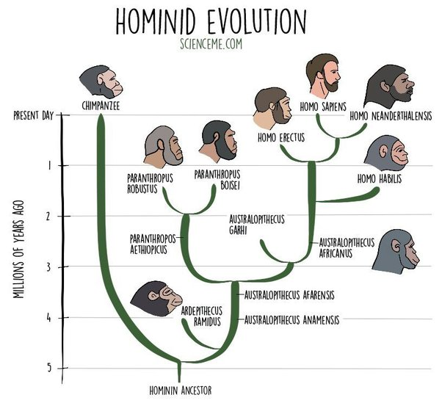
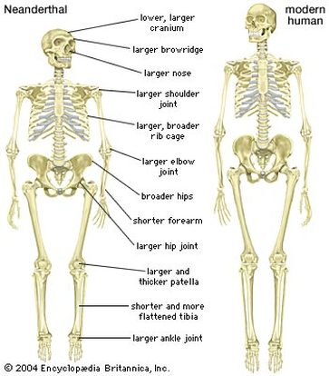

Slide 15
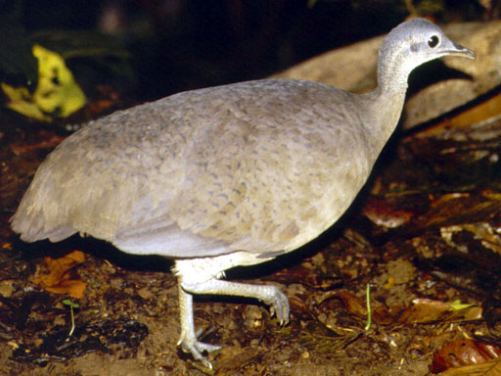
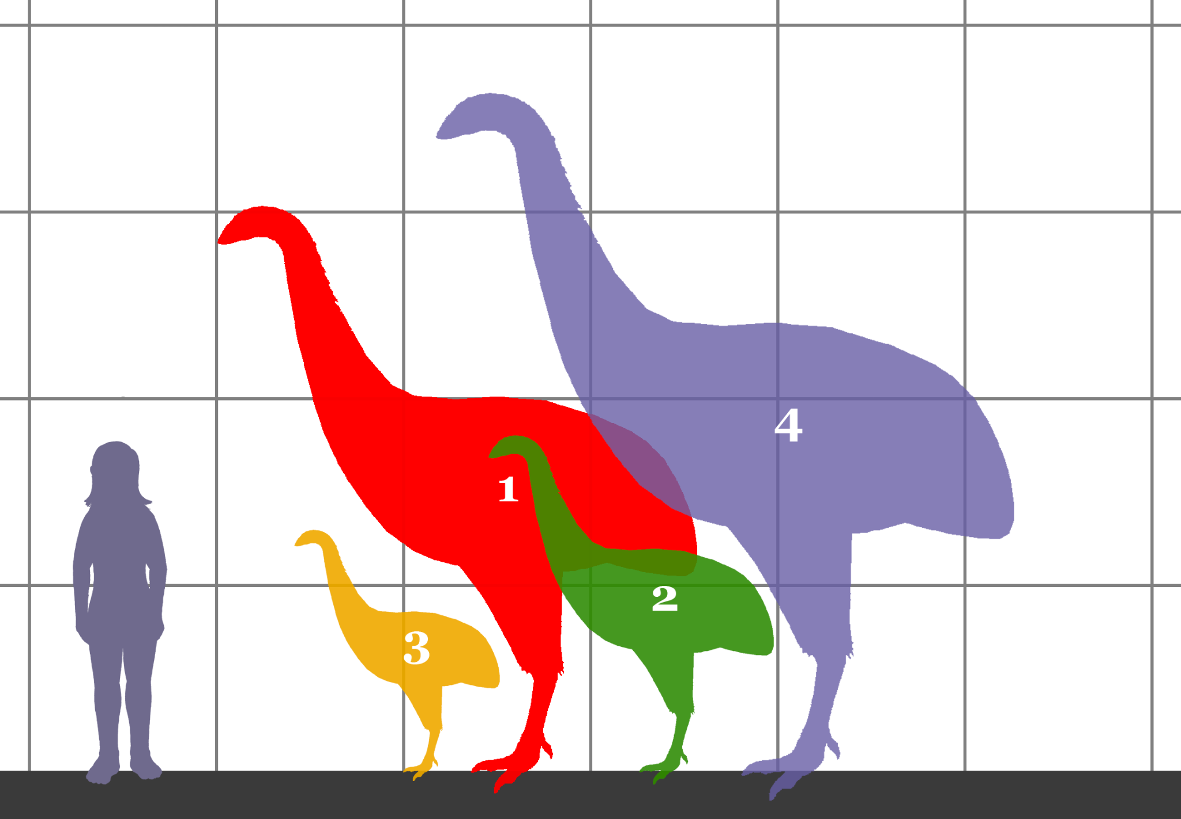

Slide 16
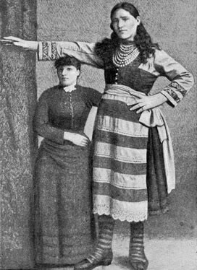
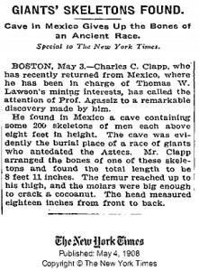
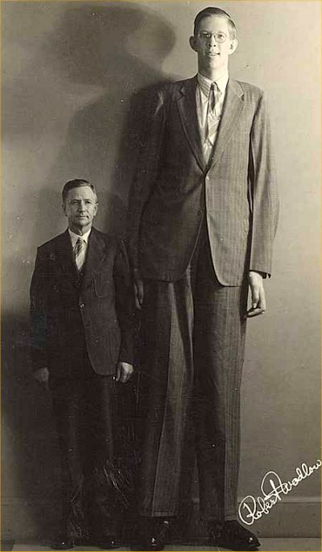

Slide 17
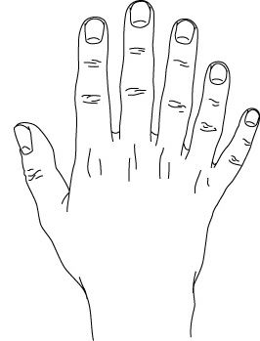
Polydactyly Gigantism
Notes:
15 Once again there was a battle between the Philistines and Israel. David went down with his men to fight against the Philistines, and he became exhausted. 16 And Ishbi-Benob, one of the descendants of Rapha, whose bronze spearhead weighed three hundred shekels[b] and who was armed with a new sword, said he would kill David. 17 But Abishai son of Zeruiah came to David’s rescue; he struck the Philistine down and killed him. Then David’s men swore to him, saying, “Never again will you go out with us to battle, so that the lamp of Israel will not be extinguished.”
18 In the course of time, there was another battle with the Philistines, at Gob. At that time Sibbekai the Hushathite killed Saph, one of the descendants of Rapha.
19 In another battle with the Philistines at Gob, Elhanan son of Jair[c] the Bethlehemite killed the brother of[d] Goliath the Gittite, who had a spear with a shaft like a weaver’s rod.
20 In still another battle, which took place at Gath, there was a huge man with six fingers on each hand and six toes on each foot—twenty-four in all. He also was descended from Rapha. 21 When he taunted Israel, Jonathan son of Shimeah, David’s brother, killed him.
22 These four were descendants of Rapha in Gath, and they fell at the hands of David and his men.

Slide 18
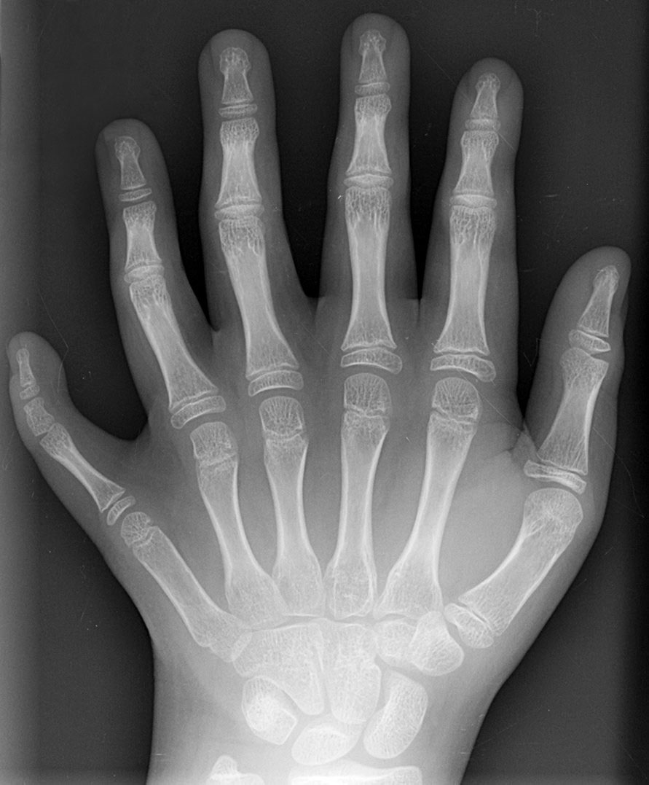
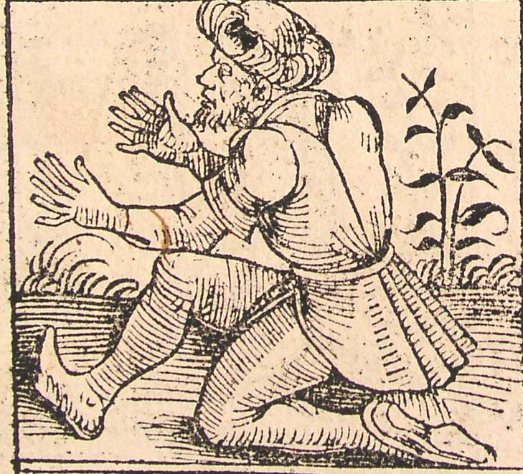
1493
Postaxial polydactyly
Notes:
15 Once again there was a battle between the Philistines and Israel. David went down with his men to fight against the Philistines, and he became exhausted. 16 And Ishbi-Benob, one of the descendants of Rapha, whose bronze spearhead weighed three hundred shekels[b] and who was armed with a new sword, said he would kill David. 17 But Abishai son of Zeruiah came to David’s rescue; he struck the Philistine down and killed him. Then David’s men swore to him, saying, “Never again will you go out with us to battle, so that the lamp of Israel will not be extinguished.”
18 In the course of time, there was another battle with the Philistines, at Gob. At that time Sibbekai the Hushathite killed Saph, one of the descendants of Rapha.
19 In another battle with the Philistines at Gob, Elhanan son of Jair[c] the Bethlehemite killed the brother of[d] Goliath the Gittite, who had a spear with a shaft like a weaver’s rod.
20 In still another battle, which took place at Gath, there was a huge man with six fingers on each hand and six toes on each foot—twenty-four in all. He also was descended from Rapha. 21 When he taunted Israel, Jonathan son of Shimeah, David’s brother, killed him.
22 These four were descendants of Rapha in Gath, and they fell at the hands of David and his men.

Slide 19
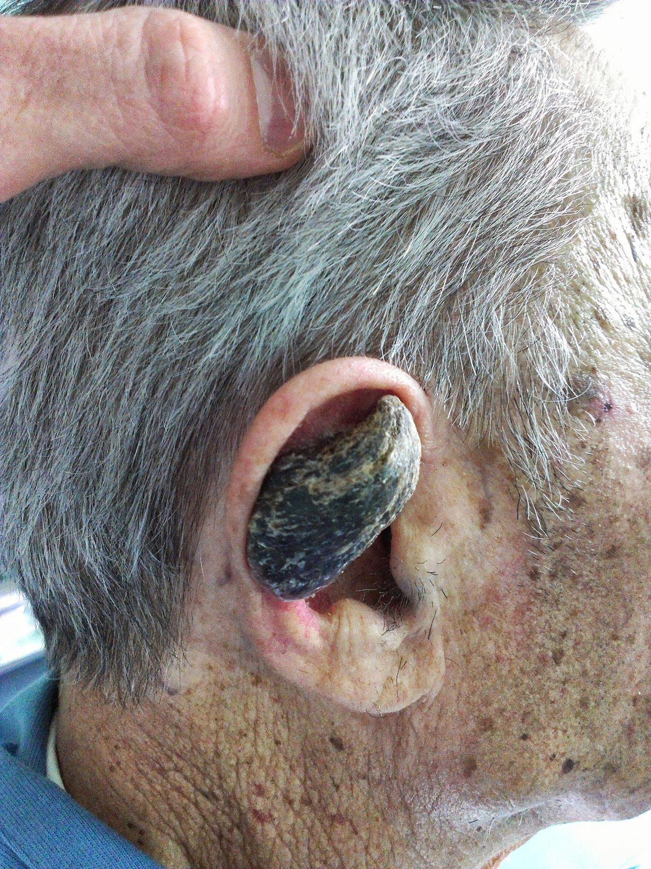
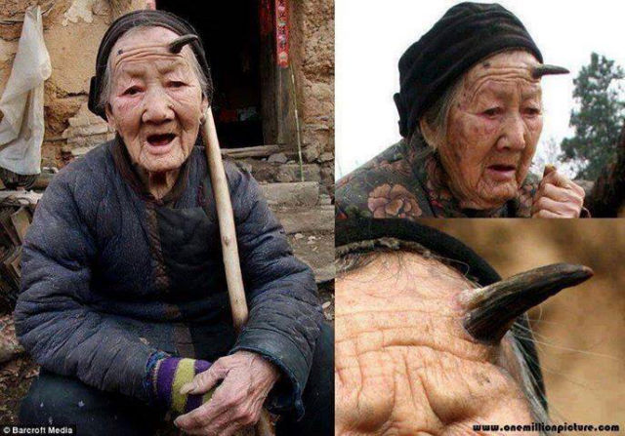
Cornu Cutaneum

Slide 20
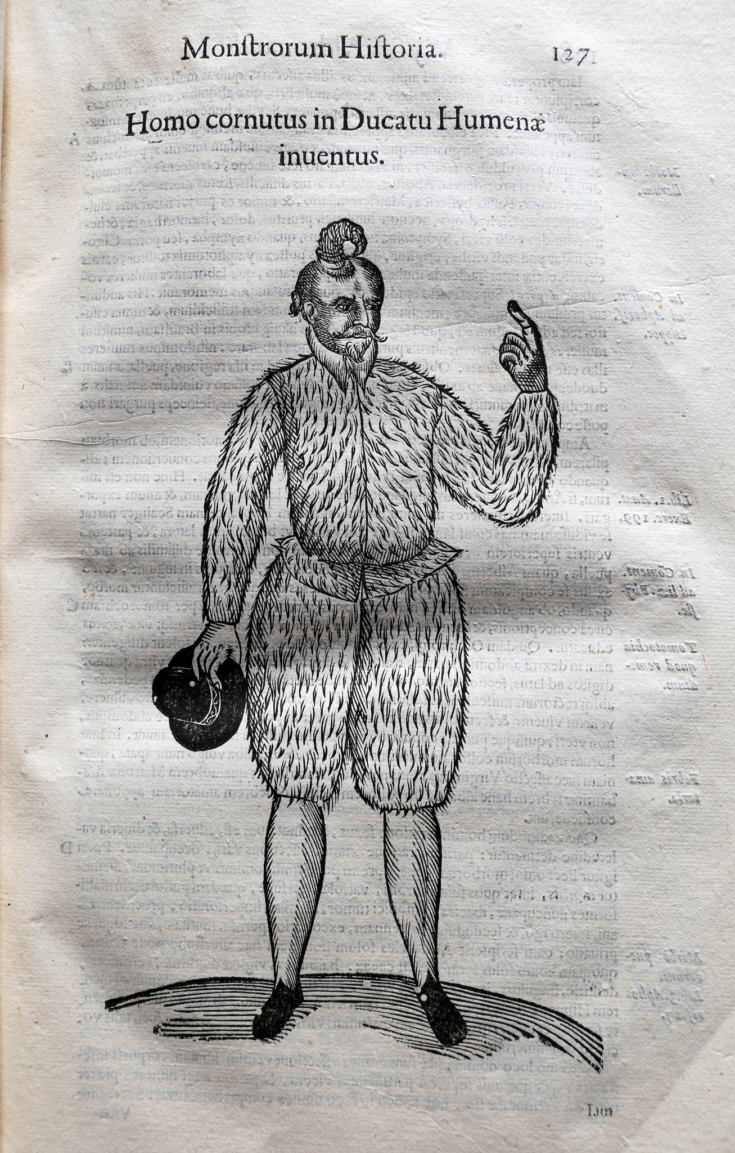
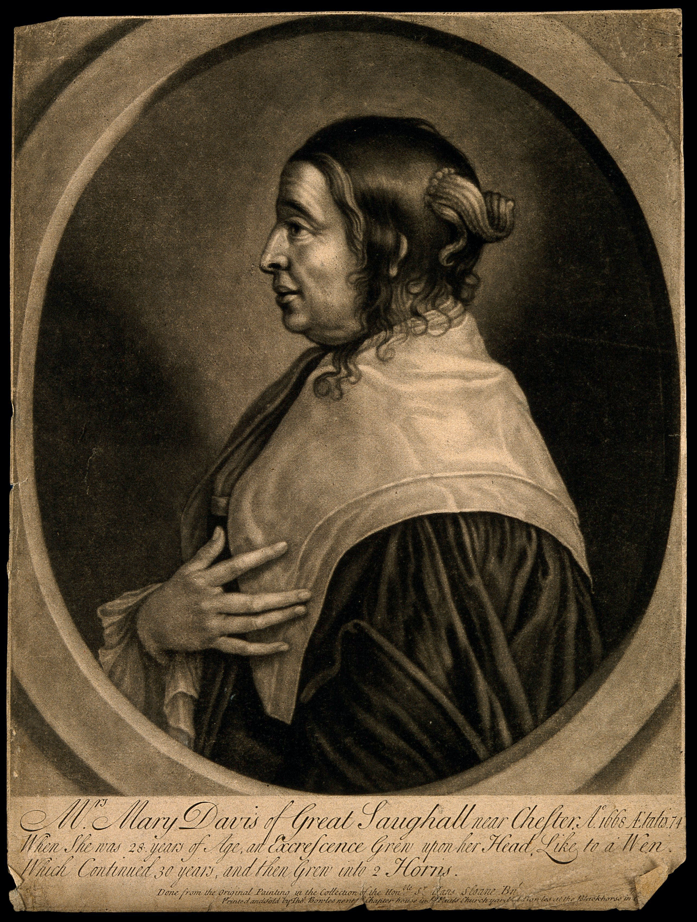
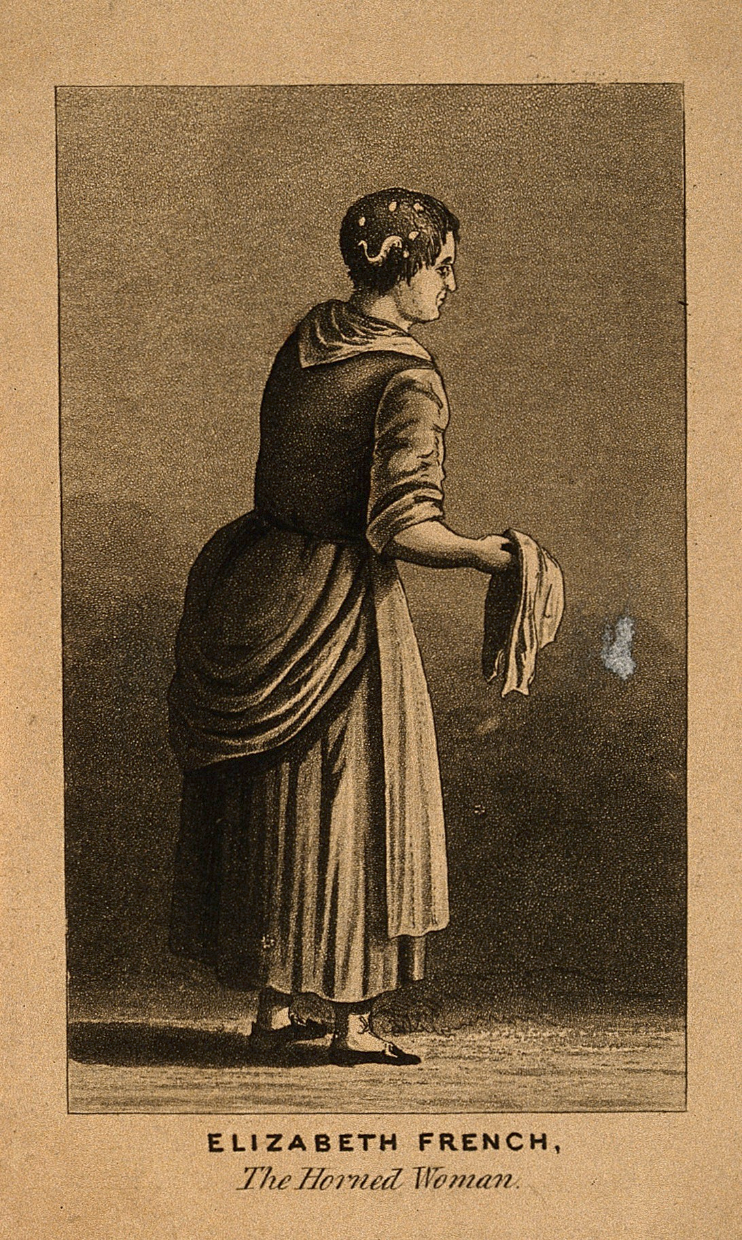

Slide 21
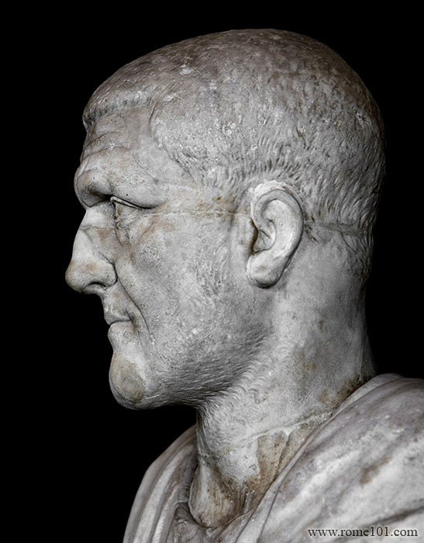
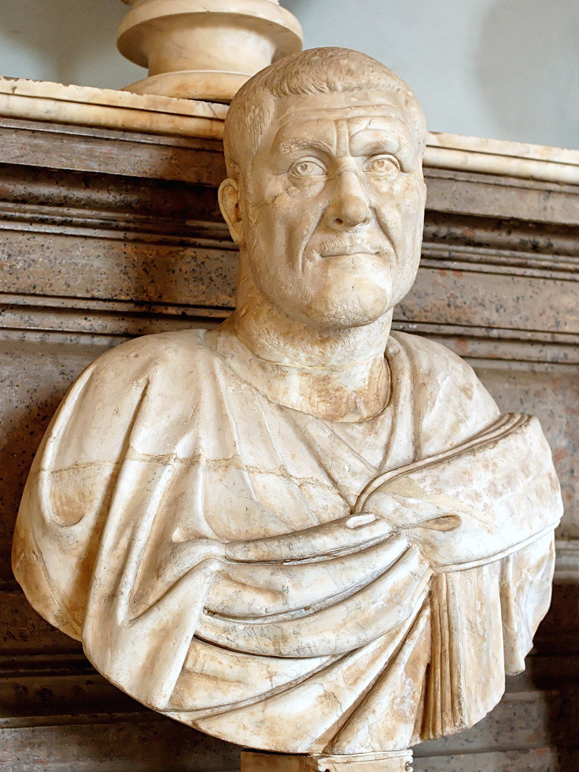
Maximinus Thrax
"He was in any case a man of such frightening appearance and colossal size that there is no obvious comparison to be drawn with any of the best-trained Greek athletes or warrior elite of the barbarians." - Herodian
His thumb was said to be so large that he wore his wife's bracelet as a ring for it.
Ancient Roman writers claimed that Maximinus Thrax stood over 8 feet tall.

Slide 22
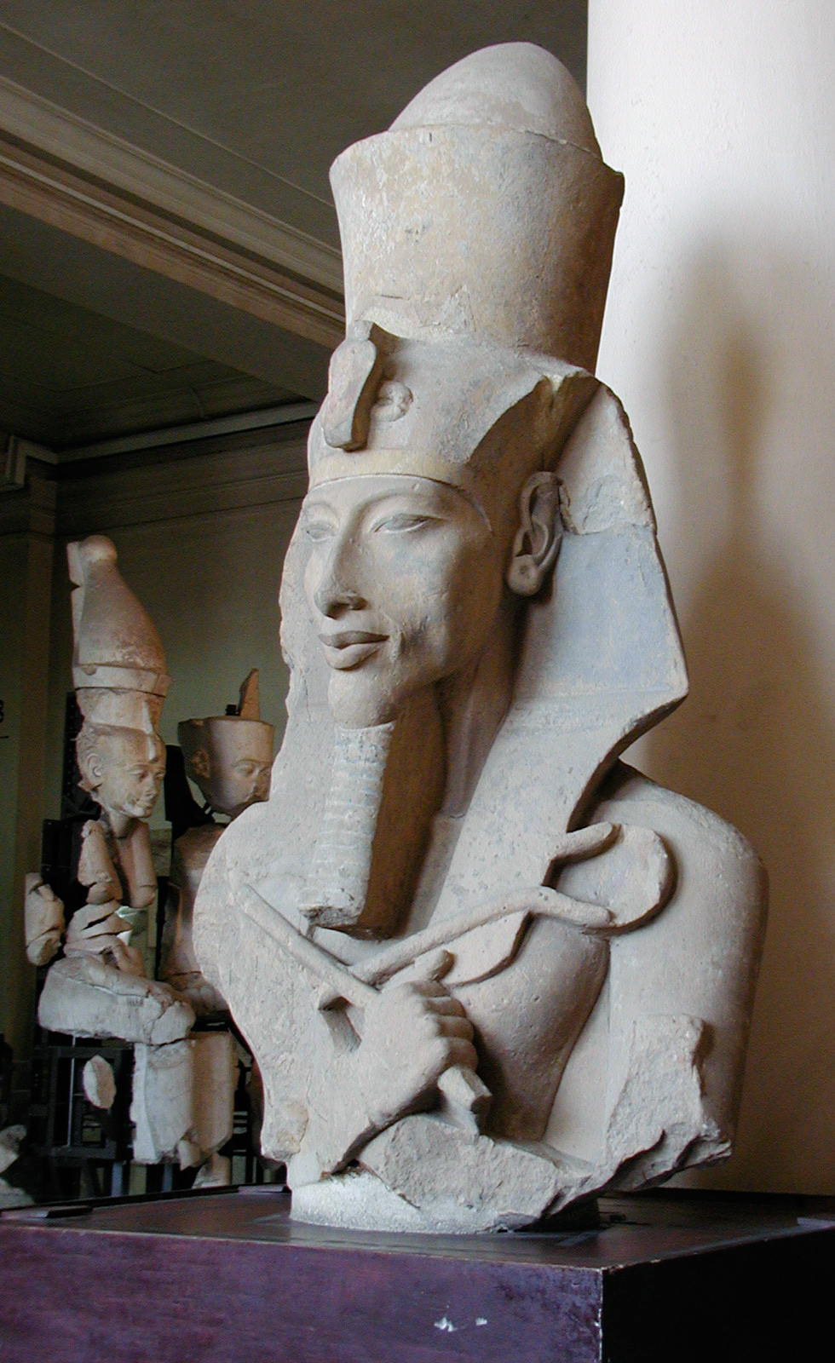
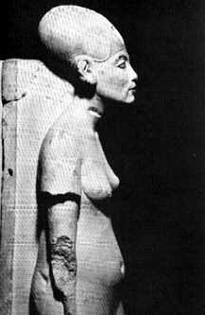
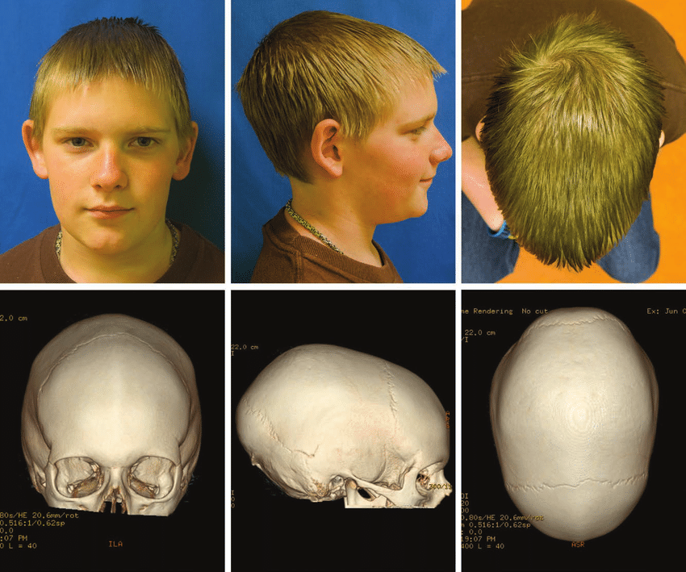
Scaphocephaly
Sagittal Craniosynostosis

Slide 23
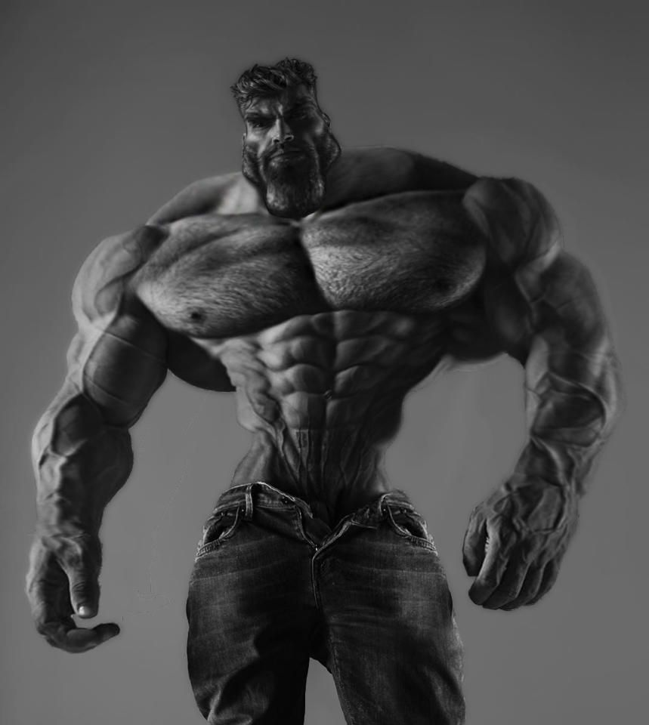
The Nephilim were GigaChads.
They held no shame.

Slide 24
IN BEGINNING…
Adam and his wife were both naked, and they felt no shame. - Genesis 2:25
When the woman saw that the fruit of the tree was good for food and pleasing to the eye, and also desirable for gaining wisdom, she took some and ate it. She also gave some to her husband, who was with her, and he ate it. Then the eyes of both of them were opened, and they realized they were naked; so they sewed fig leaves together and made coverings for themselves. - Genesis 3:6
Perhaps a salvation-promising religion enables resignation and works against God’s plan
What better purpose for God to install persecution than to make us seek perfection? Most of religion is built on salvation technology. But shame is a motor of improvement. Without it we would be the same as the ones who fell before.
Notes:
Genesis starts with “In beginnin

