Slide 1


Api • Tsur
Enlil • Nintud
El Elyon • IHOH
Elohim • Shaddai Tzevaot • Ehyeh Tetragrammaton Adonai • HaShem Kyrios • Dominus Jehovah • Yahweh
Allah • Huwa
Bahá • Shiva
Ptah • Nintud
Om • Ahura Mazda
Atum • Satnam
Api • Tsur
Enlil • Nintud
El Elyon • IHOH
Elohim • Shaddai Tzevaot • Ehyeh Tetragrammaton Adonai • HaShem Kyrios • Dominus Jehovah • Yahweh
Allah • Huwa
Bahá • Shiva
Ptah • Nintud
Om • Ahura Mazda
Atum • Satnam
JAMES
TRUE
LIVE

Slide 2
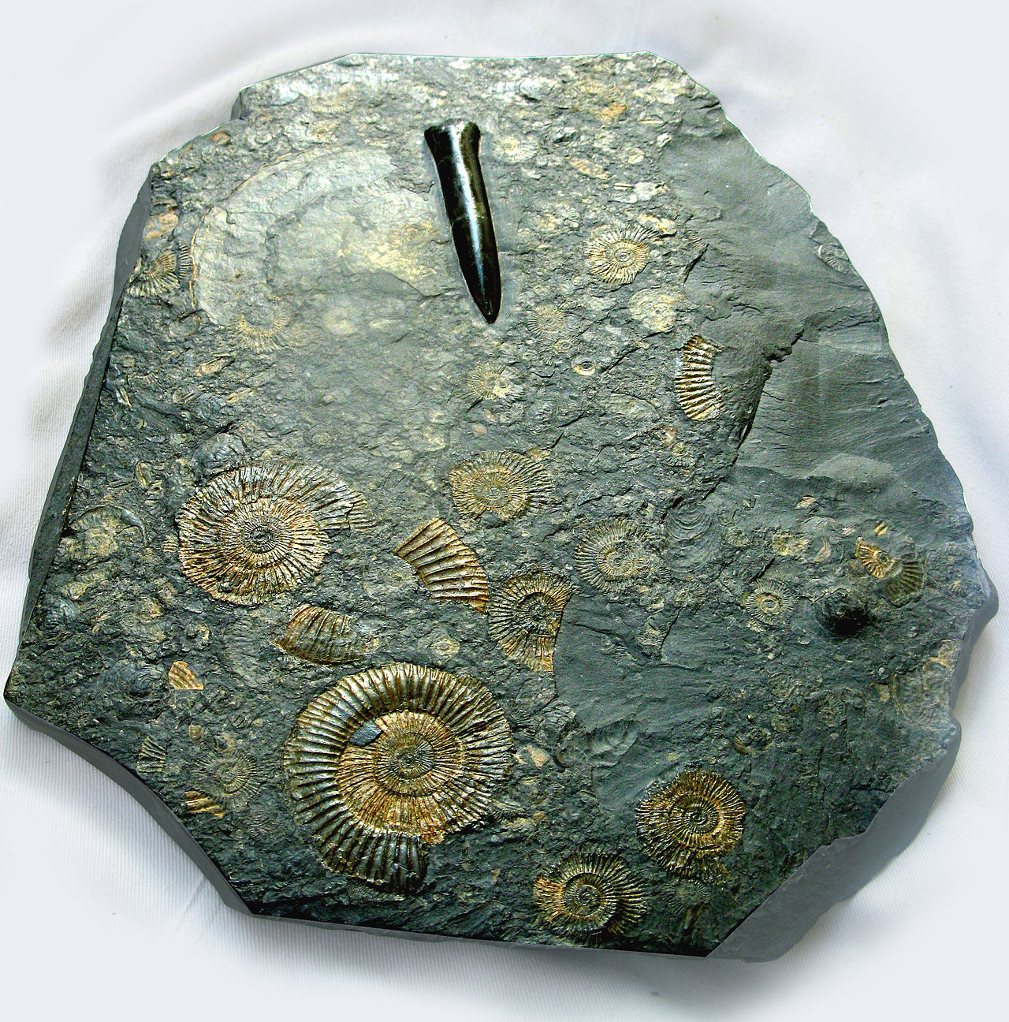
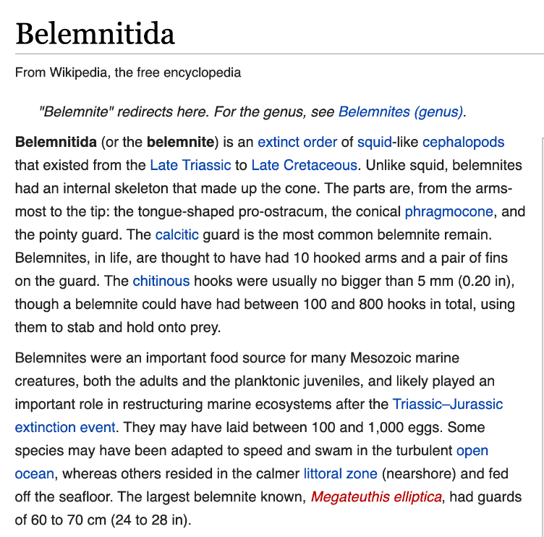

Slide 3
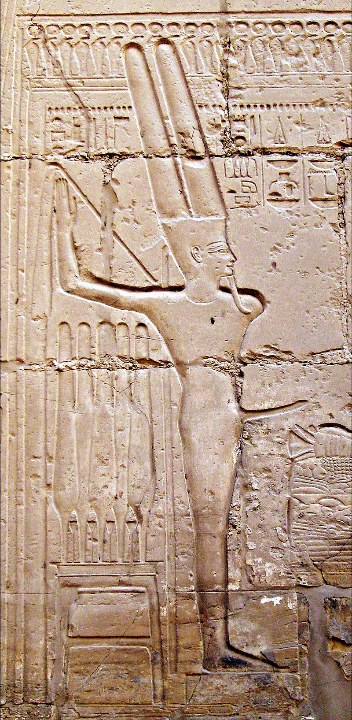
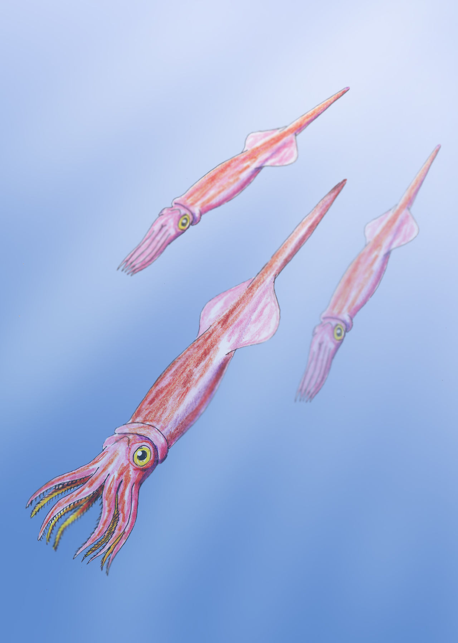
Egyptian God Min
Linked to Belemnite as late as 3100BC. People who worshipped Min were considered the first recorded heretics
Notes:
Belemnite shown on left of Min

Slide 4
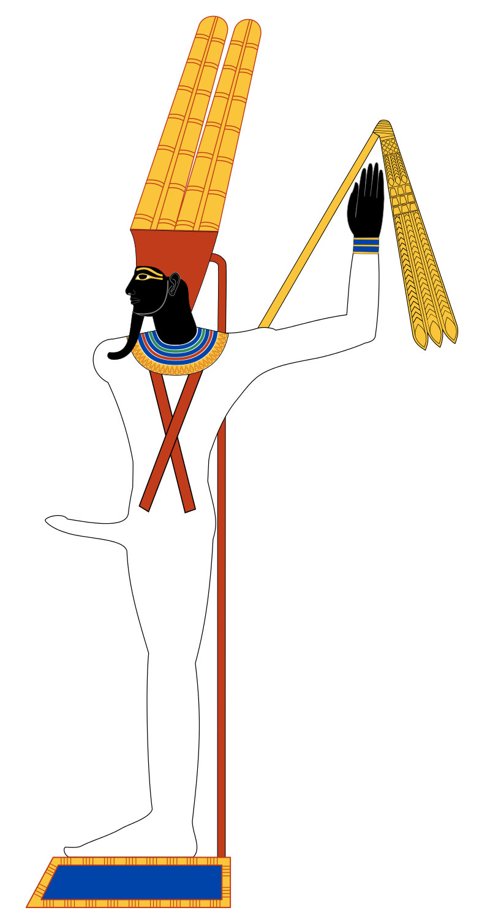
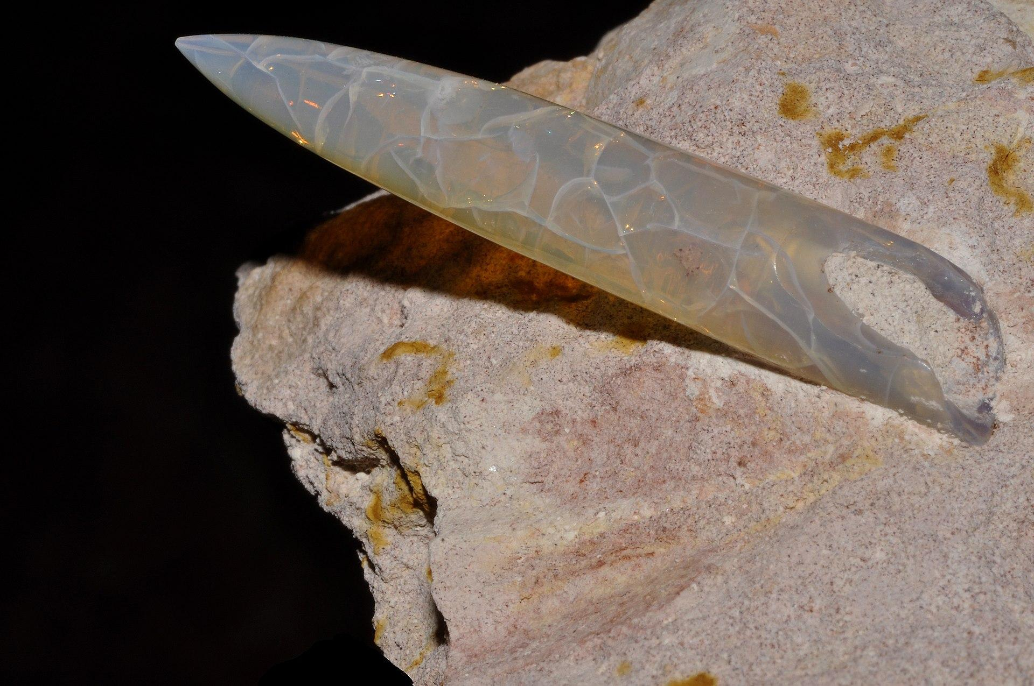
Opalized Belemnite Fossil

Slide 5
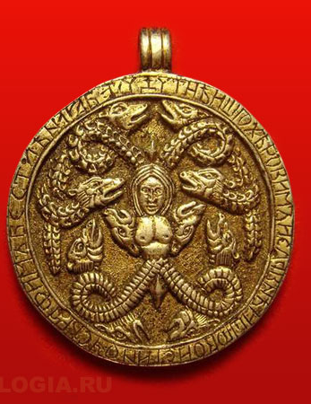
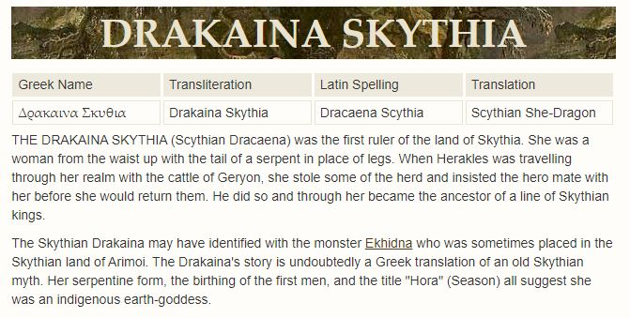
Anguipede
The Greco Roman Hebrew Yahweh appropriated his anguipede attributes from his predecessor, also a Goddess, the Kurgan Tabiti or Api, who predated him on coins and medallions by several centuries.
Notes:
The Greco Roman Hebrew Yahweh appropriated his anguipede attributes from his predecessor, also a Goddess, the Kurgan Tabiti or Api, who predated him on coins and medallions by several centuries.

Slide 6
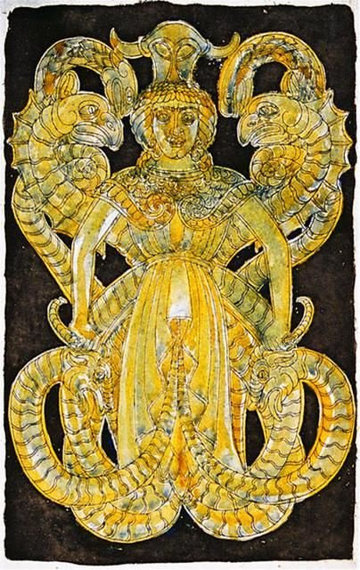
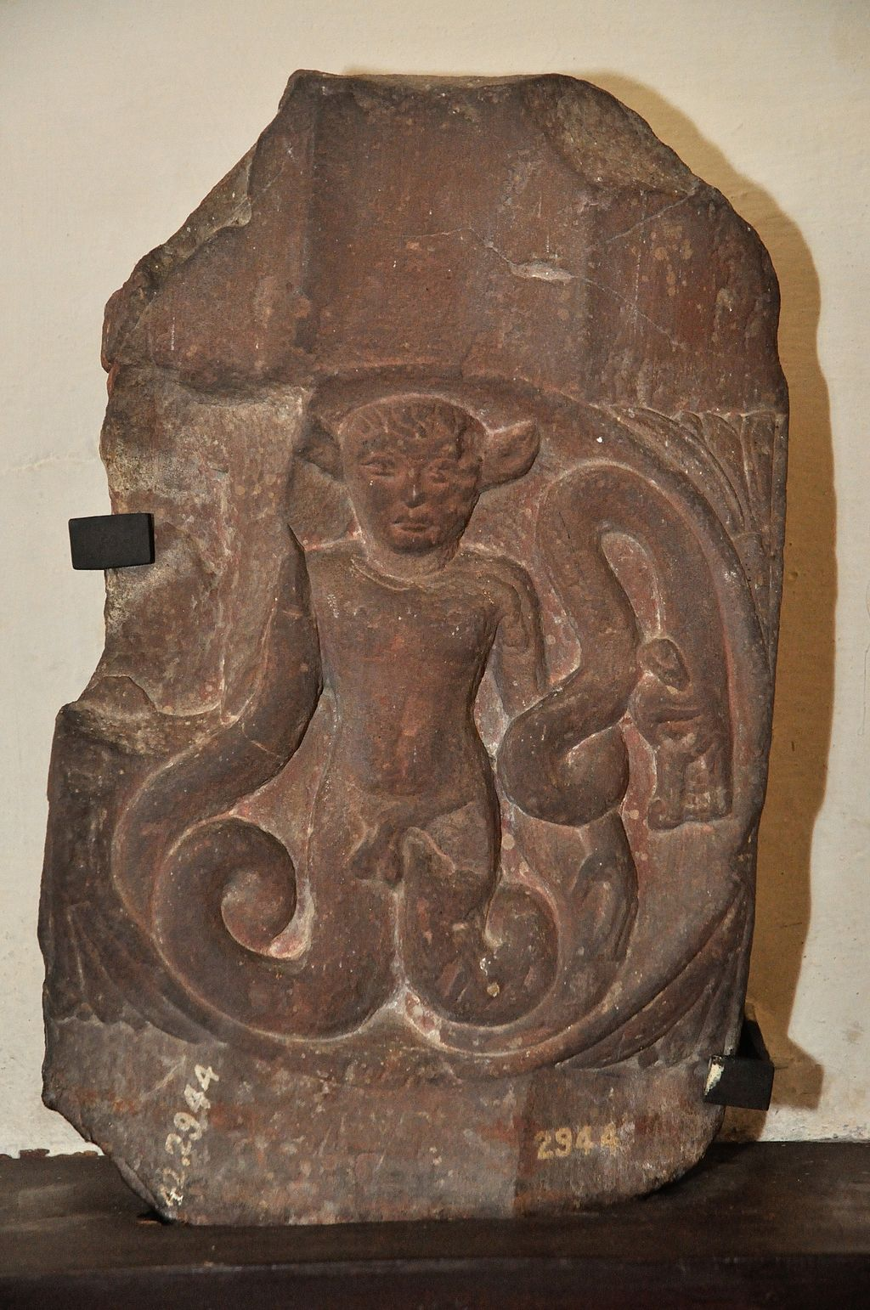
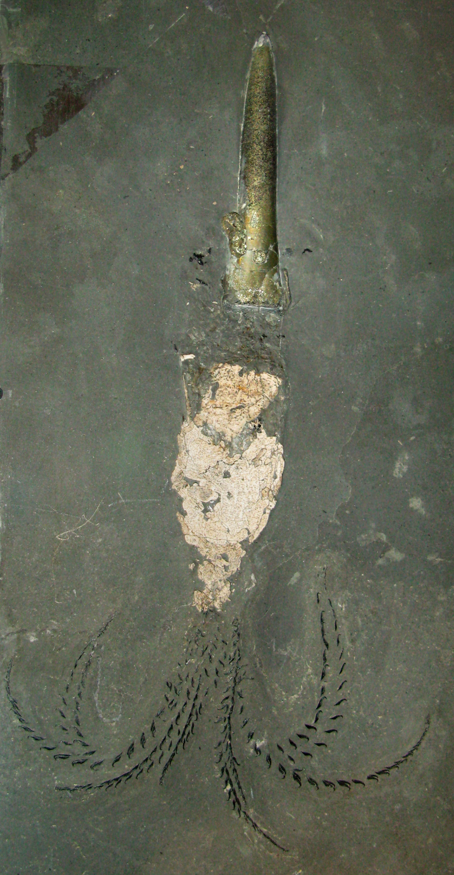
Notes:
The Greco Roman Hebrew Yahweh appropriated his anguipede attributes from his predecessor, also a Goddess, the Kurgan Tabiti or Api, who predated him on coins and medallions by several centuries.

Slide 7
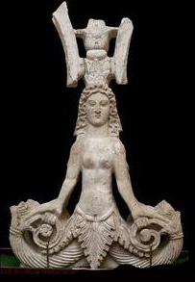
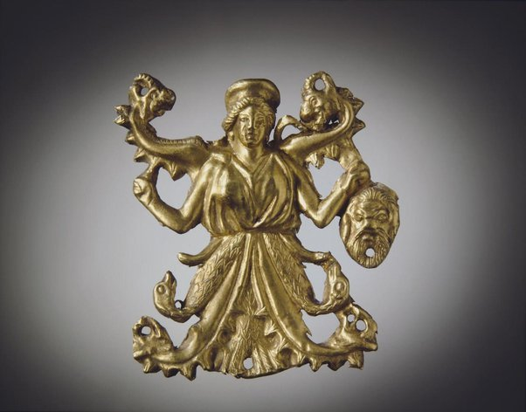
Notes:
Below are four 1st-century seal depictions of Yahweh/Jahovah from the Greco-Roman Levant in or around the purported time of Christ, showing ‘God’ with cock’s head and snake legs:
anguipede god

Slide 8
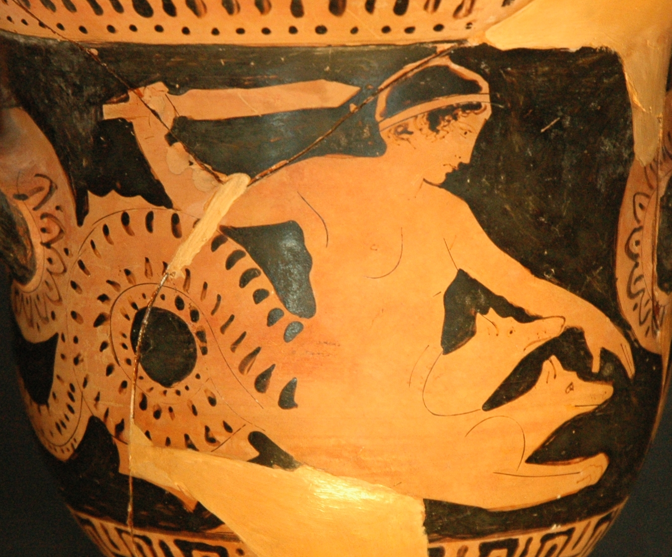
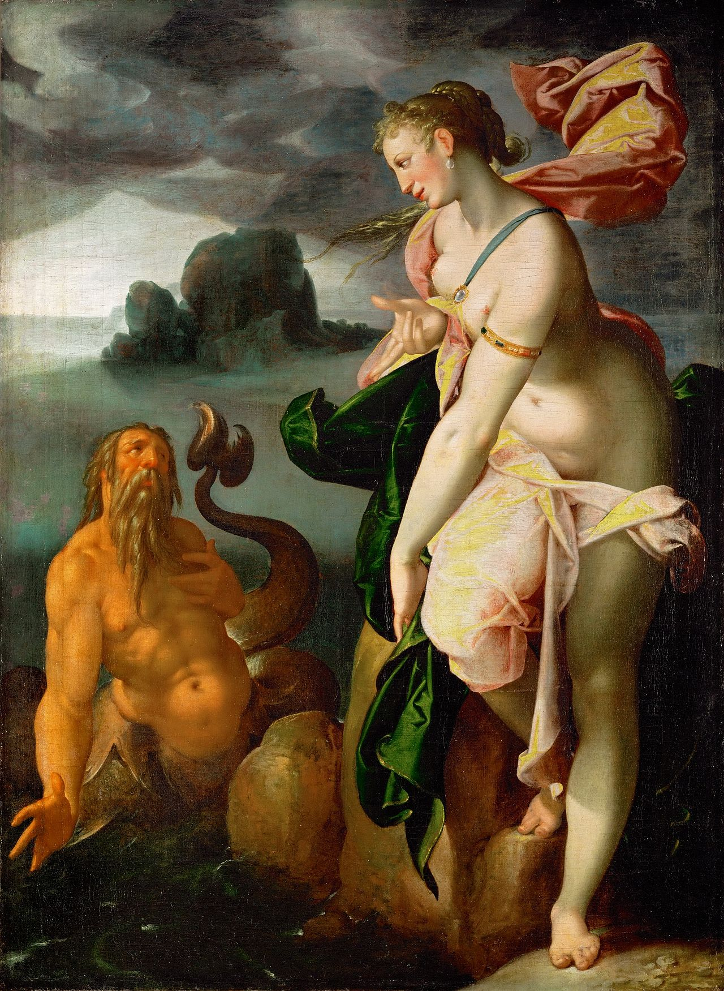
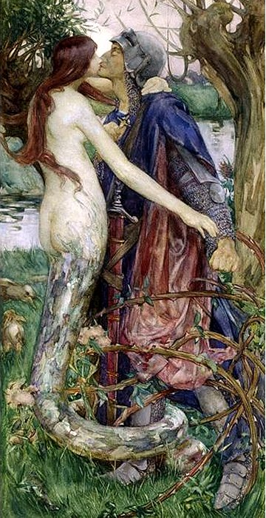
Notes:
In the earliest stories, Lamia was a beautiful queen of Libya who had an affair with Zeus. Upon learning this, Zeus's wife Hera robbed Lamia of her children, the offspring of her affair with Zeus, either by kidnapping or by killing them. The loss of her children drove Lamia insane, and in vengeance and despair, Lamia snatched up any children she could find and devoured them
Scylla as a maiden with a kētos tail and dog heads sprouting from her body. Detail from a red-figure bell-crater in the Louvre, 450–425 B.C. This form of Scylla was prevalent in ancient depictions, though very different from the description in Homer, where she is land-based and more dragon-like.

Slide 9
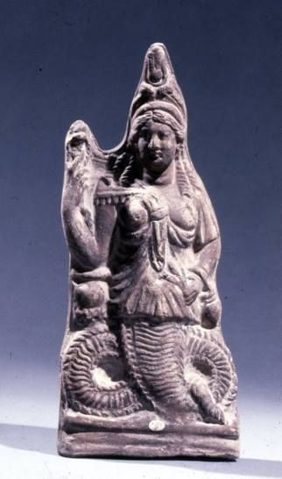
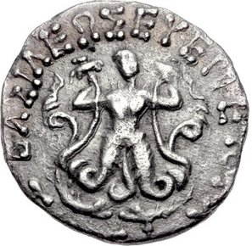
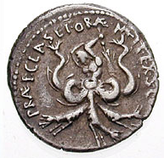
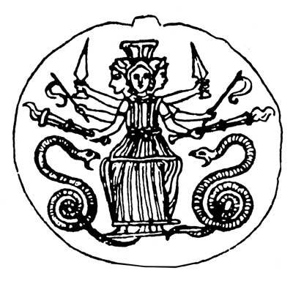
The Mixoparthenos
(half-maiden)
Argimpasa, the Scythian Goddess of Fertility, Warfare, and Magic. The Greeks identified her with Aphrodite Ourania
Notes:
The Greco Roman Hebrew Yahweh appropriated his anguipede attributes from his predecessor, also a Goddess, the Kurgan Tabiti or Api, who predated him on coins and medallions by several centuries.

Slide 10
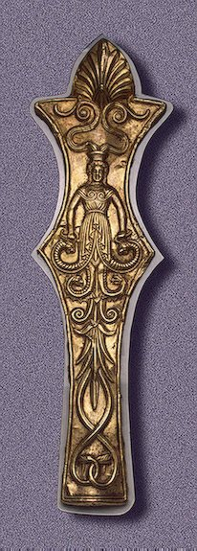
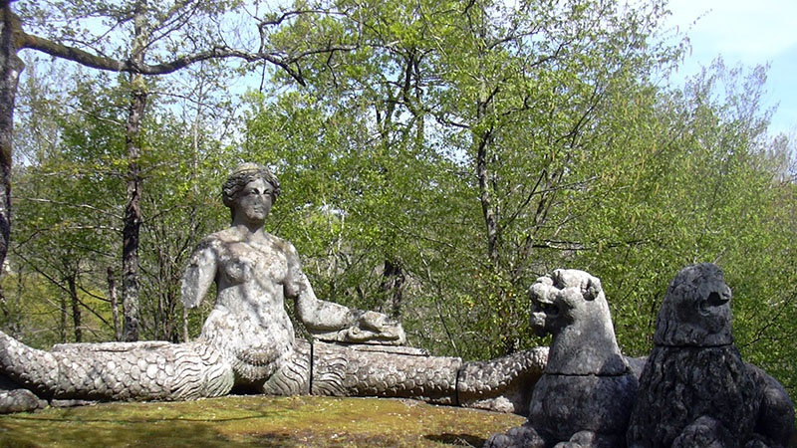
Notes:
She gave her image to the archaic anguipede Greek and Etruscan Goddesses. The Renaissance sculptor depicted Archaic Greek Echidna below, in 1555, based on ancient depictions on vases and friezes: In Greek mythology, Echidna (/ɪˈkɪdnə/; Greek: Ἔχιδνα, "She-Viper")[2] was a monster, half-woman and half-snake, who lived alone in a cave.

Slide 11
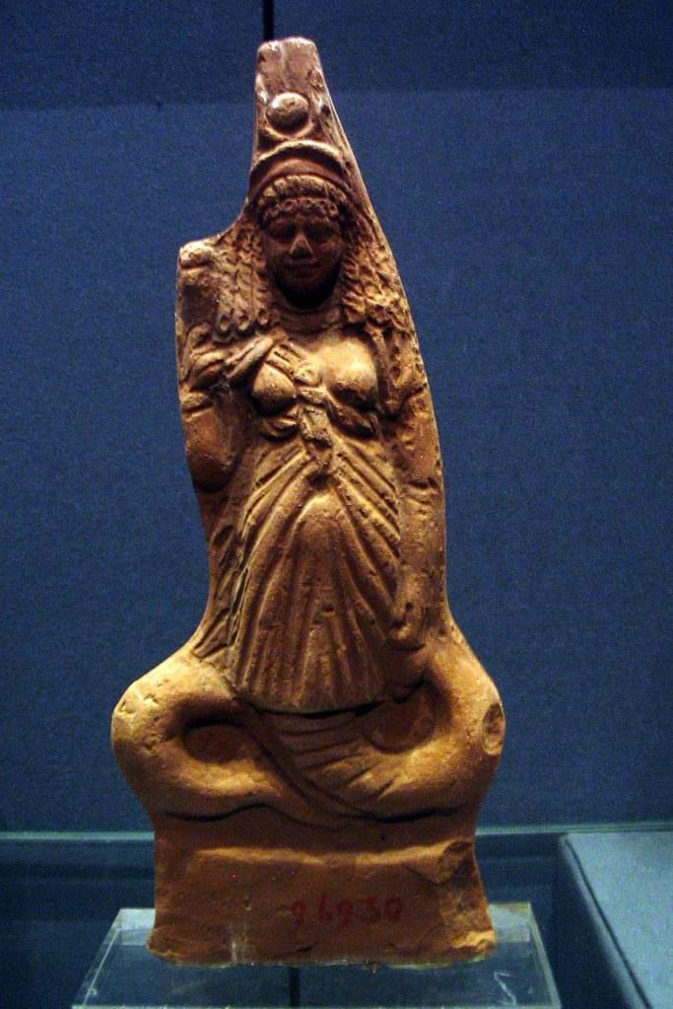

Notes:
Her image appears about a century and a half before the time of Christ and contemporary Yahweh as a cock-headed anguipede, as in these post-Alexandrian Empire versions from the reign of Telephos:

Slide 12
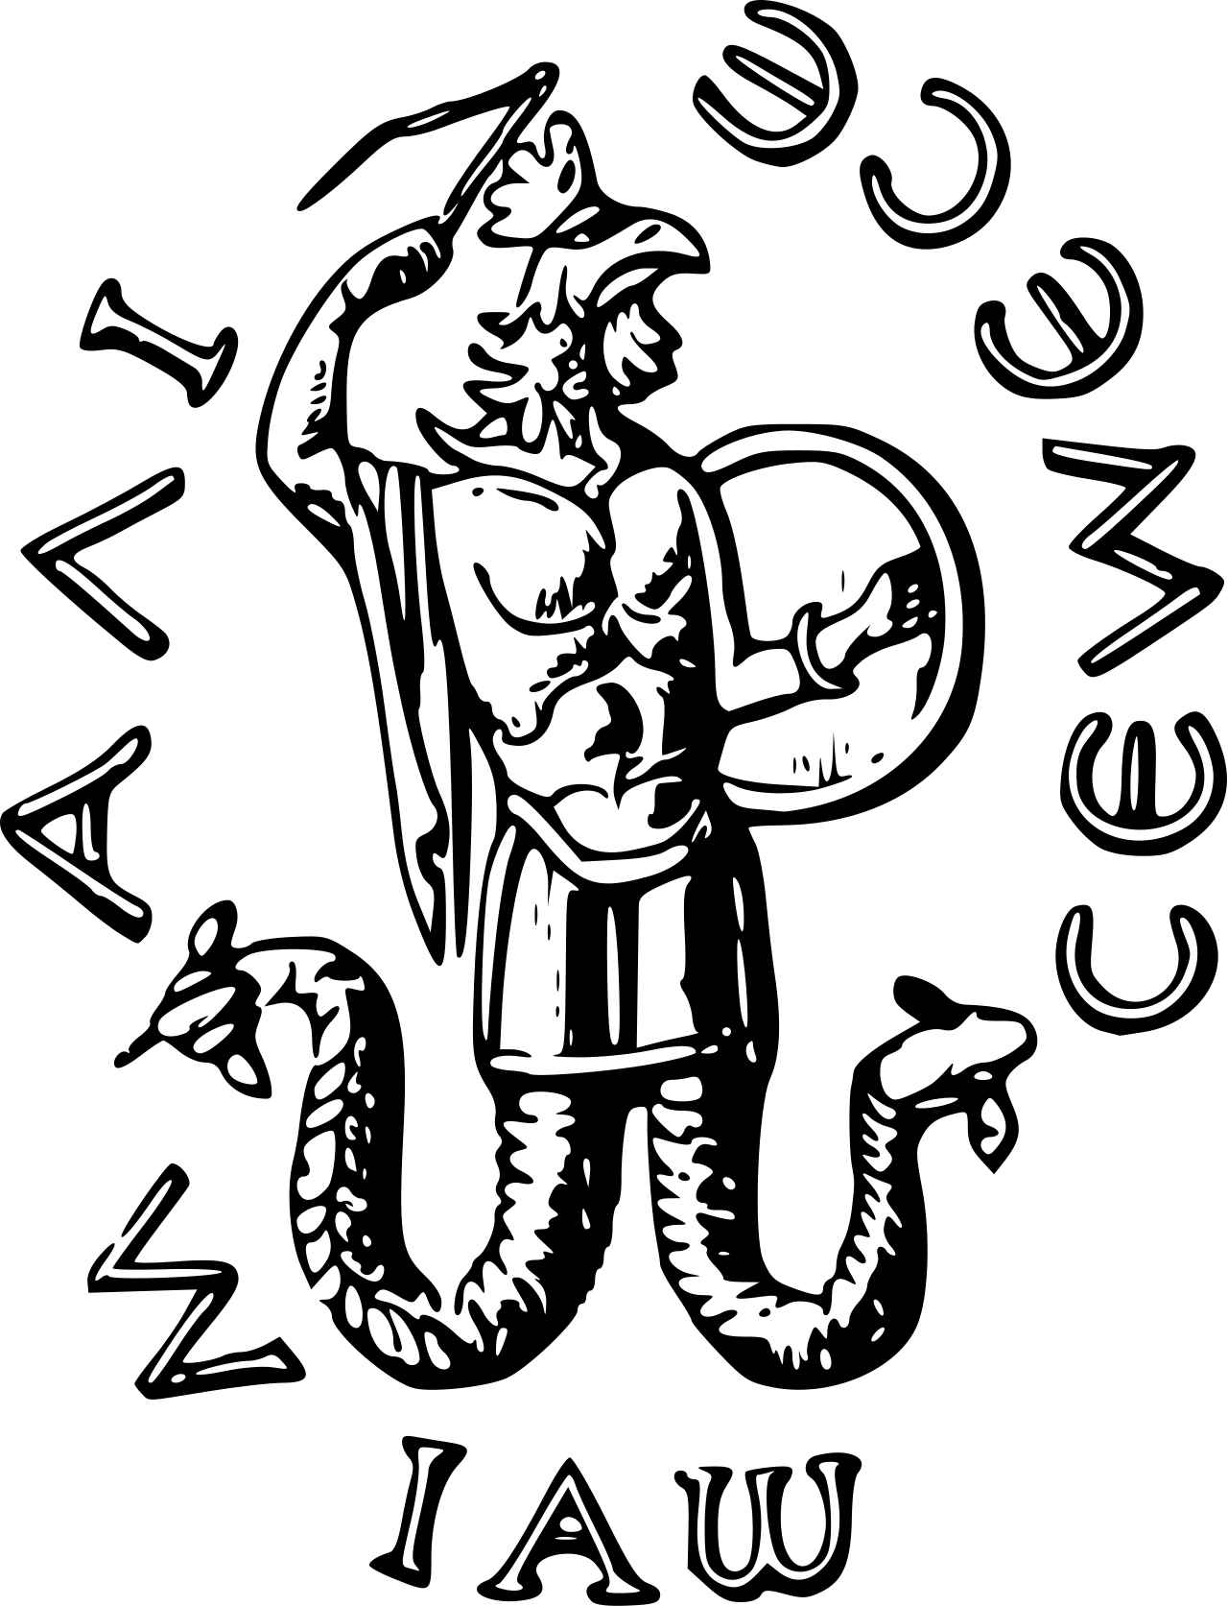
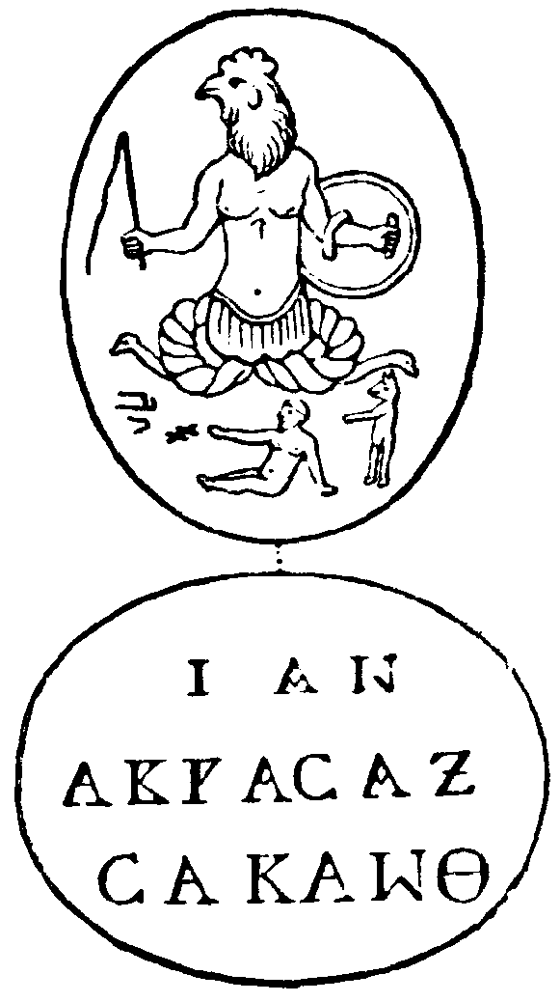
Enter Abraxas
Abraxas The seven letters spelling its name may represent each of the seven classic planets. The word may be related to Abracadabra, although other explanations exist.
Notes:
Abraxas The seven letters spelling its name may represent each of the seven classic planets.^{[3]} The word may be related to Abracadabra, although other explanations exist.

Slide 13
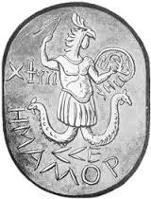
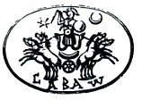
Abraxas was the birth of textual sigils and letters representing incarnations of God. Capacitors.
Notes:
Abraxas, the most common kind of Anguiped, is depicted as a creature with the head of a rooster and snakes for legs, symbolism thought to be of Persian origin. Sometimes inscribed below is Iao, a form of the Tetragrammaton – the four letters used to represent the name of the God of Judaism.
In the Talmud, people who turned away from Judaism to such cults are referred to as minim – often translated as "heretics" or "apostates".[1][2][3]
In Graeco-Roman art, both Typhon and the giants (after around 380 BCE)[4][5][6] are often conventionally depicted as anguipeds. A common religious motif in Roman Germany and eastern Gaul depicts an equestrian Jupiter riding down an anguipedal giant.[7]

Slide 14
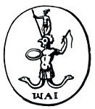
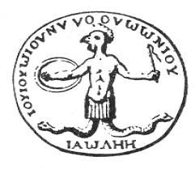
The Birth of Yahweh
The All God

Slide 15
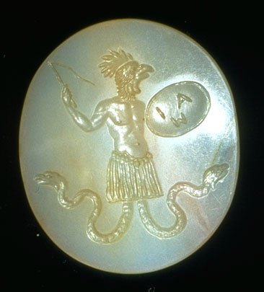
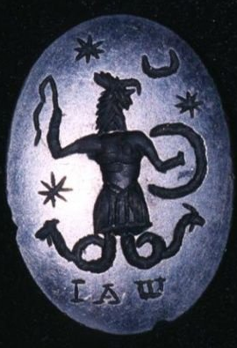
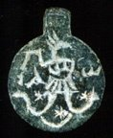
The Birth of
Yahweh
The All-God
Notes:
Pantheus incorporated YHWH into the All God assimilation, inscribing the name IAW / IAO on amulets for protection. Names of the supreme male deities became not just names, but talismans to ward off evil when spoken in prayers, incantations and worn as amulets.

Slide 16
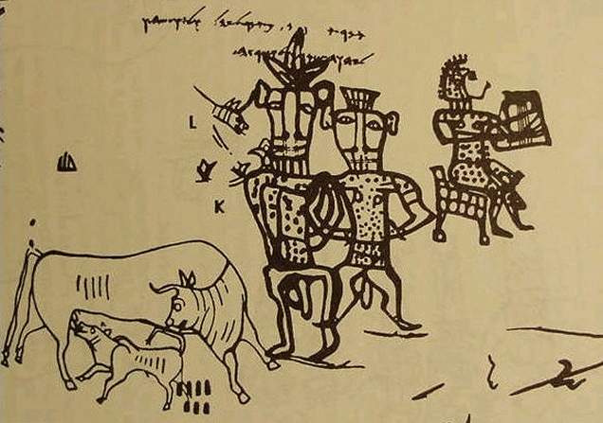
Notes:
[Images of Yahweh paired with Asherah, the ancient Hebrew Love and Fertility Goddess and Tree of Life]

Slide 17
The Secret Name of God
YHWH
Adonai
El
Elohim
Shaddai
Tzevaot
Ehyeh
Adonai (hebrew for lord)
HaShem (THE Name)
Kurios (greek for lord)
Dominus (latin for lord)
1300 Jehovah
Yahweh

Slide 18
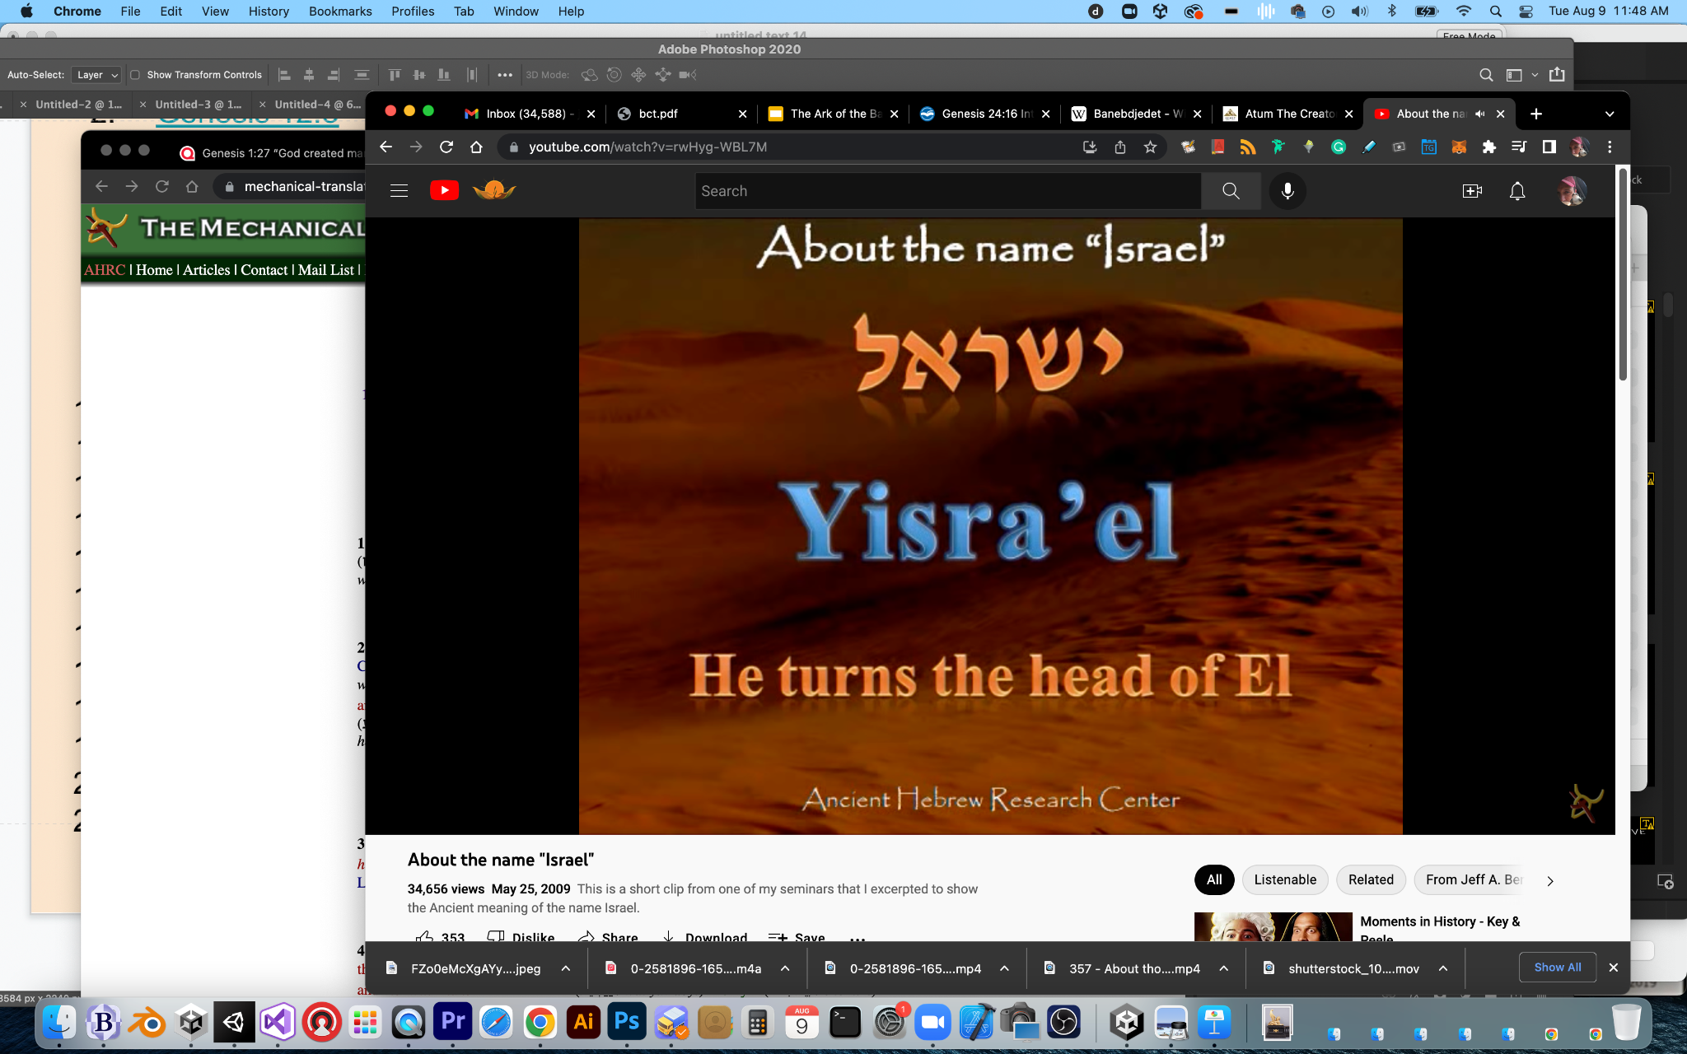
Elohim
אֱלֹהִים
Yoked to a singular spirit over the waters

Slide 19
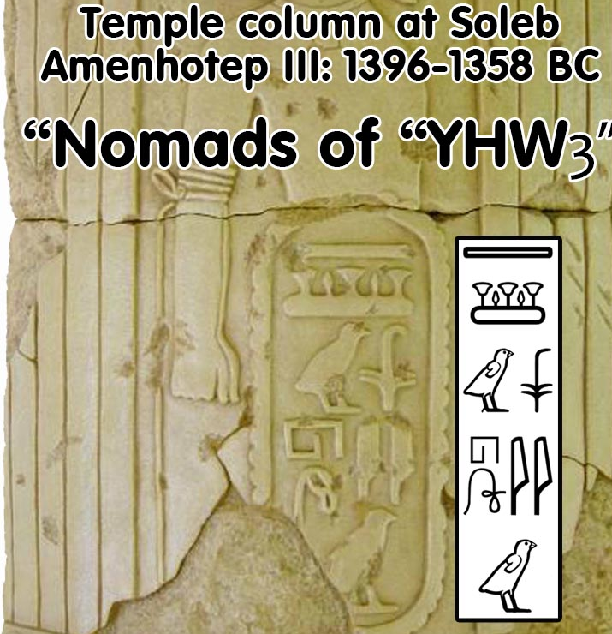
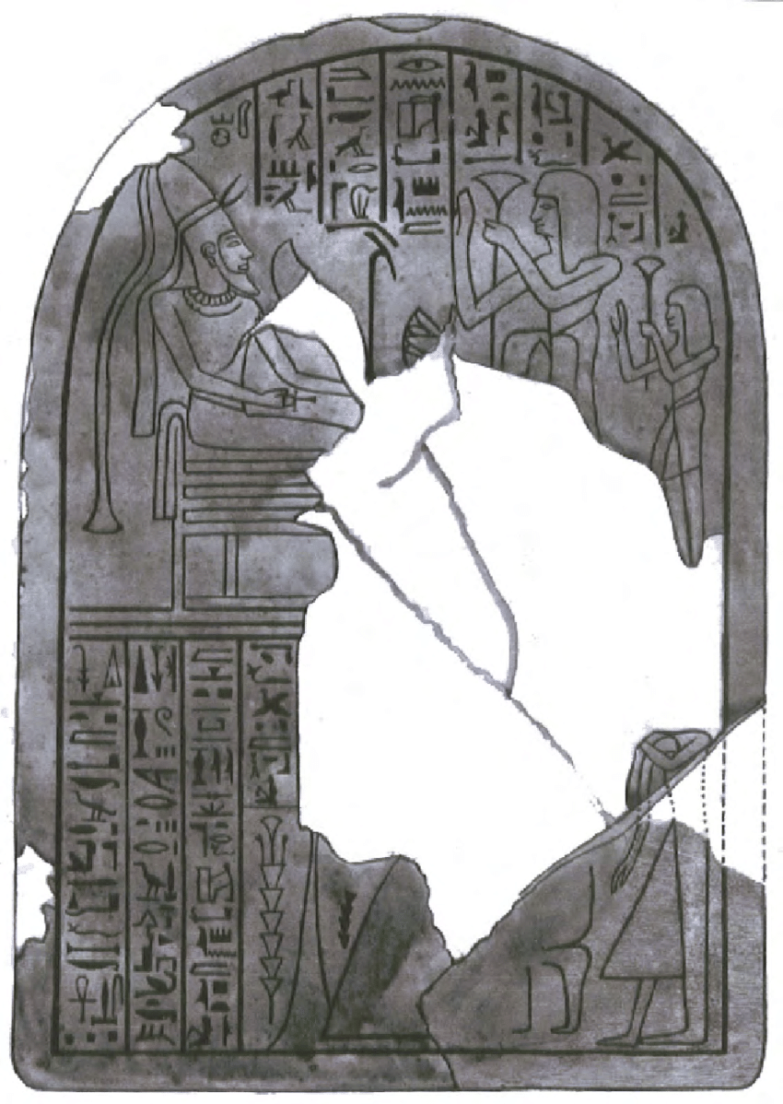
Amenhotep III - 1396–1358 BC
Ramses II - 1304–1237 BC
Notes:
Amarah West Bedouin area

Slide 20
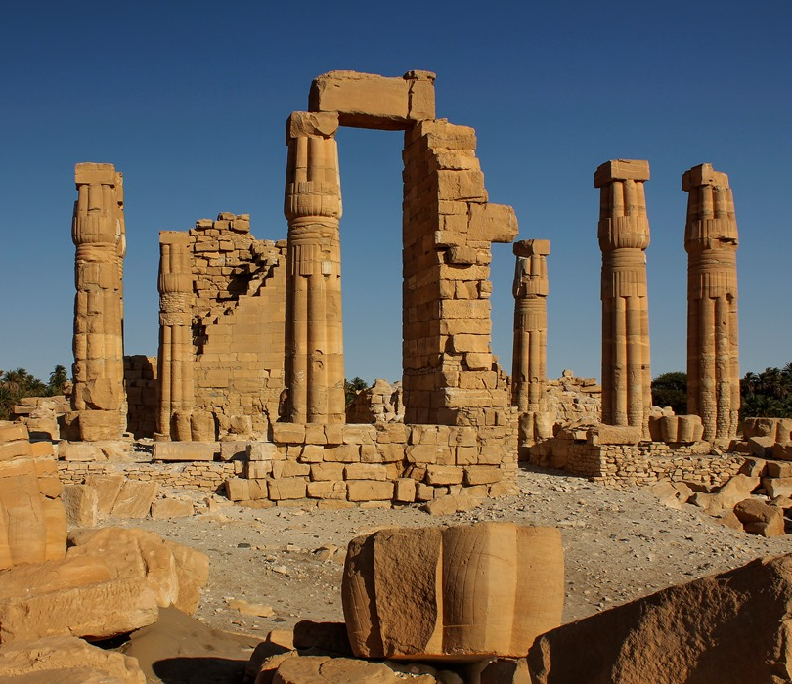
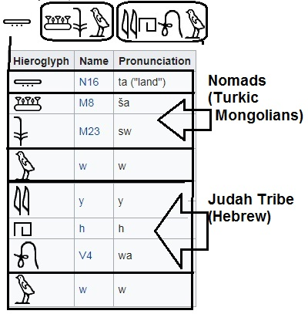
The Land of the Shasu of Yhw
Egyptian Hieroglyphs at Soleb Temple of Amenhotep III in Nubia describing a nomadic slave tribe.

Slide 21
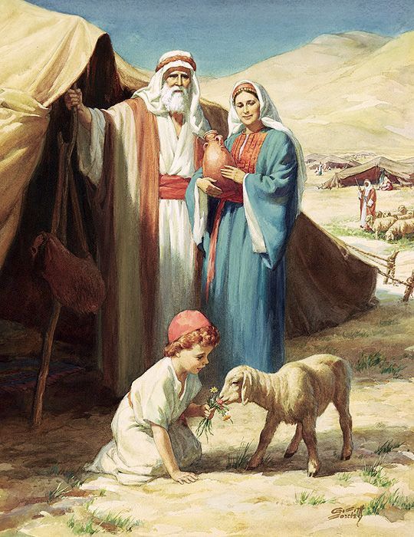
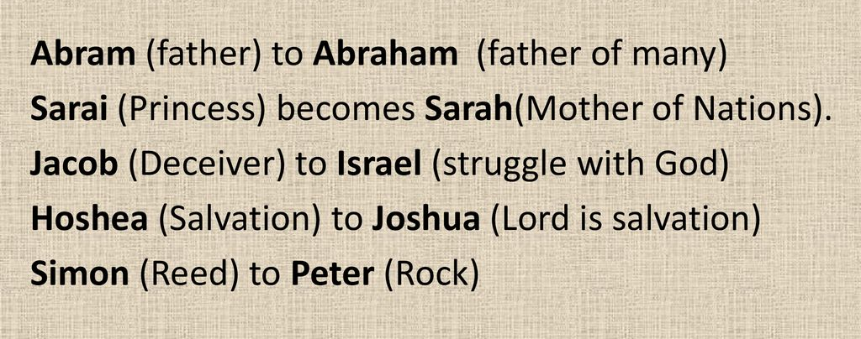
YHW to YHWH
Abram to Abraham
Sarai to Sarah

Slide 22
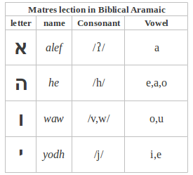
Mothers of Reading
Matres lectionis (from Latin "mothers of reading", singular form: mater lectionis, from Hebrew: אֵם קְרִיאָה 'em kri'a) are consonants that are used to indicate a vowel, primarily in the writing down of Semitic languages such as Arabic, Hebrew and Syriac.
YHW are magic letters dual gendered ss consonants and vowels

Slide 23
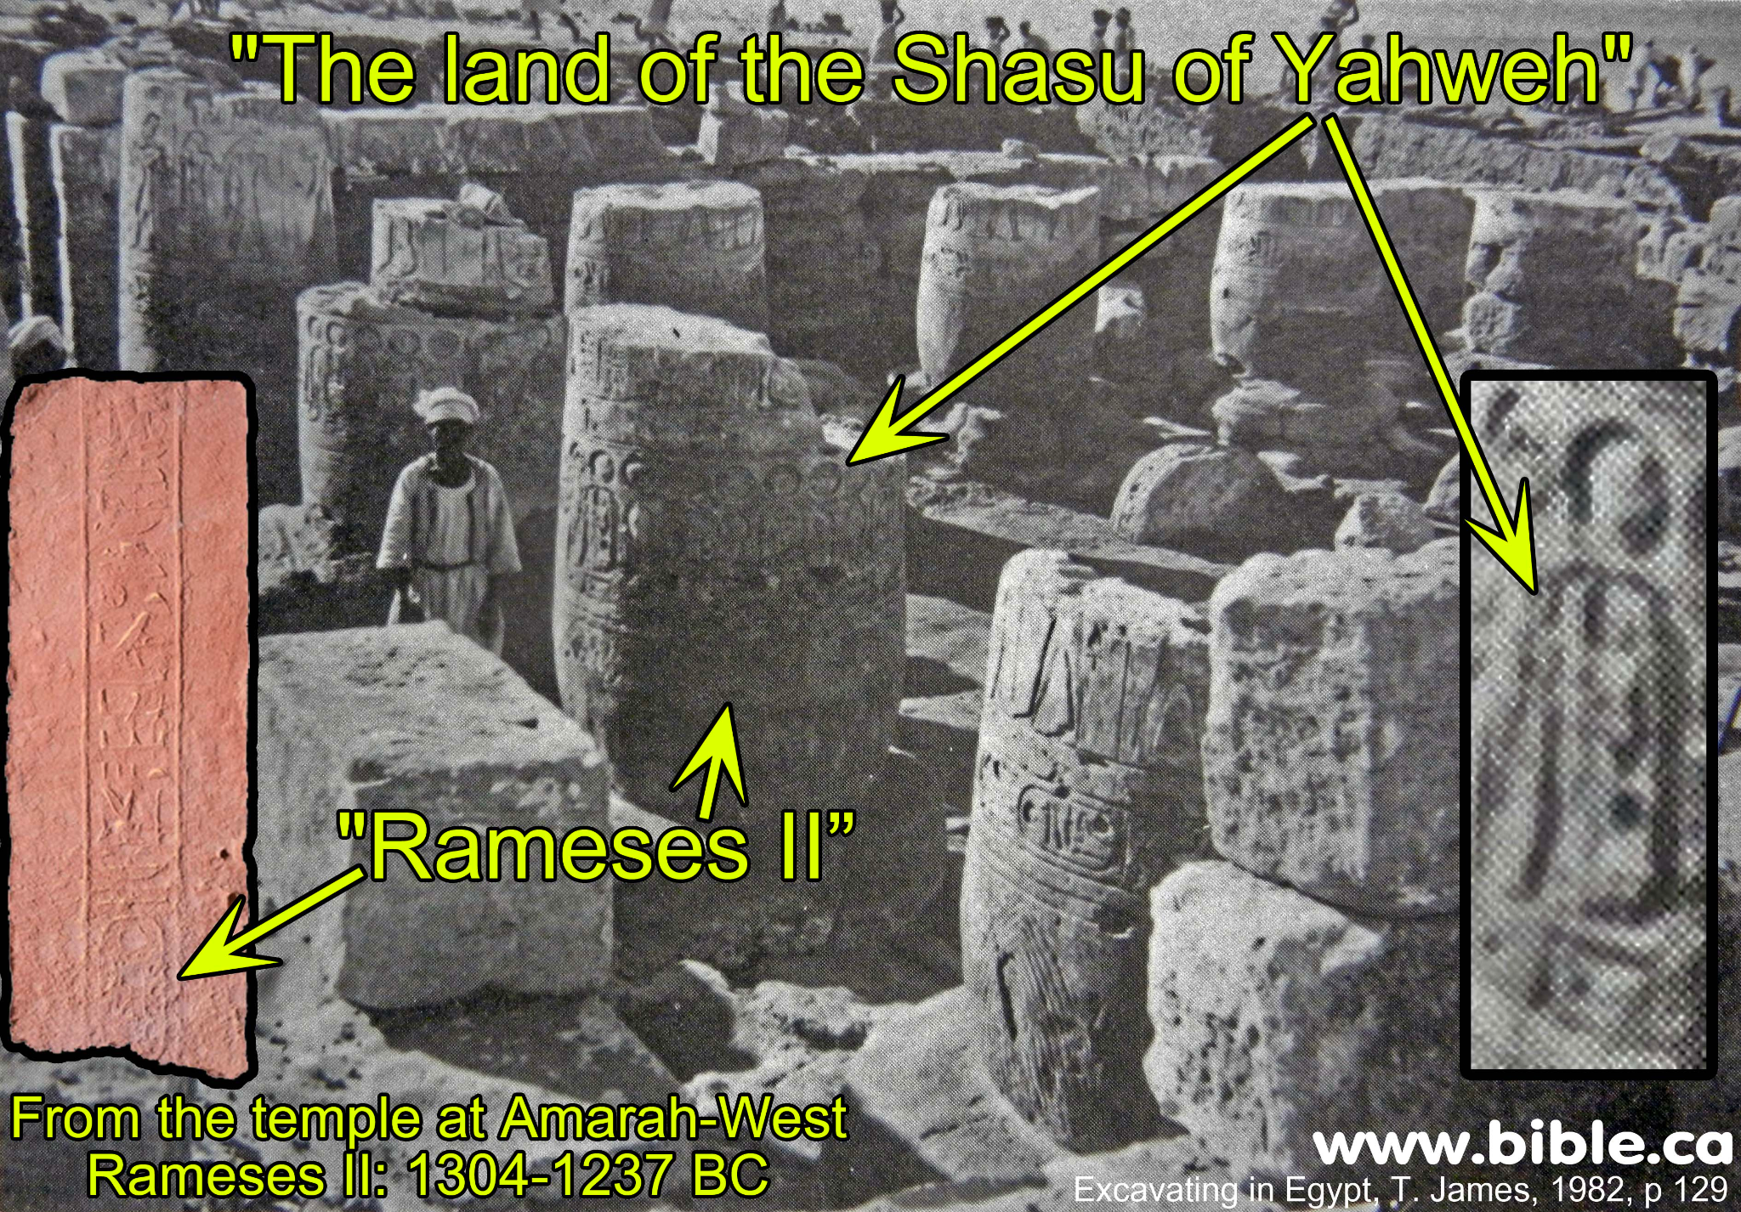
Amarah West inscription: 1304-1237 BC
"The Shashu of Yahweh's Land"
"This fragmentary hieroglyphic inscription contains one of the first mentions of Israel. "According to a recently published article by Manfred Görg, Peter van der Veen and Christoffer Theis, the name-ring on the right may indeed read “Israel,” and they date it almost 200 years earlier than the reference to Israel on the Merneptah Stele." (Clyde Billington, Associates for Bible Research)

Slide 24
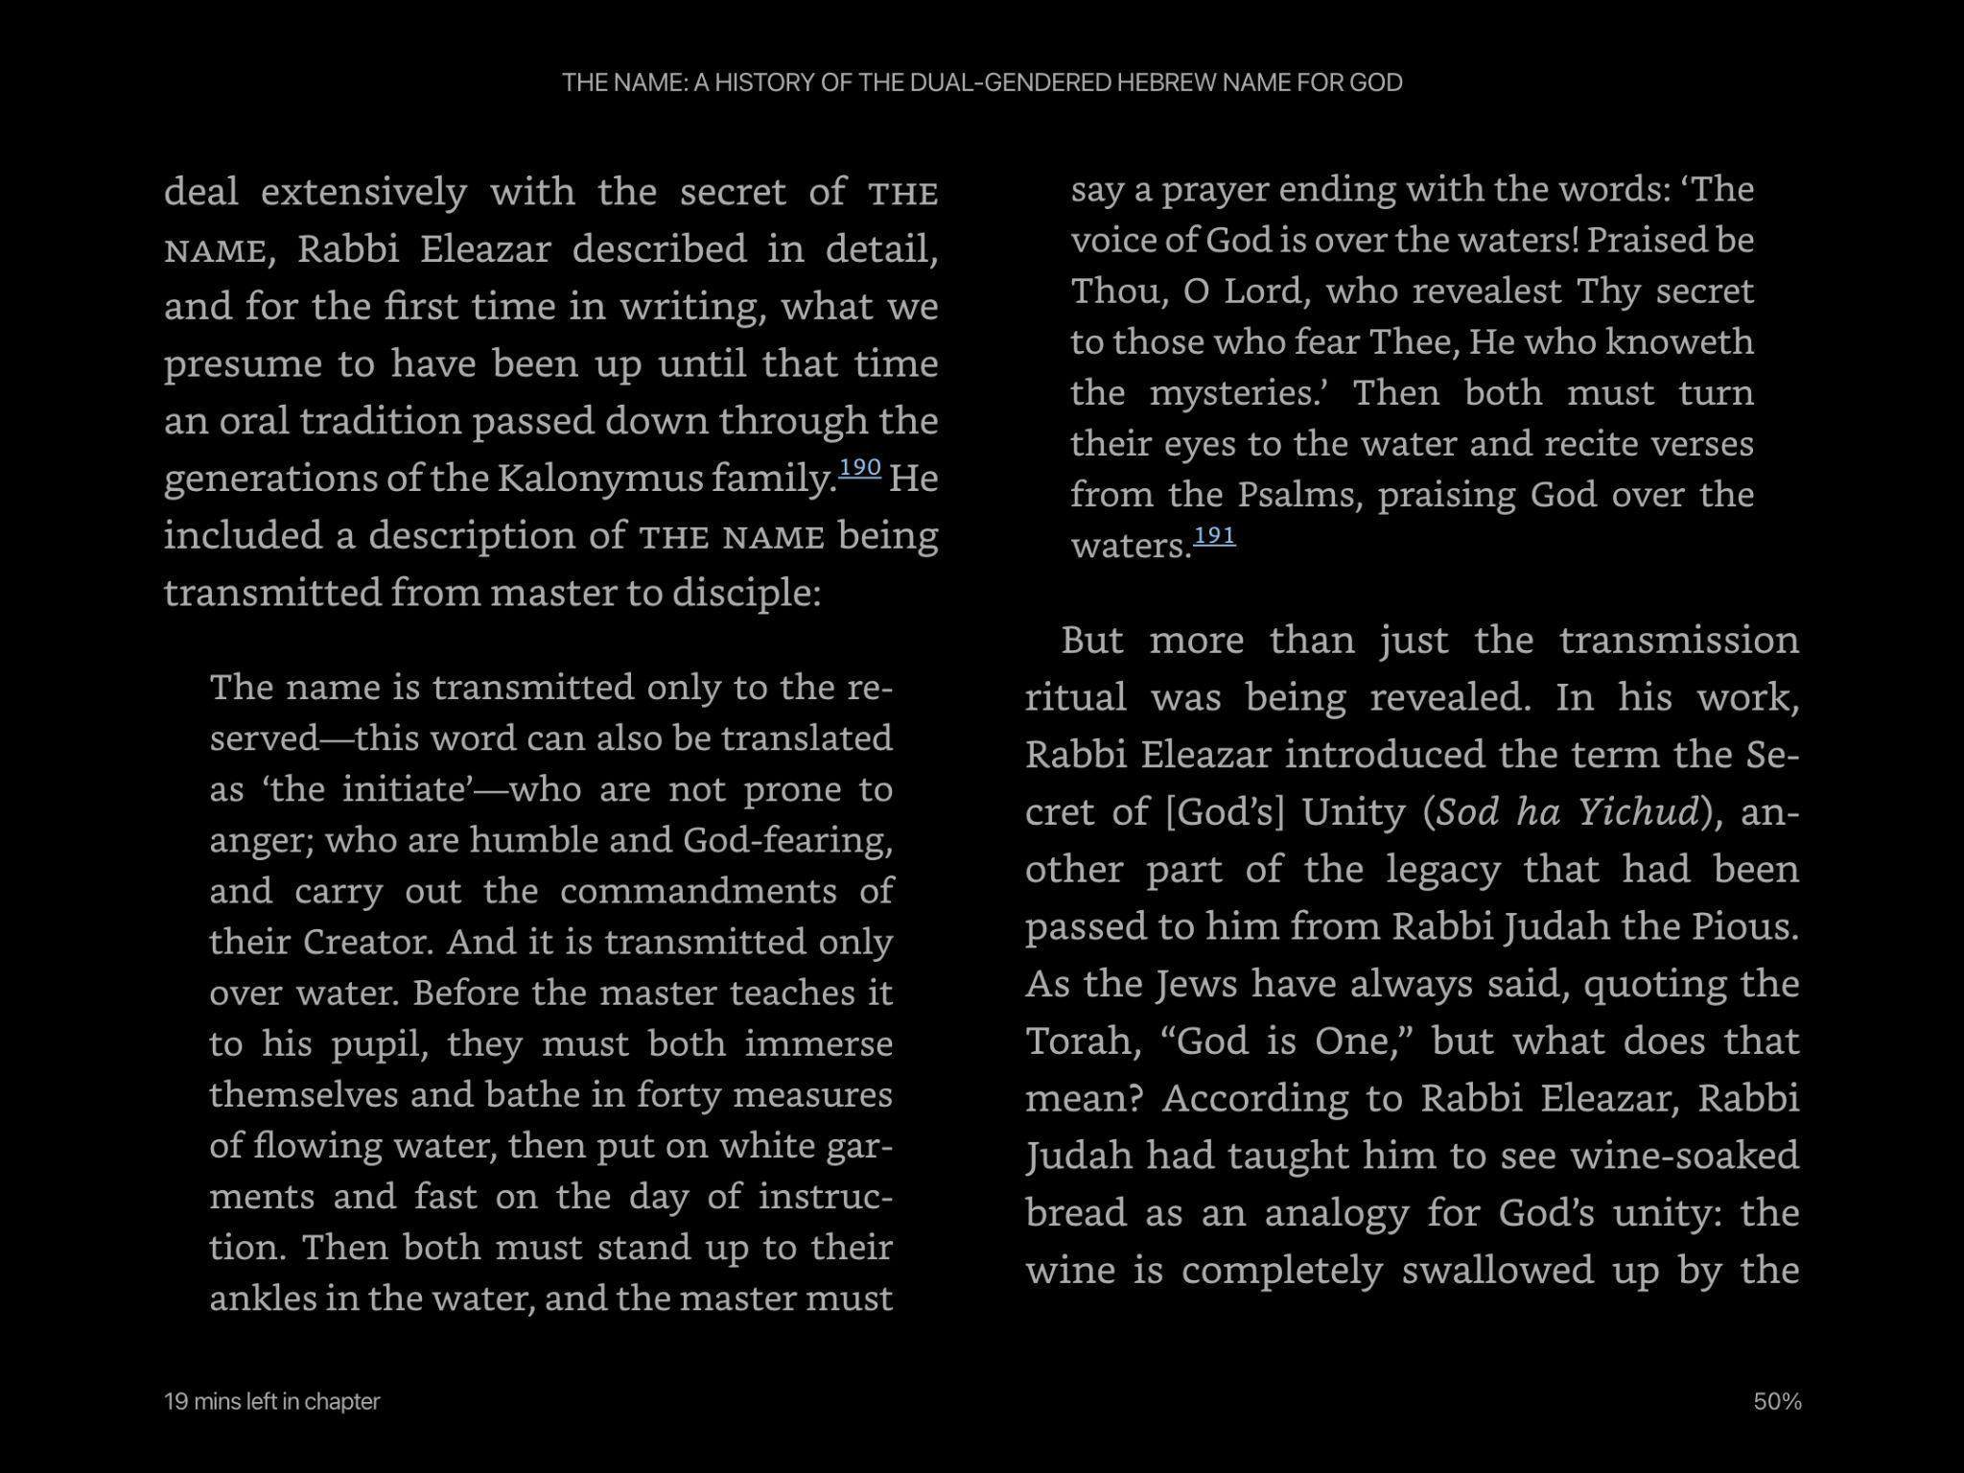
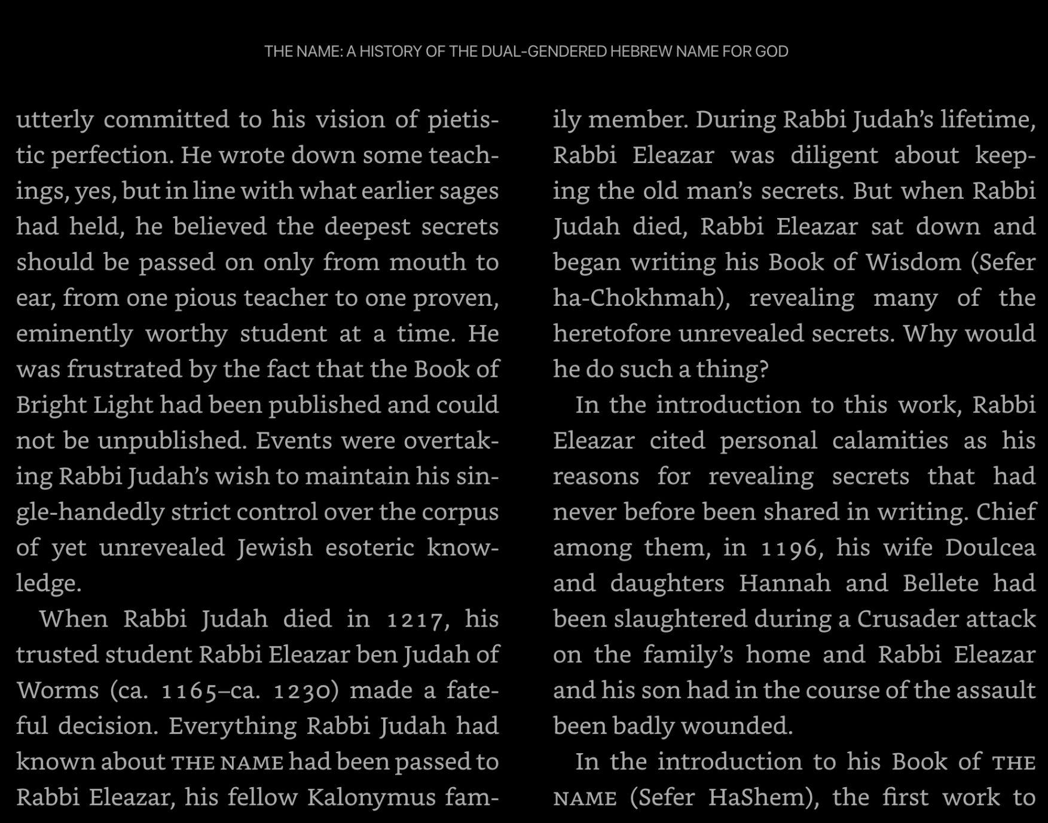
Transmitting the Name
600 BC
200 BC Simon the Just
Ba’alei Shem - masters of the name
Exodus 3:14
The Hebrew name of God--YHWH--has not been uttered in public for over two thousand years. Some thought the lost pronunciation was "Jehovah" or "Yahweh." But Sameth traces the name to the late Bronze Age and argues that it was expressed Hu-Hi--Hebrew for "He-She." Among Jewish mystics, we learn, this has long been an open secret.

Slide 25
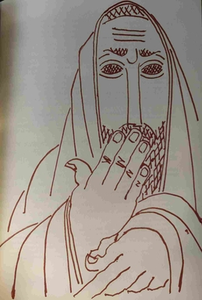
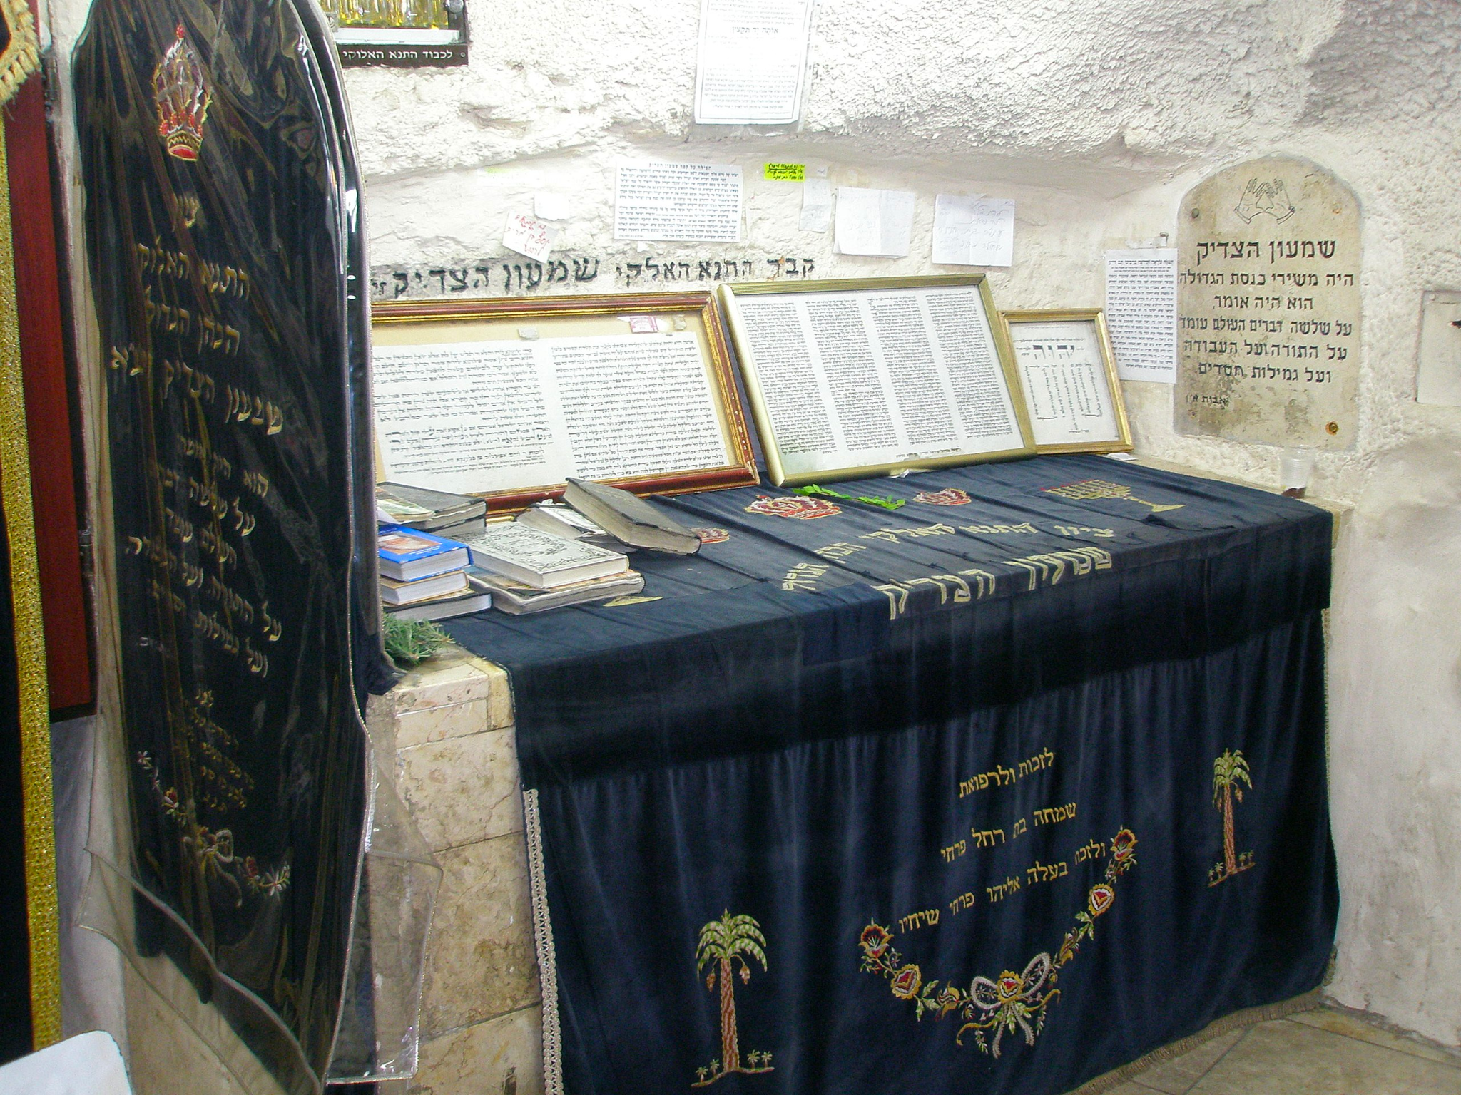
God’s name didn’t die in a fire. It was smothered by a priesthood who thought the people weren’t worthy of knowing his name.
300-200 BCE
On a certain Yom Kippur Simeon came from the Holy of Holies in a sad mood, and when asked the reason, he replied that on every Yom Kippur a figure clothed in white had ushered him into the Holy of Holies and then had escorted him out. This time, however, the apparition had been clothed in black and had conducted him in, but had not led him out, a sign that this year was to be his last. He is said to have fallen ill soon after, for seven days, and died after Sukkot.
Without the presence of Simeon, the Just, (Shimon HaTzaddik) among them, the Jewish people were no longer worthy of the miracles that had occurred during his lifetime. For this reason, following his death, the priests, refrained from blessing the Jewish people with the explicit name of God, the Tetragrammaton in the priestly blessing.
Tetragrammaton, Adonai, HaShem, Kyrios, Dominus, Jehovah, Yahweh

Slide 26
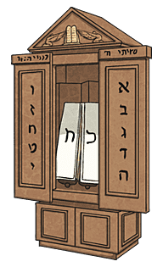
The Ark of the Name

Slide 27


Macular
IRIS
OSIRIS
ISIS
peripheral
Notes:
Aten

Slide 28
God’s full name
Who. He. Who. Ha. Ha. Ting. Tang. Walla. Walla. Big. Bang.

