Slide 1



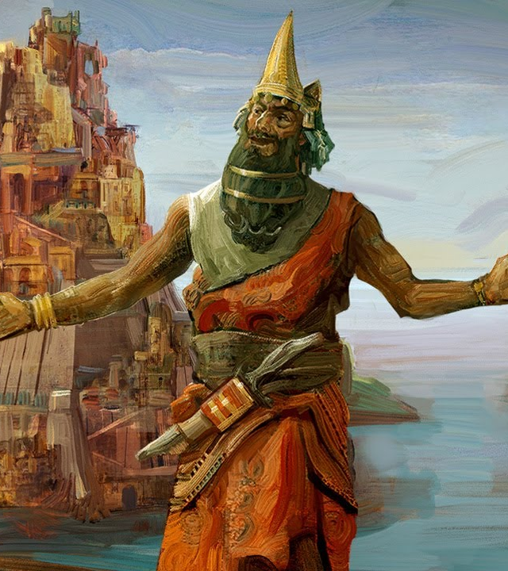

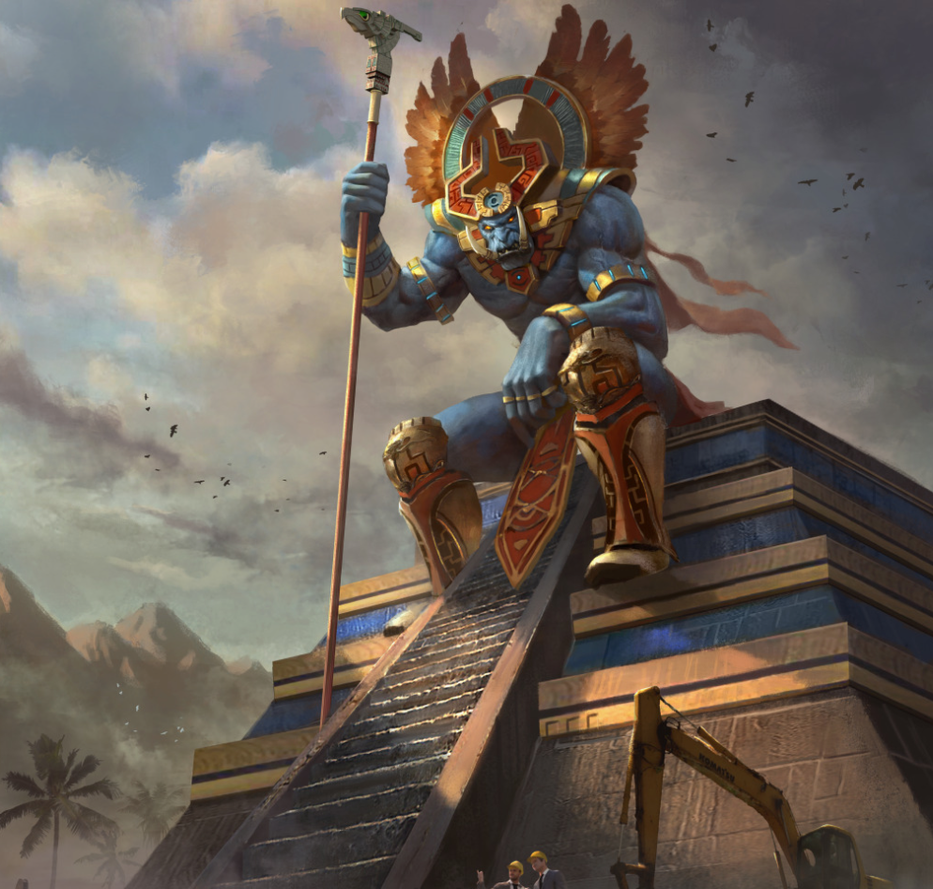
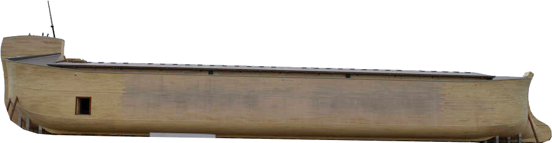

JAMES
TRUE
LIVE
Ark of the Baphomet
Nimrod the architect
Xelhua the architect

Slide 2
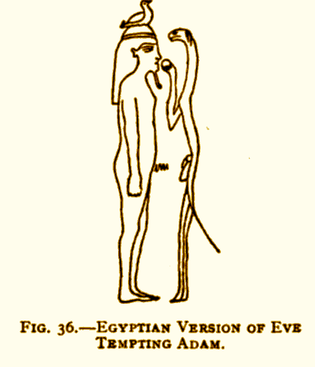
No pyramids in the Bible because the new religion could never point back to Egypt.

Slide 3
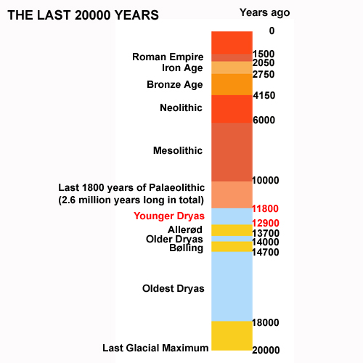
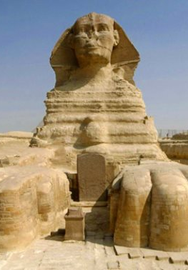
ALL OF KNOWN HISTORY
EARLIEST POSSIBLE DATE FOR SPHINX
Geologists propose the possibility of a great flood in the Middle East at the end of the last Ice Age, which was about 7,000 years ago. At that time, the Black Sea was a freshwater lake surrounded by farmlands.

Slide 4
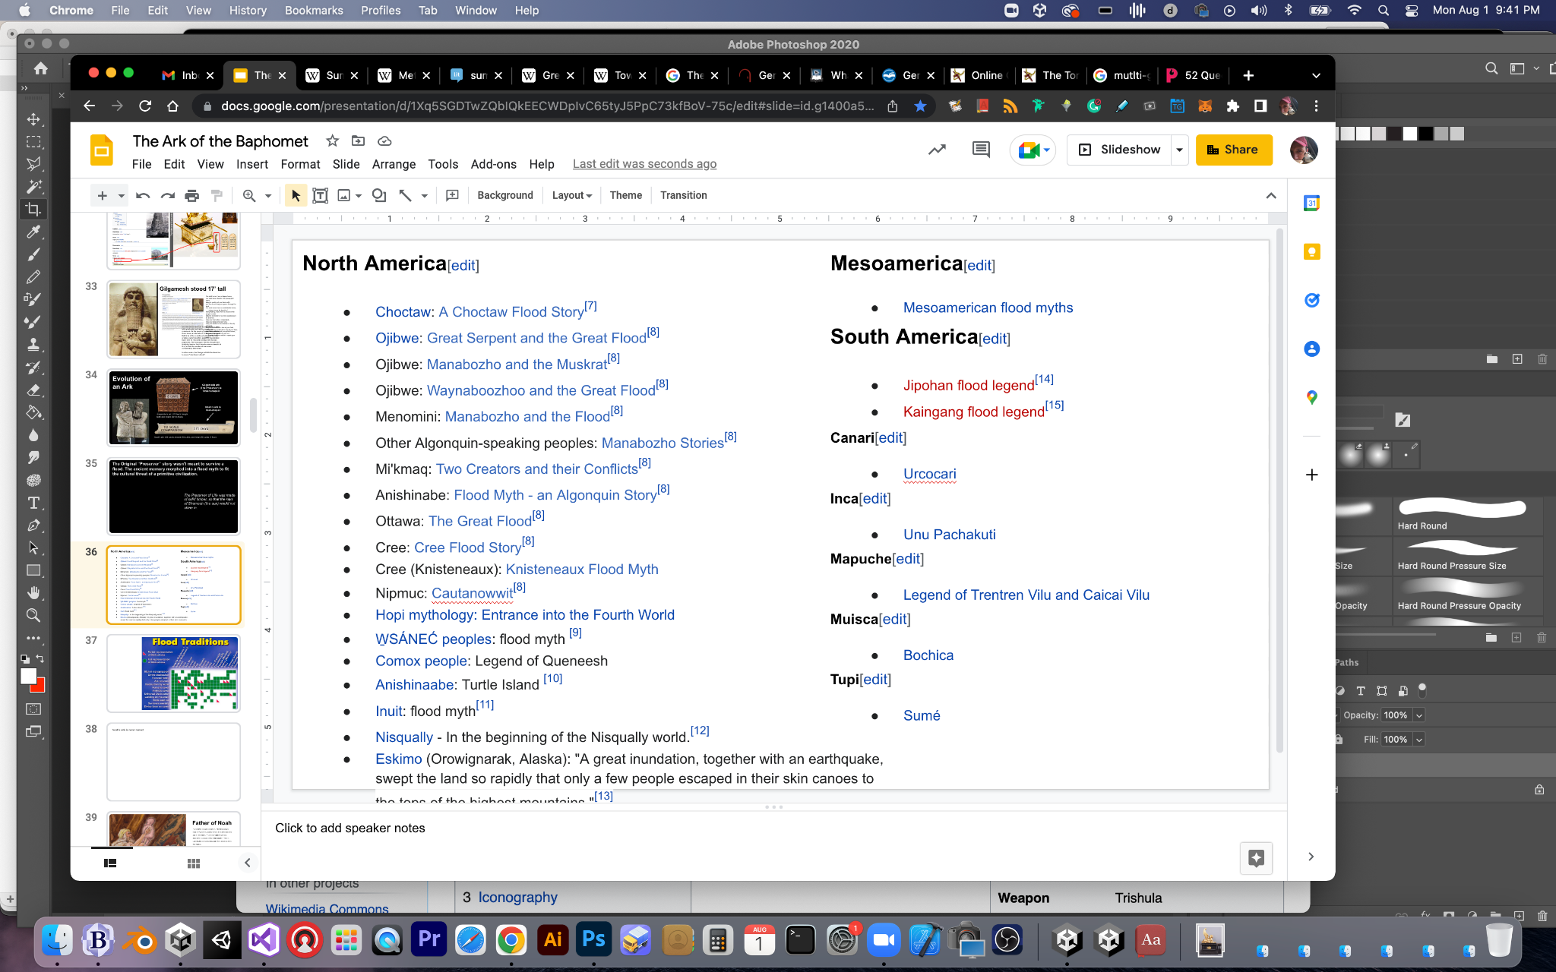
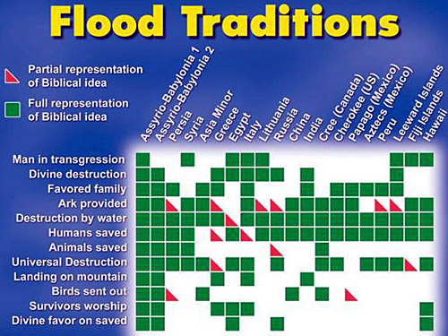

Slide 5
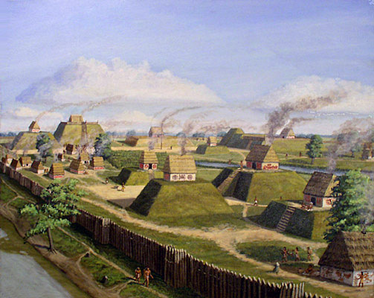
The Tower of Babel and the Flood Stories intermix. Both are vehicles for ancient trauma in the collective. Both place the truth in the room (reset) framed in an acceptable costume for the current audience.
Notes:
Before the great inundation which took place 4,800 years after the erection of the world, the country of Anahuac was inhabited by giants, all of whom either perished in the inundation or were transformed into fishes, save seven who fled into caverns. When the waters subsided, one of the giants, called Xelhua, surnamed the 'Architect,' went to Cholula, where, as a memorial of the Tlaloc which had served for an asylum to himself and his six brethren, he built an artificial hill in the form of a pyramid. He ordered bricks to be made in the province of Tlalmanalco, at the foot of the Sierra of Cecotl, and in order to convey them to Cholula he placed a file of men who passed them from hand to hand. The gods beheld, with wrath, an edifice the top of which was to reach the clouds. Irritated at the daring attempt of Xelhua, they hurled fire on the pyramid. Numbers of the workmen perished. The work was discontinued, and the monument was afterwards dedicated to Quetzalcoatl.

Slide 6
Nimrod the architect
Xelhua the architect
Notes:
Before the great inundation which took place 4,800 years after the erection of the world, the country of Anahuac was inhabited by giants, all of whom either perished in the inundation or were transformed into fishes, save seven who fled into caverns. When the waters subsided, one of the giants, called Xelhua, surnamed the 'Architect,' went to Cholula, where, as a memorial of the Tlaloc which had served for an asylum to himself and his six brethren, he built an artificial hill in the form of a pyramid. He ordered bricks to be made in the province of Tlalmanalco, at the foot of the Sierra of Cecotl, and in order to convey them to Cholula he placed a file of men who passed them from hand to hand. The gods beheld, with wrath, an edifice the top of which was to reach the clouds. Irritated at the daring attempt of Xelhua, they hurled fire on the pyramid. Numbers of the workmen perished. The work was discontinued, and the monument was afterwards dedicated to Quetzalcoatl.

Slide 7
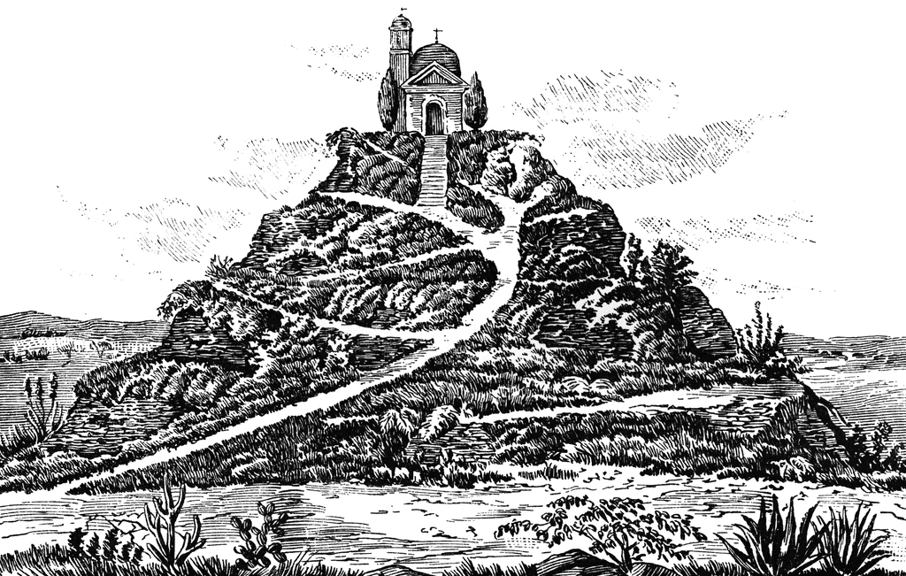
World’s largest pyramid by volume, the Great Pyramid of Cholula has its origin in the ancient Nahuatl word cholollan, meaning "place of refuge." The city was once called Acholollan
(in Nahuatl), meaning place of flight or water that falls in the place of flight.
The Aztecs believed that Xelhua,
one of the giants from their
mythology, had constructed
the pyramid of Cholula.
At its peak, Cholula had the second largest population in Mexico of an estimated 100,000 people. Residents abandoned the Great Pyramid in the 8th century as the city suffered a drastic population drop. Even after this population drop, the Great Pyramid retained its religious importance.
Notes:
Before the great inundation which took place 4,800 years after the erection of the world, the country of Anahuac was inhabited by giants, all of whom either perished in the inundation or were transformed into fishes, save seven who fled into caverns. When the waters subsided, one of the giants, called Xelhua, surnamed the 'Architect,' went to Cholula, where, as a memorial of the Tlaloc which had served for an asylum to himself and his six brethren, he built an artificial hill in the form of a pyramid. He ordered bricks to be made in the province of Tlalmanalco, at the foot of the Sierra of Cecotl, and in order to convey them to Cholula he placed a file of men who passed them from hand to hand. The gods beheld, with wrath, an edifice the top of which was to reach the clouds. Irritated at the daring attempt of Xelhua, they hurled fire on the pyramid. Numbers of the workmen perished. The work was discontinued, and the monument was afterwards dedicated to Quetzalcoatl.

Slide 8
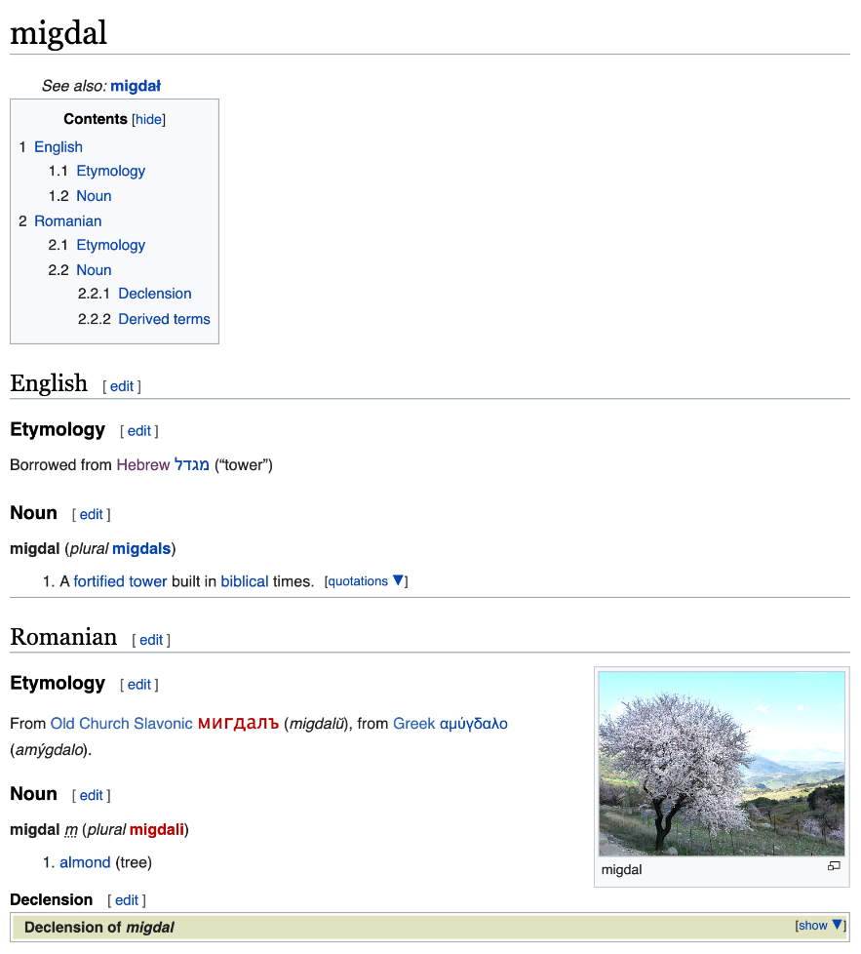
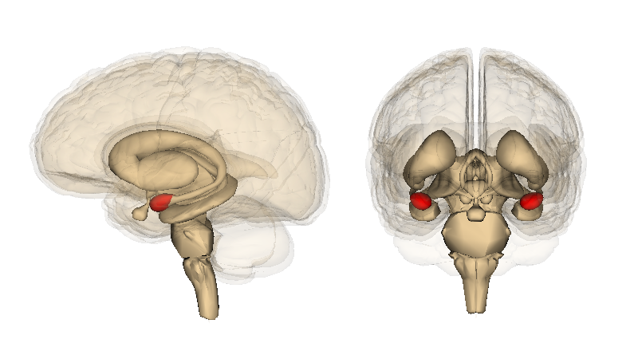
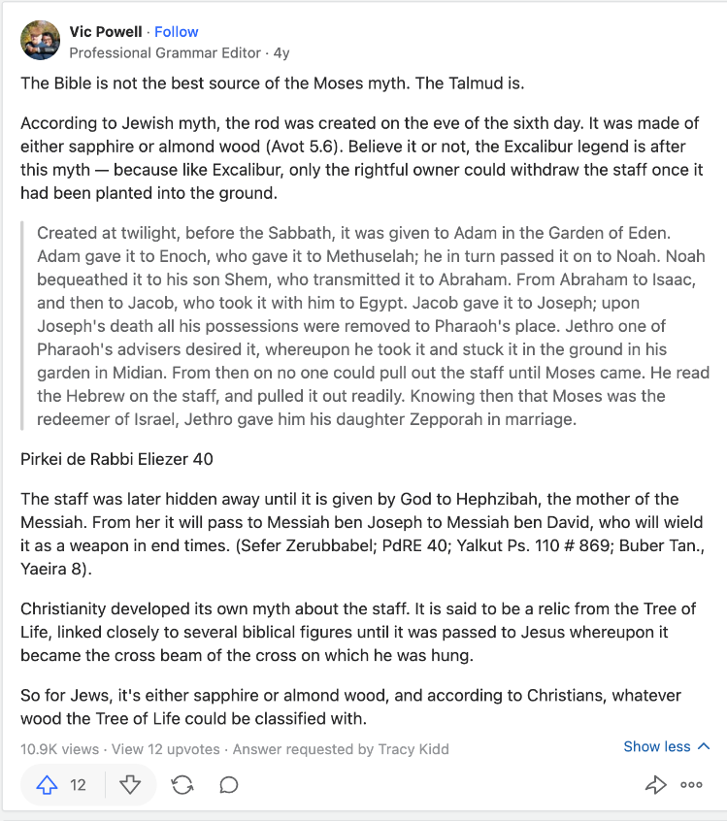
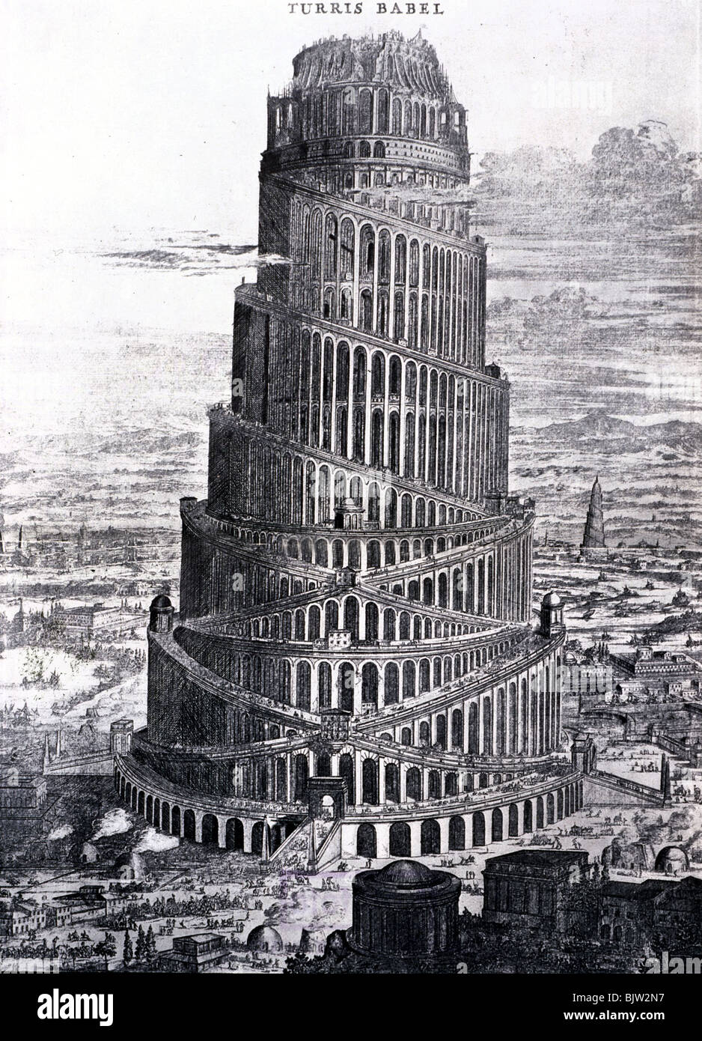
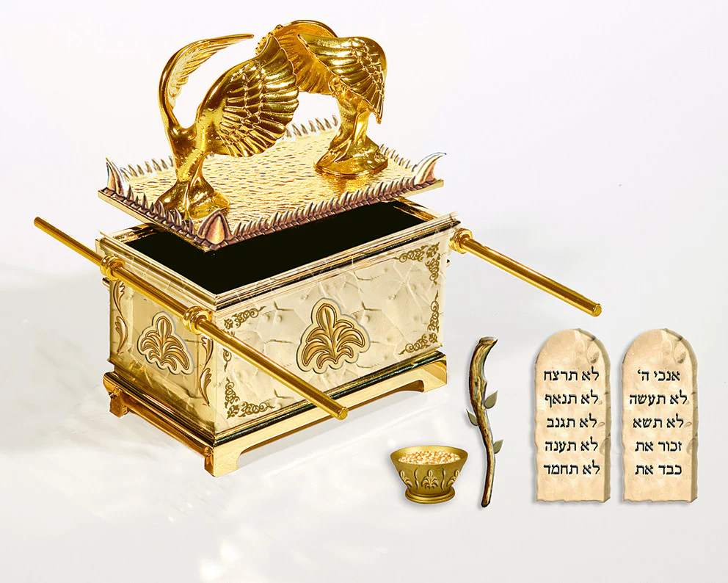

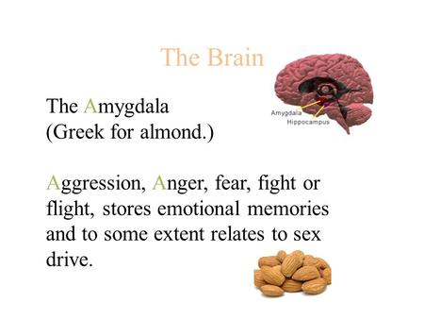
Tower of Babel
Ark of the Covenant
The Almond Connection
Notes:
Covenant means the choicest meat. Making a covenant is the cutting of the meat (and passing it between)

Slide 9
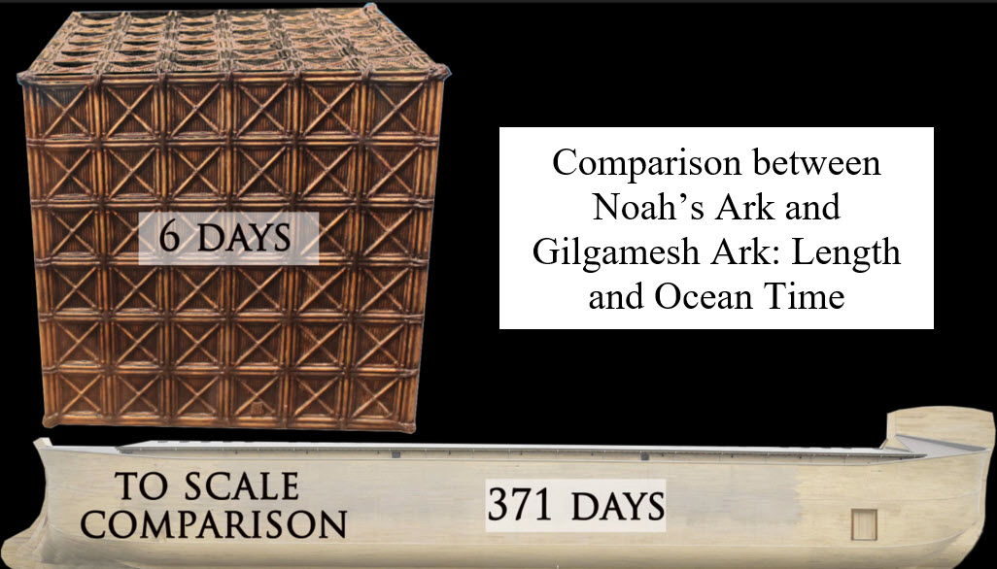
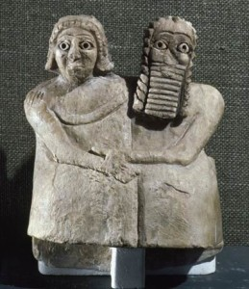
Evolution of
an Ark
Gilgamesh ark (The Preserver) is
Tower-shaped
Noah’s ark is
boat-shaped
Utnapishtim’s ark: 200 feet in length, width and height, Seven floors,
Noah's ark: 300 cubits, breadth 50 cubits, and height 30 cubits. 3 floors

Slide 10
The Original “Preserver” story wasn’t meant to survive a flood. The ancient memory morphed into a flood myth to fit the cultural threat of a primitive civilization.
The Preserver of Life was made of solid timber, so that the rays of Shamash (the sun) would not shine in.

Slide 11
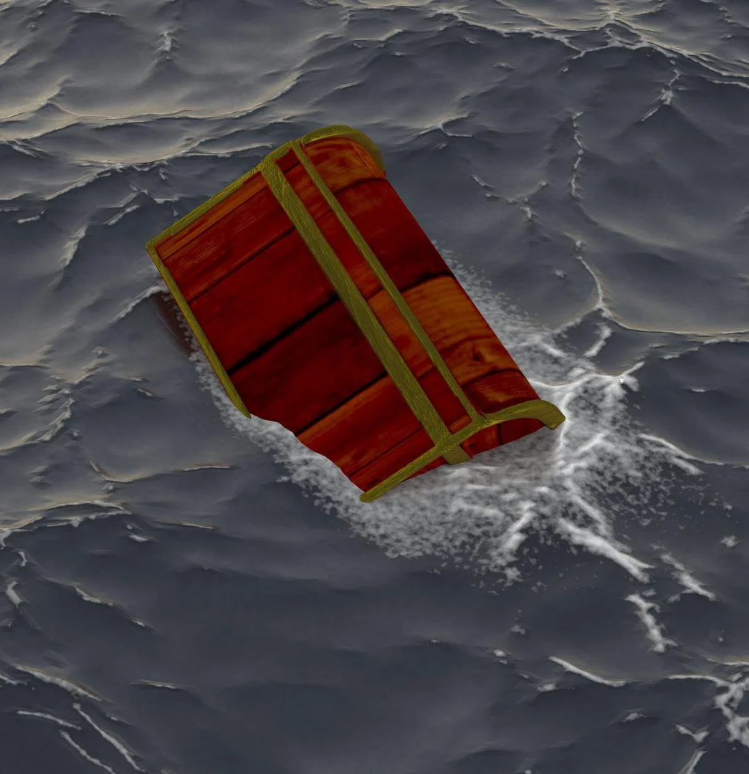
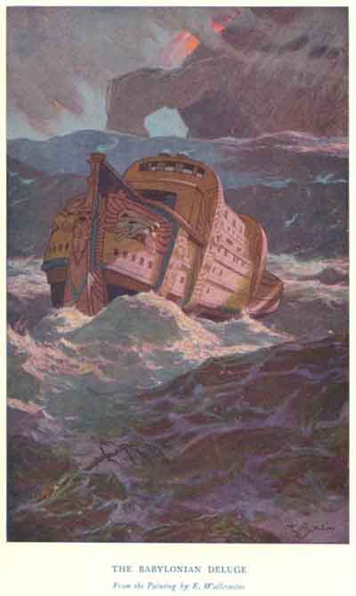

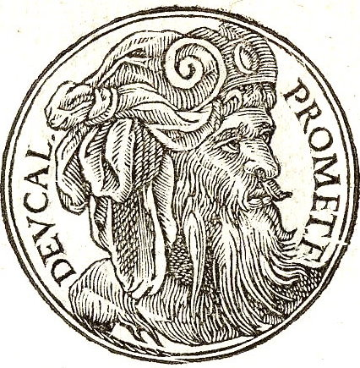
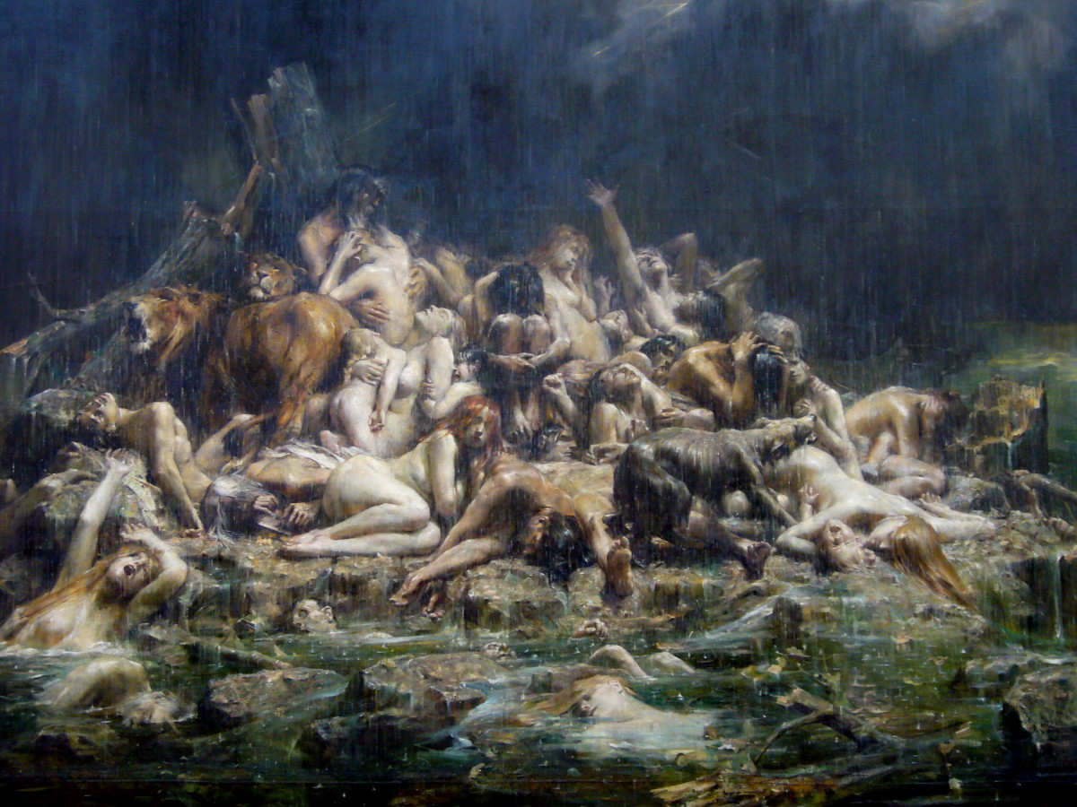
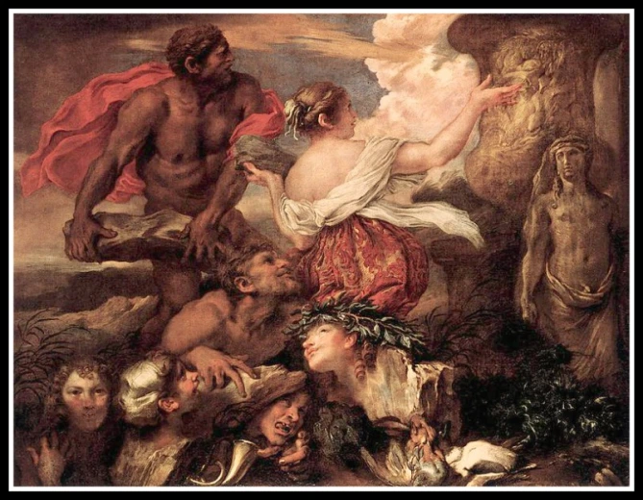
Deucalion, with the aid of his father Prometheus, was saved from this deluge by building a chest. Like the biblical Noah and the Mesopotamian counterpart Utnapishtim, he uses this device to survive the deluge with his wife, Pyrrha, daughter of Epimetheus. They repopulated the world by throwing stones over their shoulders.

Slide 12
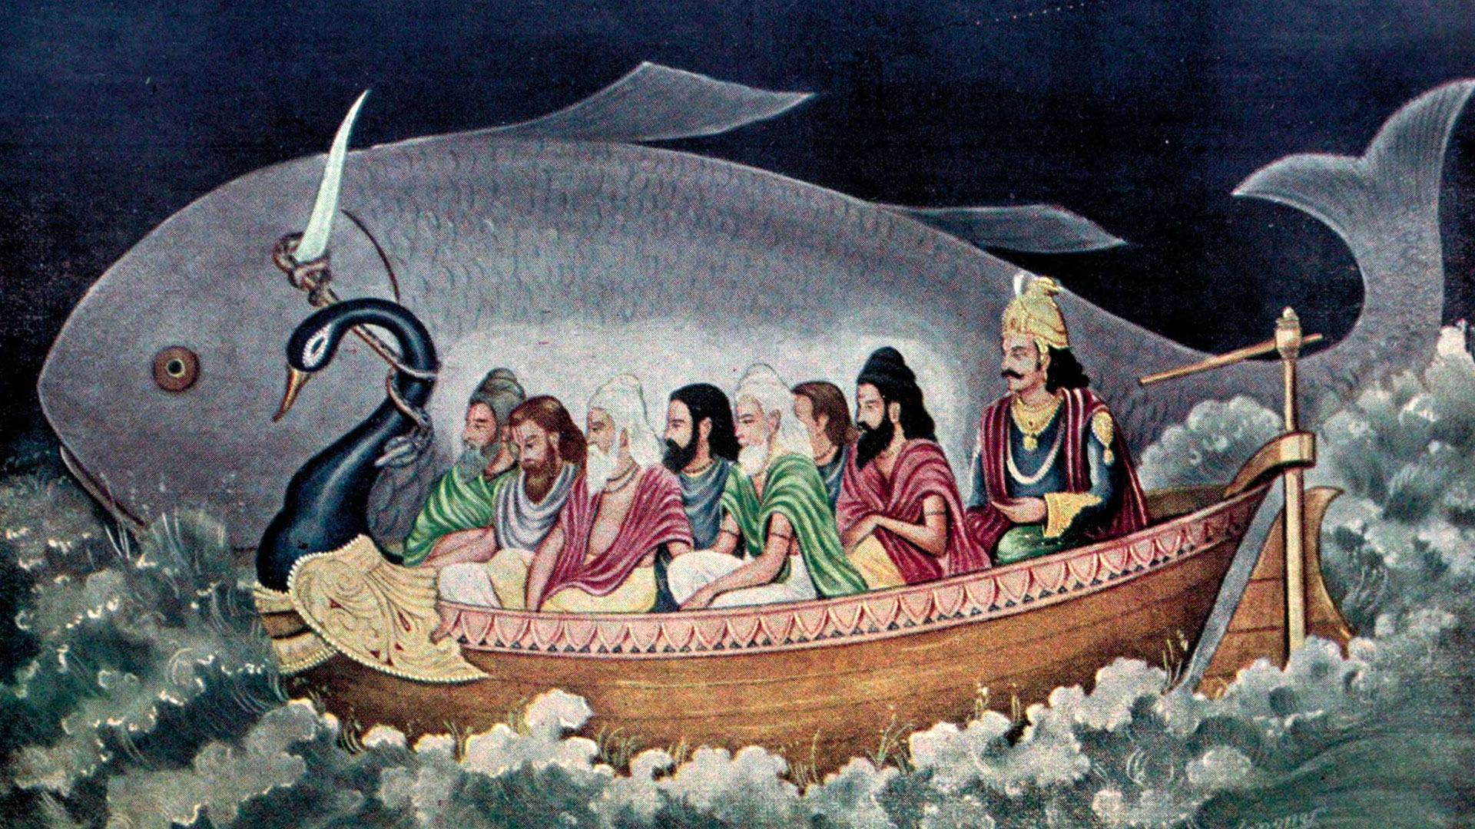
In Hindu teachings, Manu, or the first man, was visited by a fish, Lord Vishnu. Vishnu told Manu that the world would be destroyed in a great flood. Manu built a boat and tied it to the horn of the great fish. The fish guided Manu’s boat through the floods and, not surprisingly, to the top of a mountain. When the floodwaters receded, Manu performed a ritual sacrifice and poured butter and sour milk into the sea. After a year, a woman rose from the water and announced herself as “the daughter of Manu.” So it is Manu and his “daughter” that repopulate the earth.

Slide 13
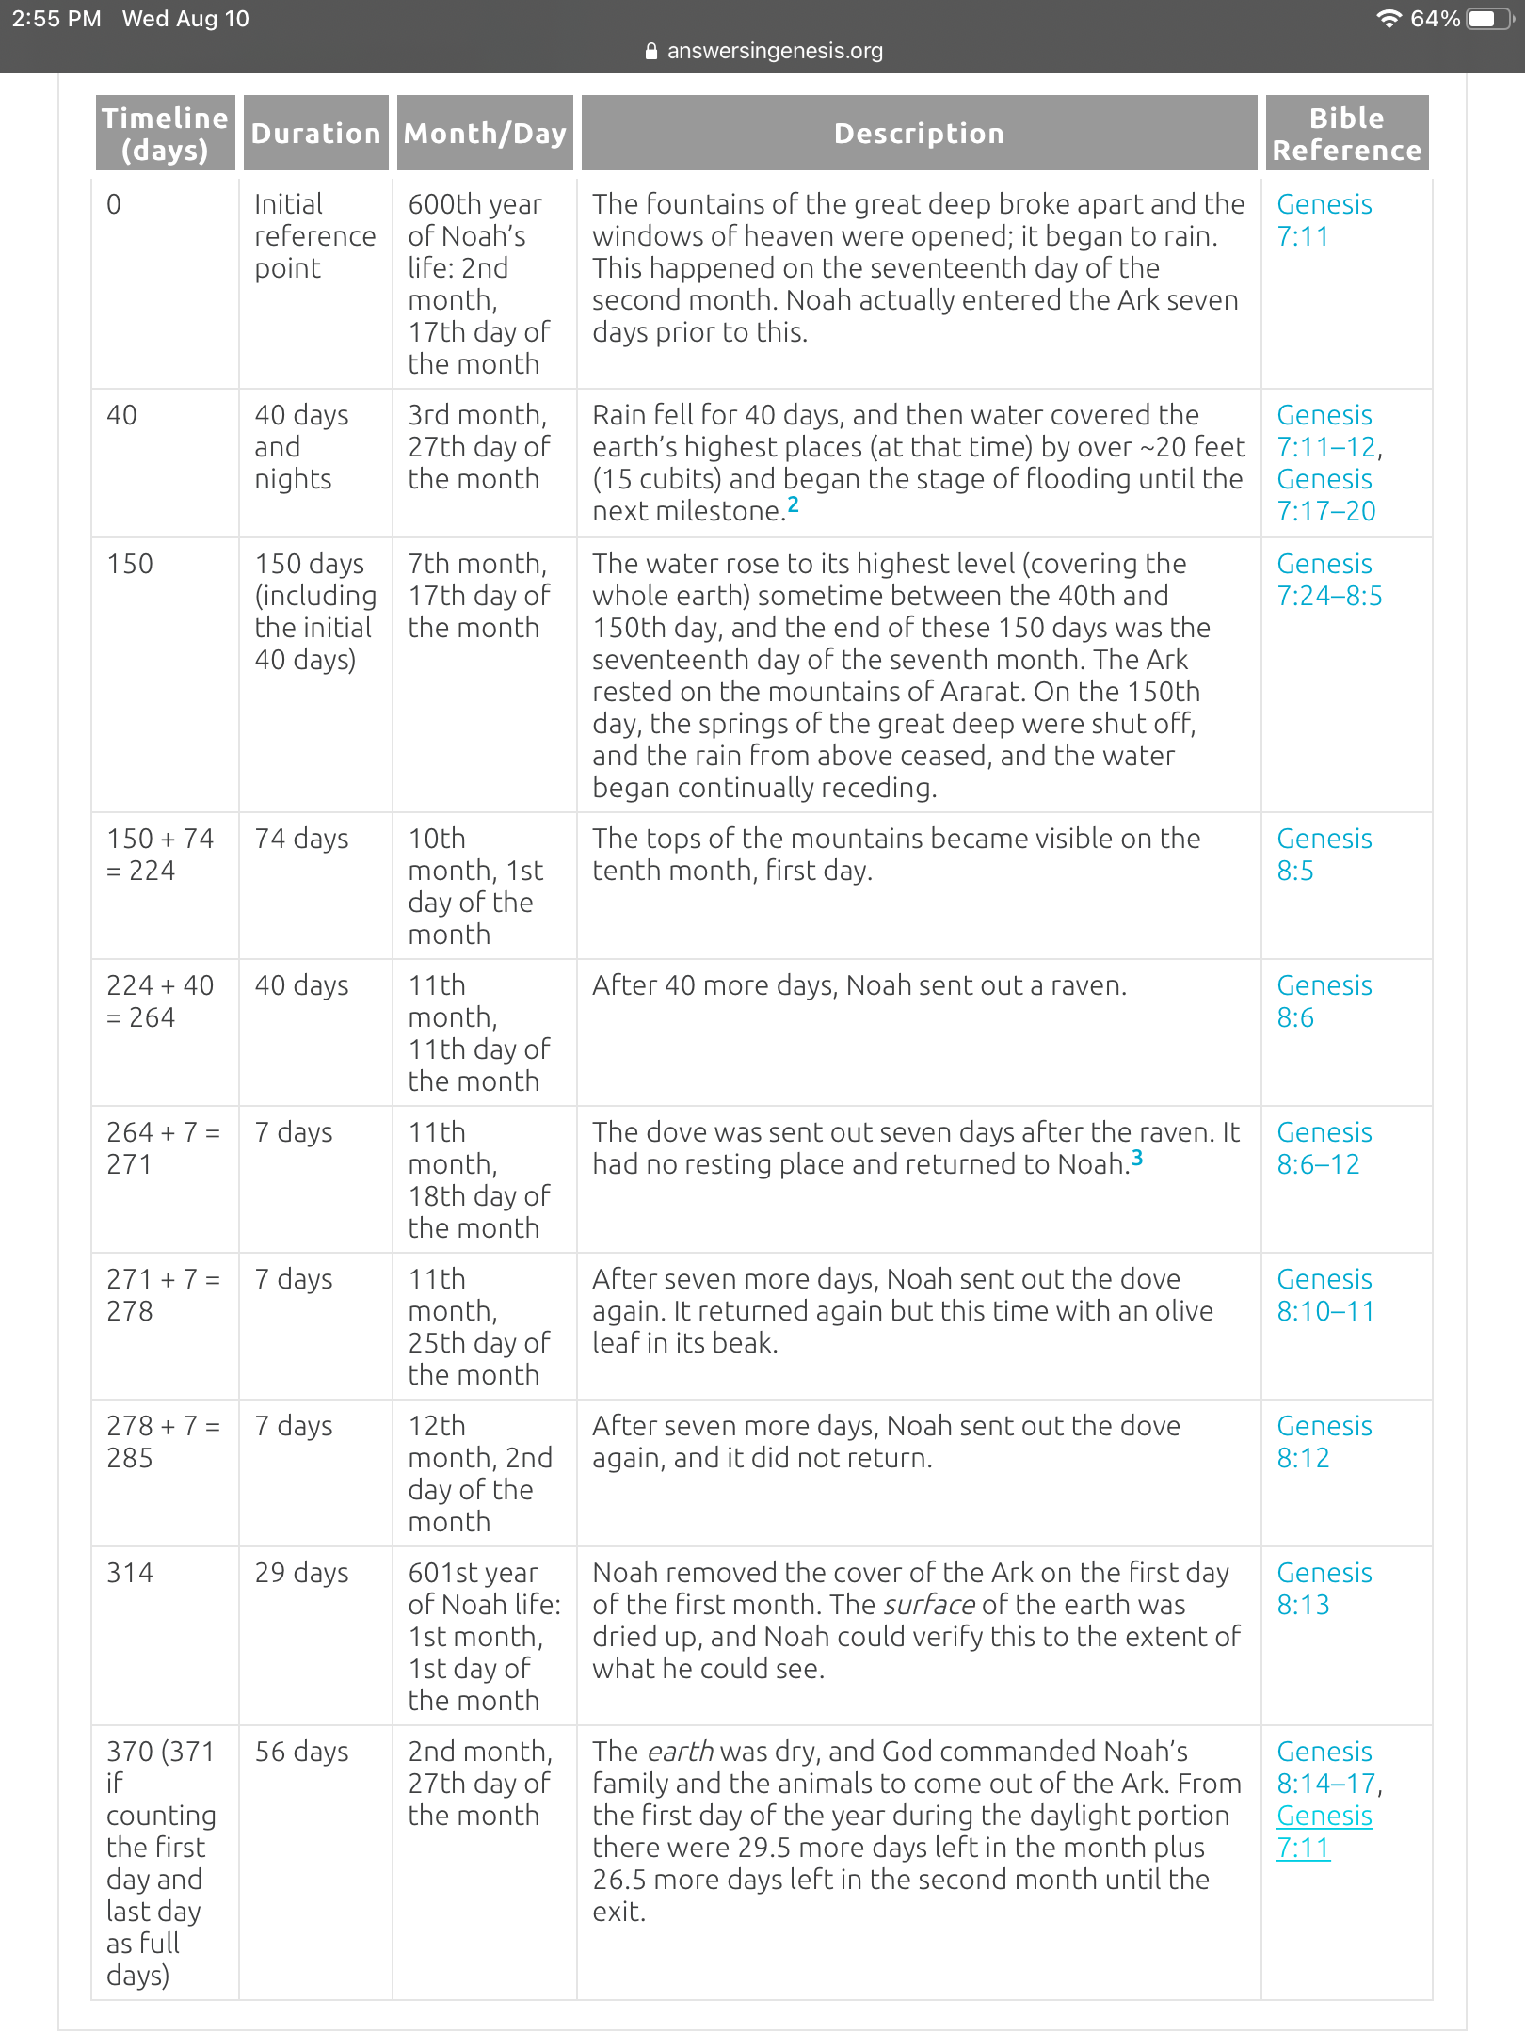

ancient Egypt , China , and Japan , and the sacred mountain is called to - day by the Arabs “ Allah's Lat ” ( or male organ ) , which is the same as “ Arah's Rat , " or Ararat . So the Ark ( the fertile female ) rested on Allah's Lat , and brought forth life , an account of a sexual creation . It was 284 days on the " waters , ” the period of woman's gestation , when “ life " issued from the “ Ark . "

Slide 14
The Purpose of Giants

Slide 15
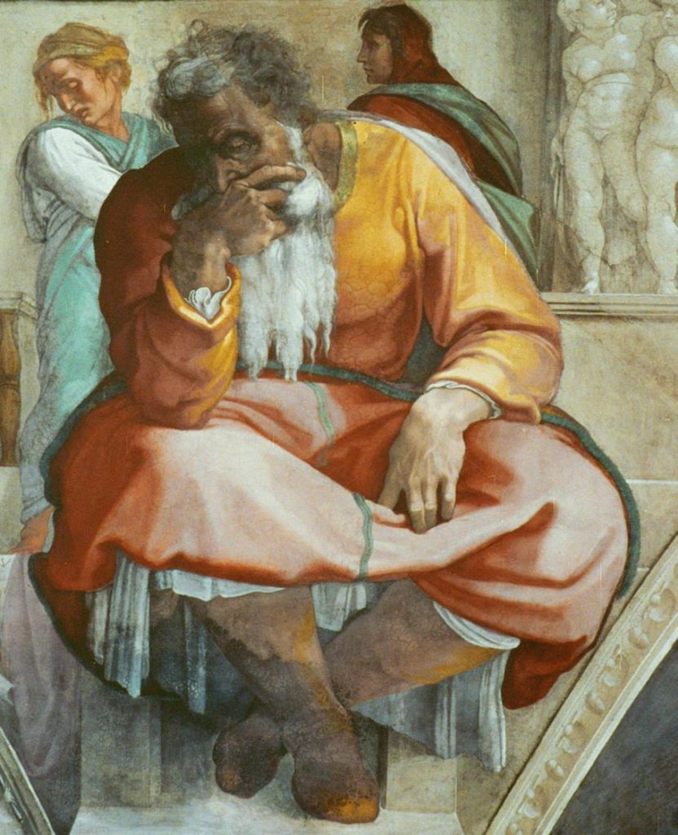
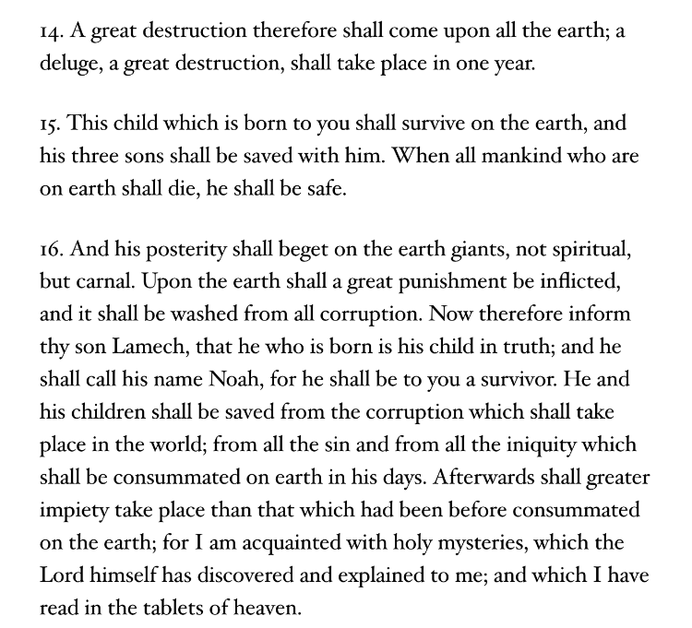
Book of Enoch Chapter 105

Slide 16
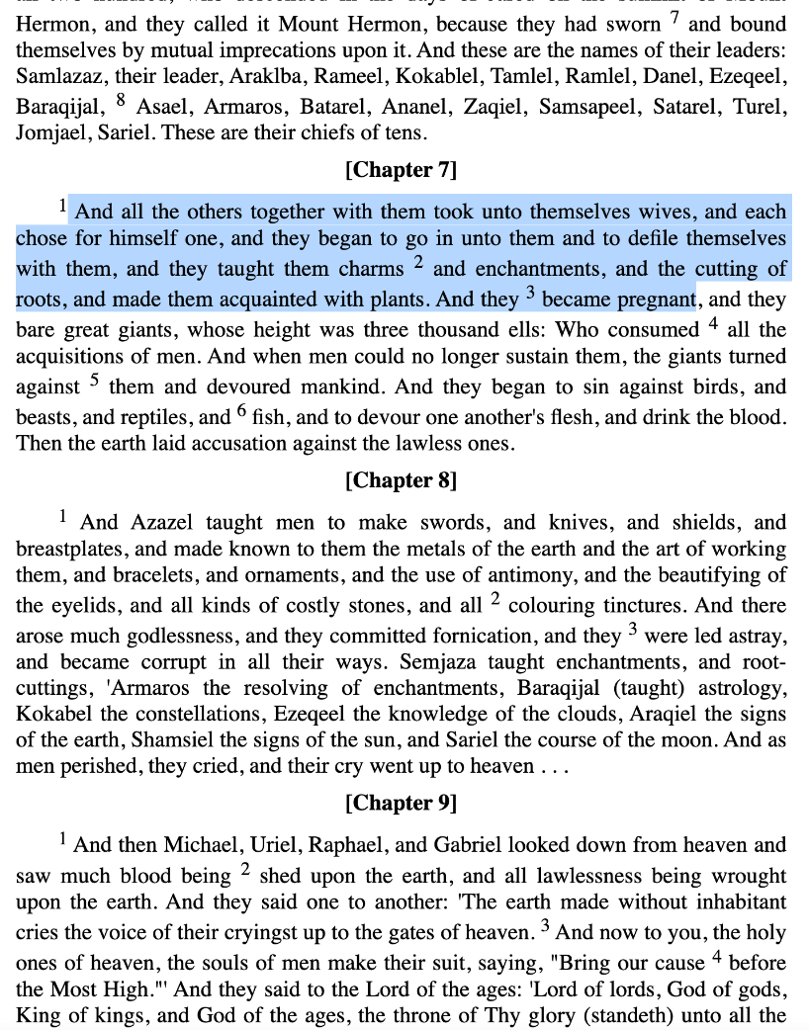
Notes:
Genesis 9:23, NIV: But Shem and Japheth took a garment and laid it across their shoulders; then they walked in backward and covered their father's naked body. Their faces were turned the other way so that they would not see their father naked.

Slide 17
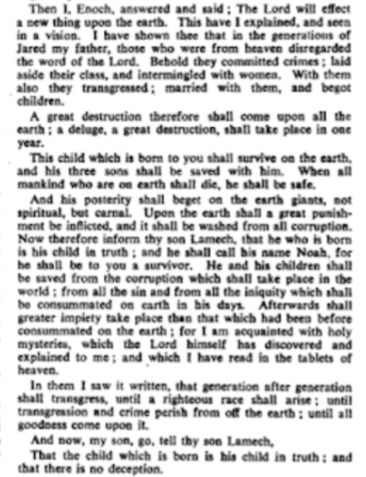
Enoch, from the line of Seth, understood the purpose of trauma.
Notes:
The Book of Enoch was written about 200 BCE. Fragments of the Book of Enoch were found among the Dead Sea Scrolls. One of the most interesting descriptions in the book is about the birth of Noah.
"the flesh of which was white as snow, and red as a rose; the hair of whose head was white like wool, and long; and whose eyes were beautiful. When he opened them, he illuminated all the house, like the sun".

Slide 18
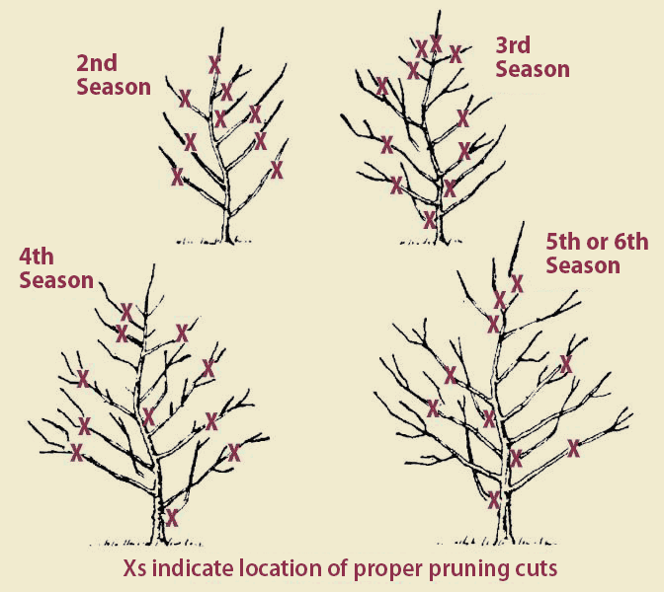
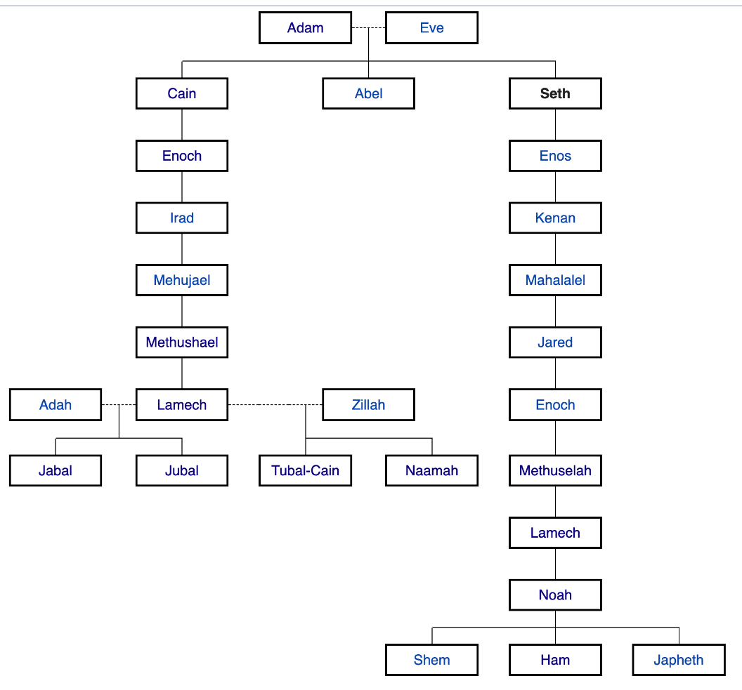
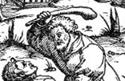
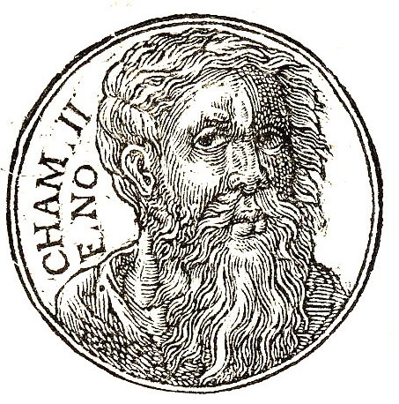
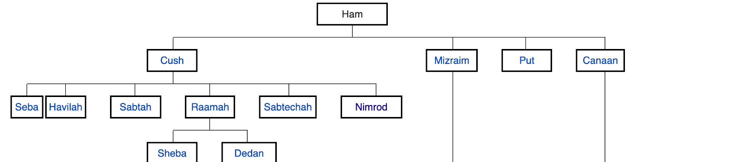
1st Adam and Eve LXXVIII:16[10] says "Then on the morrow Adam said unto Cain his son, 'Take of thy sheep, young and good, and offer them up unto thy God; and I will speak to thy brother, to make unto his God an offering of corn.'"
Cain’s seed was cursed and sown
Ham’s seed Canaan was cursed and sown
Notes:
The Book of Enoch was written about 200 BCE. Fragments of the Book of Enoch were found among the Dead Sea Scrolls. One of the most interesting descriptions in the book is about the birth of Noah.
"the flesh of which was white as snow, and red as a rose; the hair of whose head was white like wool, and long; and whose eyes were beautiful. When he opened them, he illuminated all the house, like the sun".

Slide 19
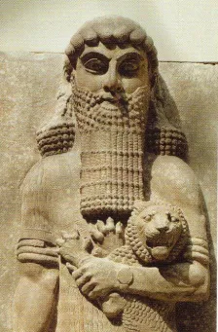
Reset Implications
The idea that humans are evil/broken or that humans know too much is contradicted by certain humans being selected to persist.
This tells us, humans are valued and prolific and are plucked and refined. The implication of overpopulation is there which suggests a creator has limited real estate.

