Slide 1
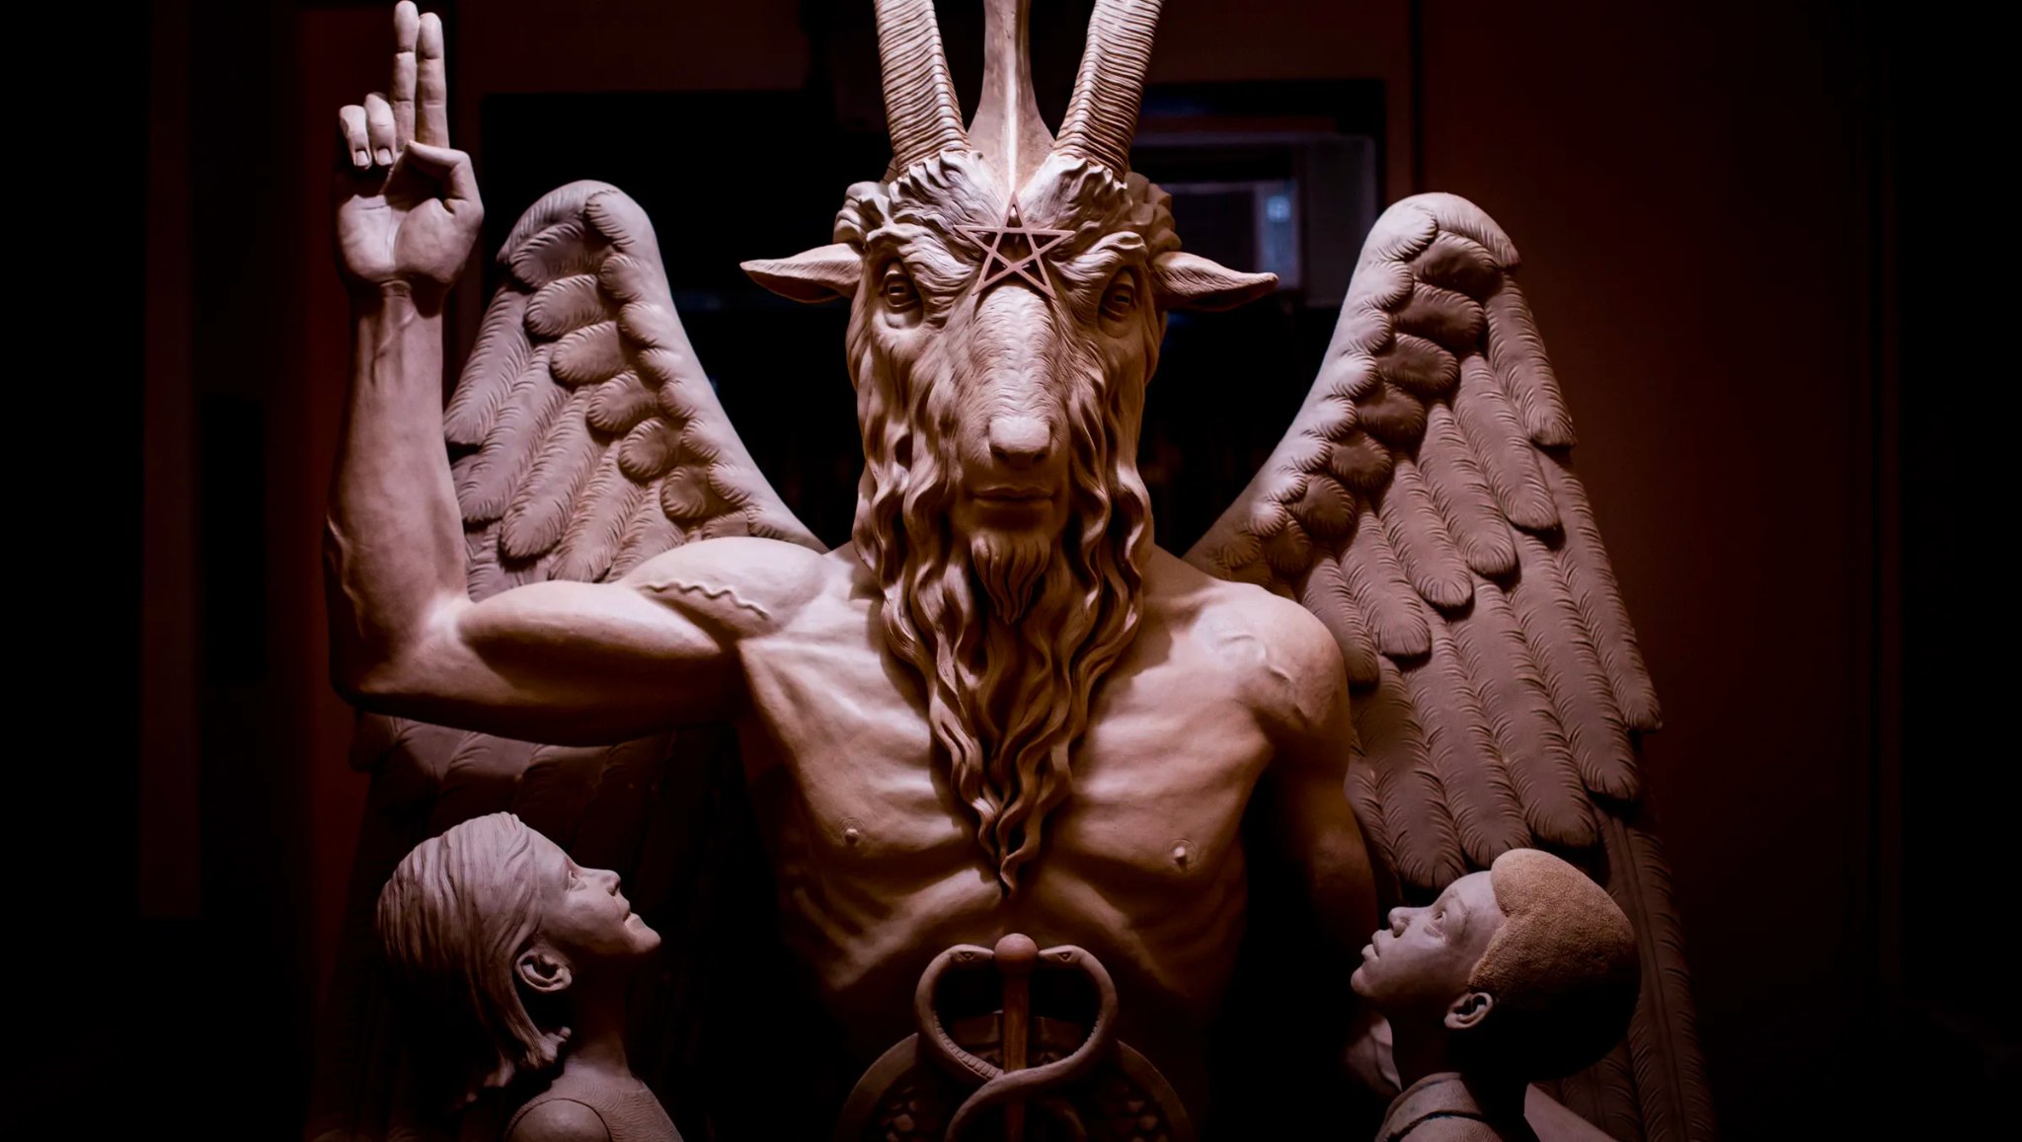

Slide 2
Mechanics of Mythology
The more a story resonates the archetype the more it lingers in society’s mind.

Slide 3
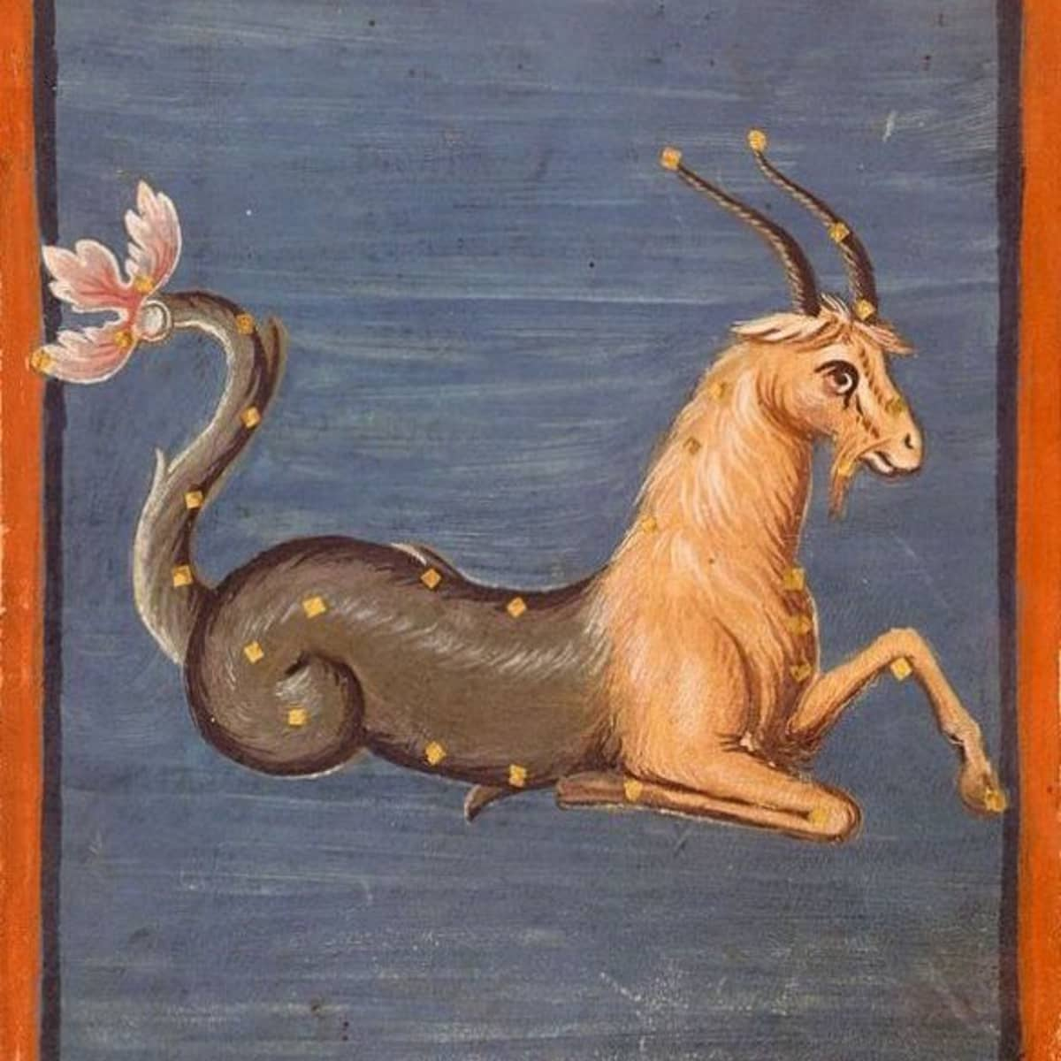
Abraxas - > Aegipan -> Pan - > Capricorn -> Baphomet

Slide 4
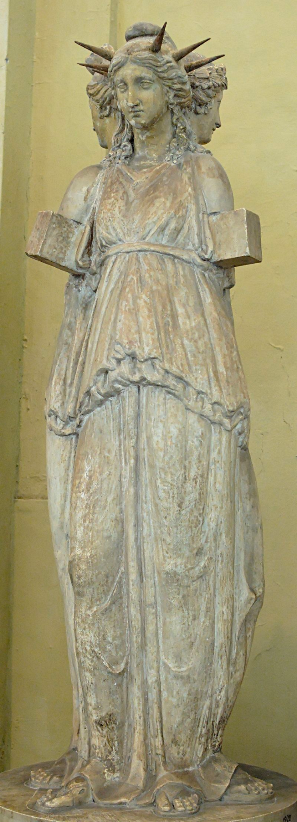
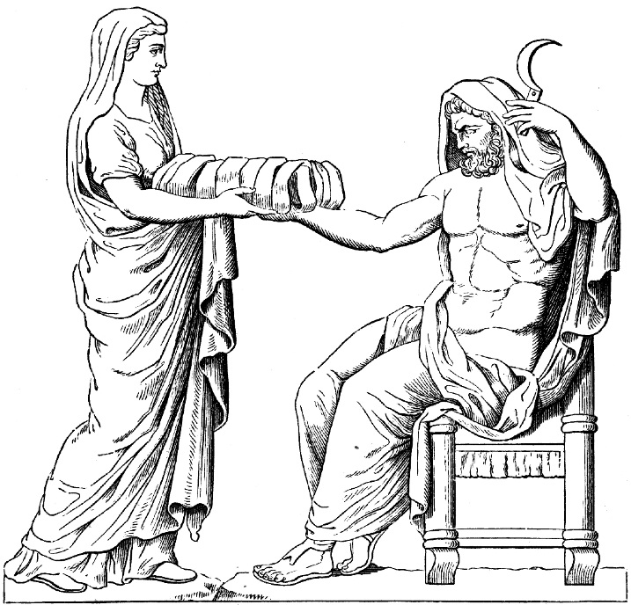
The Twelve Titans were twins
Oceanus and Tethys
Hyperion and Theia
Coeus and Phoebe
Cronus and Rhea
Mnemosyne and Themis
Crius and Iapetus

Slide 5
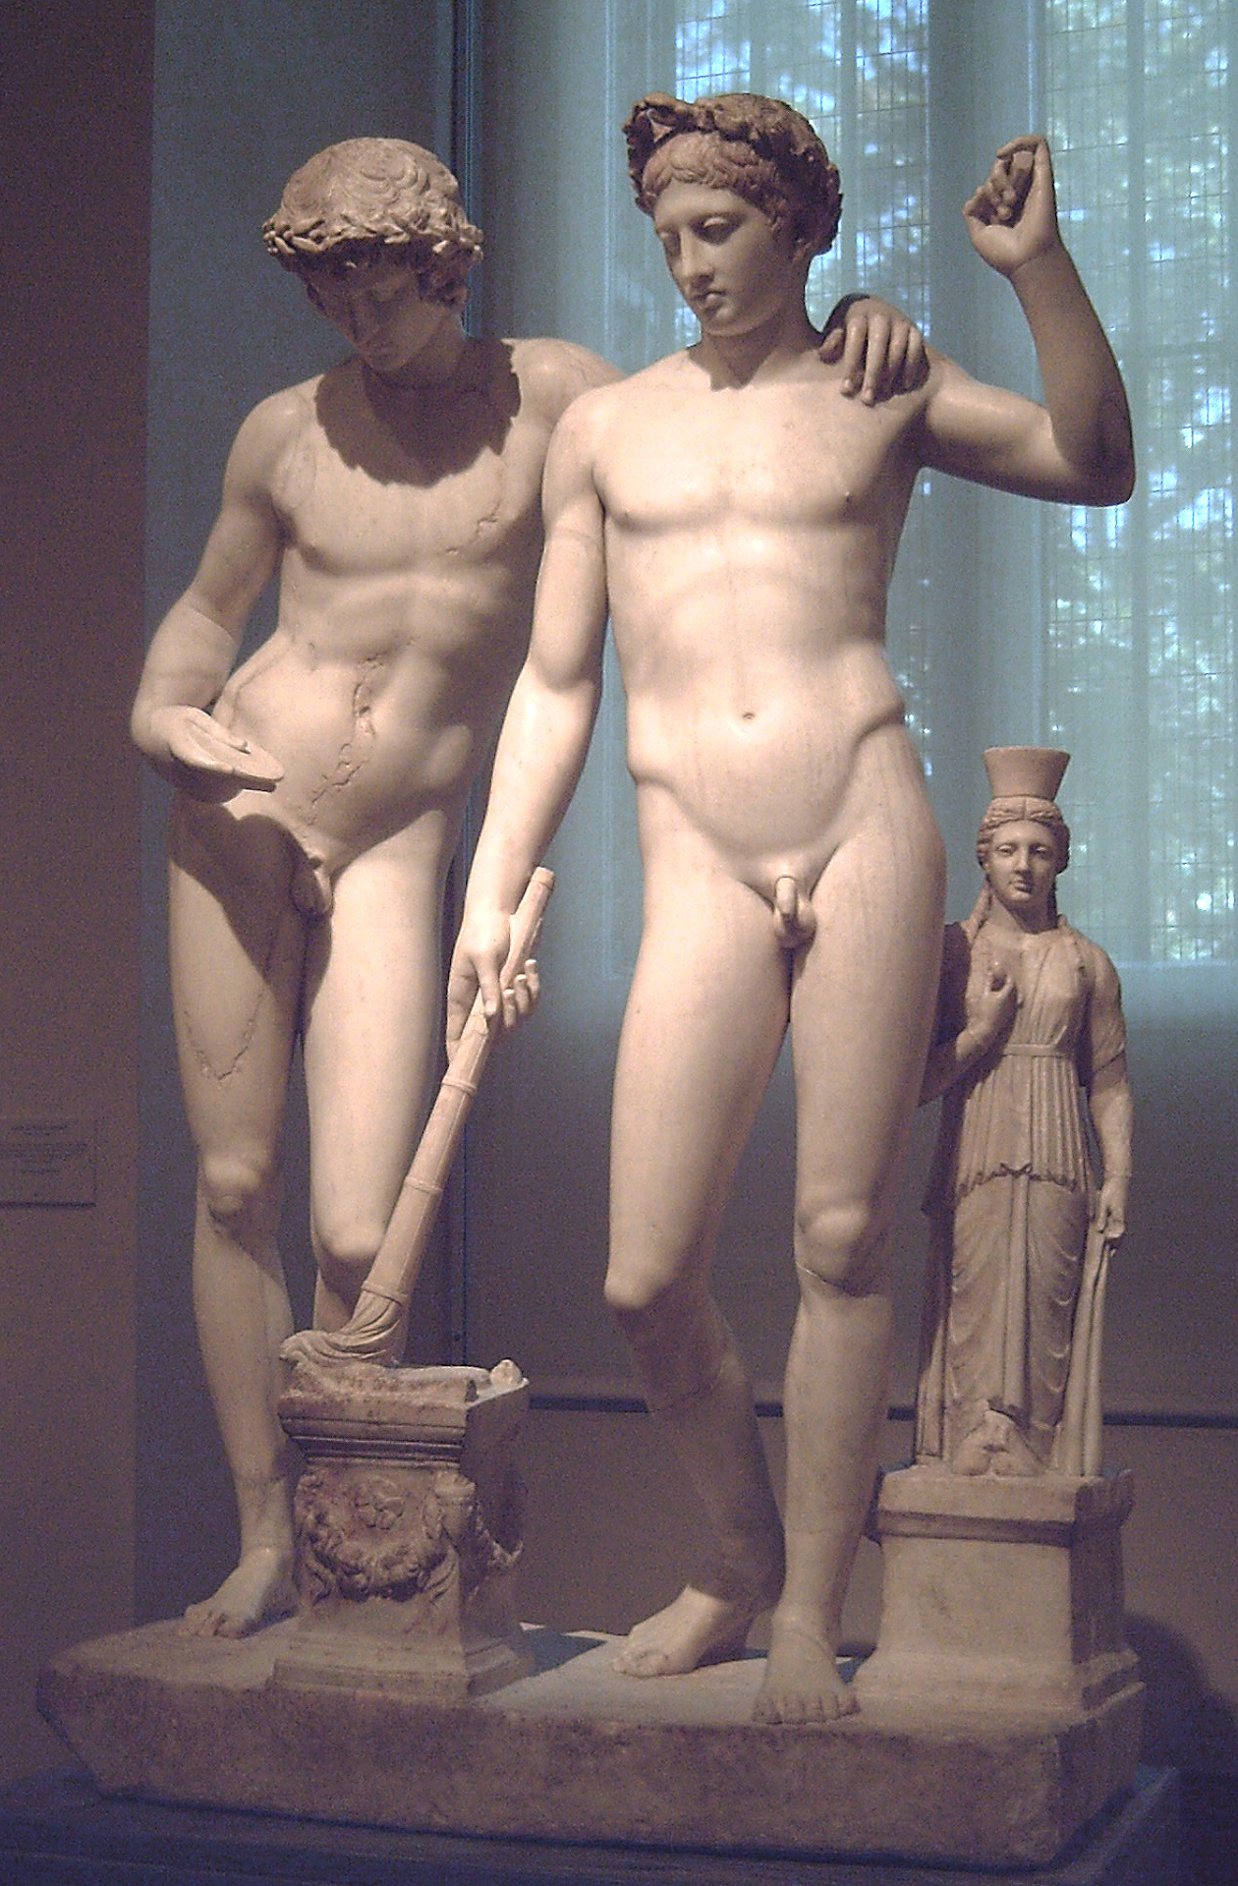
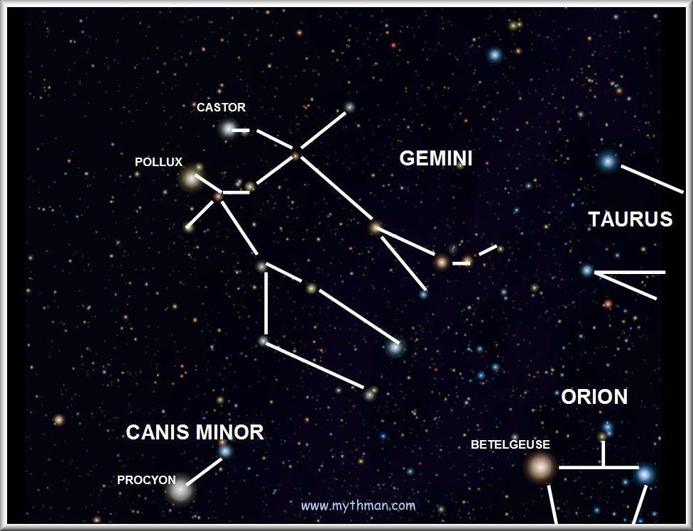
Castor/Pollux (Twin sons of Zeus):
Founders of Rome

Slide 6
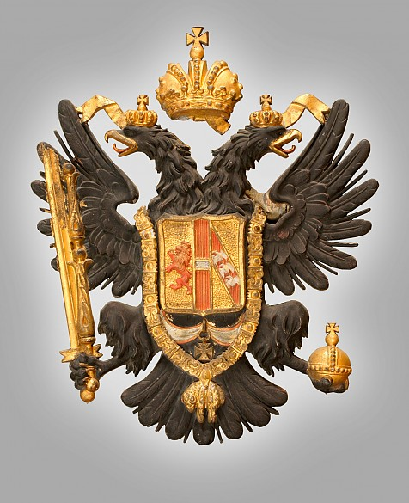
Double-headed eagle could be seen as a symbol of elite hermaphrodite

Slide 7
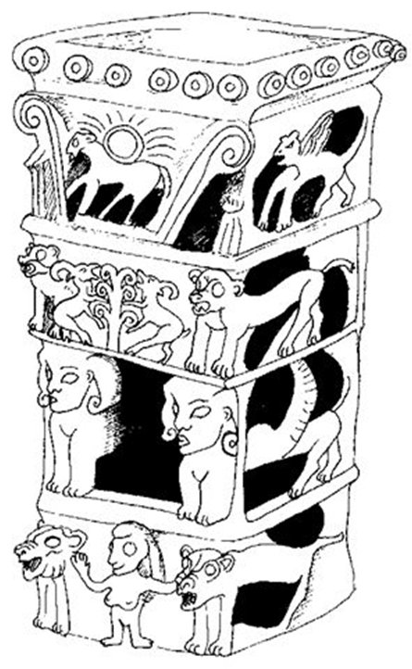
I have blessed you by Yahweh of Samaria and his Asherah

Slide 9
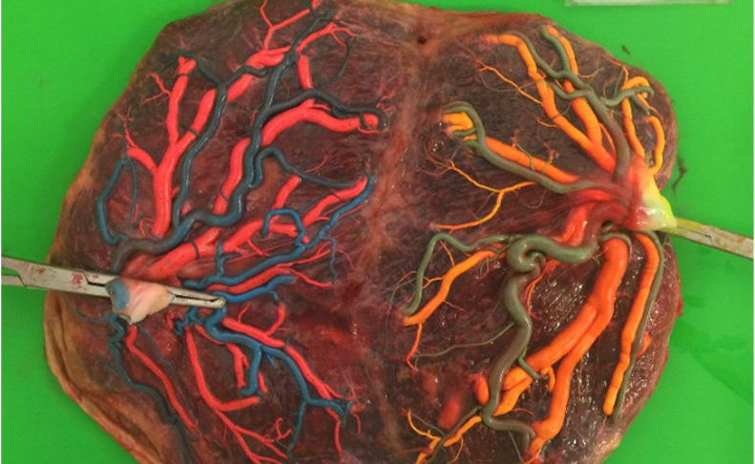
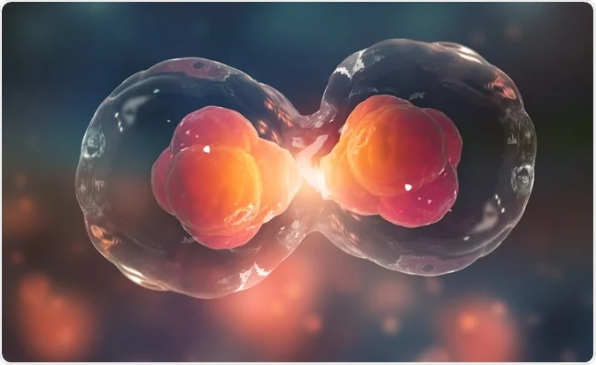
Pregnancy looks like mitosis. The very act of separation is life.

Slide 10
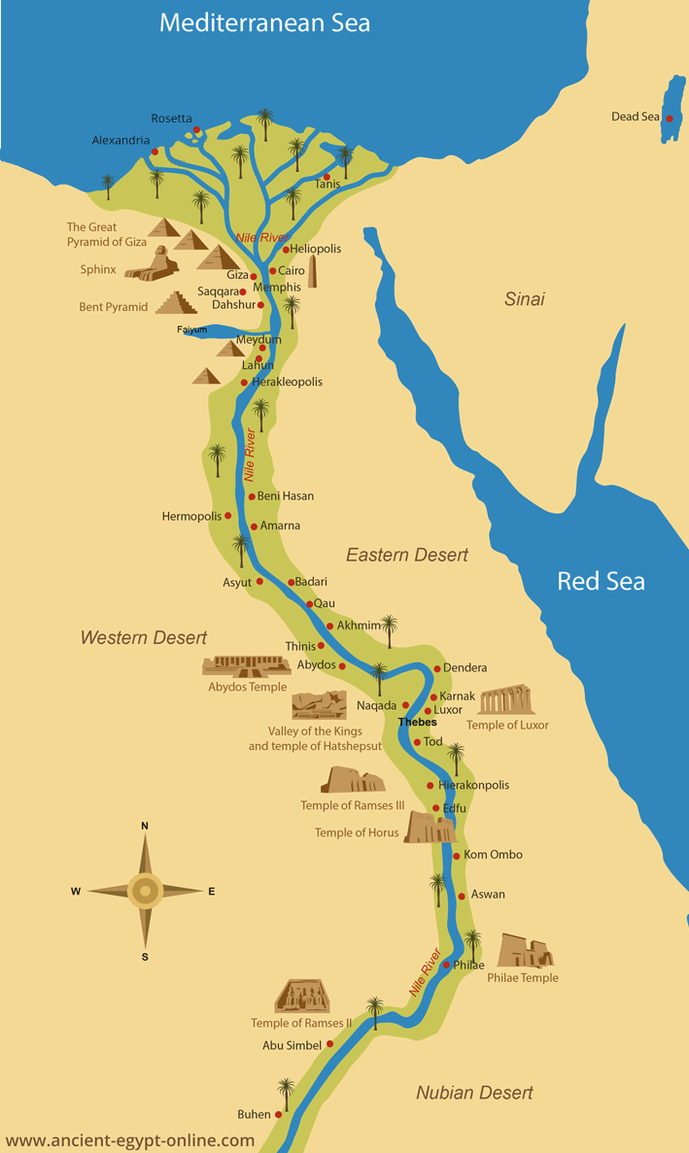
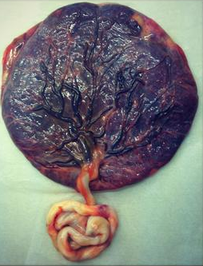
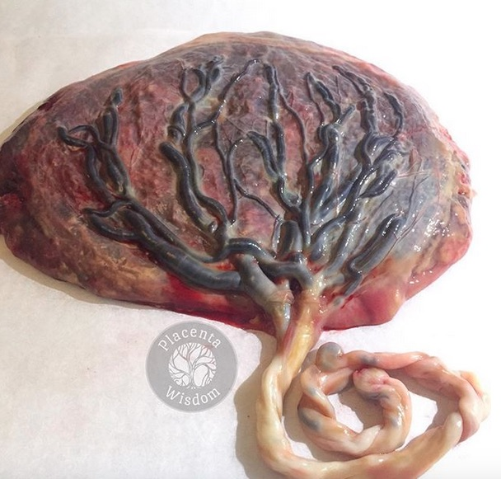
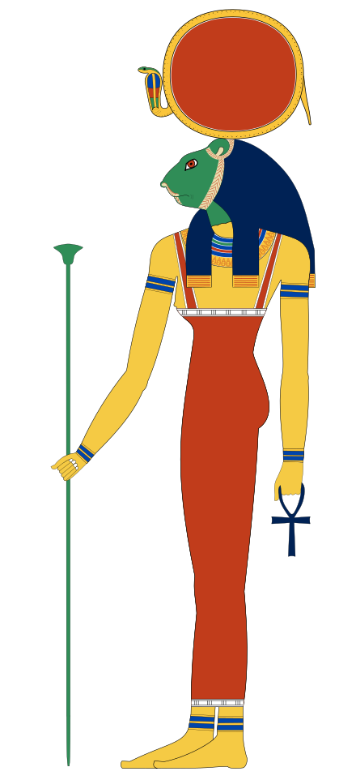
Out of Africa Land of Black
Thebes/Karnak = white chapel
Memphis/Saqqara = white wall

Slide 11
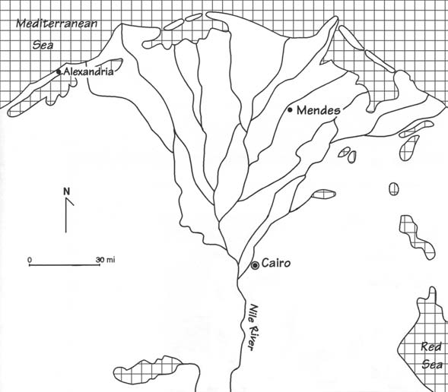
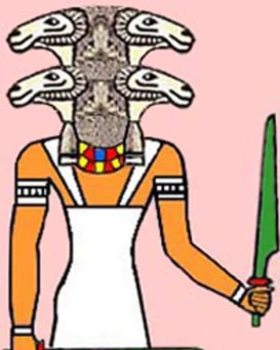
Banebdjedet
(Ba of the Lord of Djedet),
Djedet

Slide 12
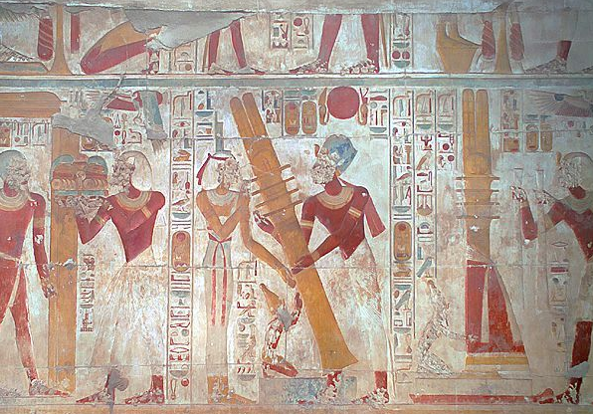
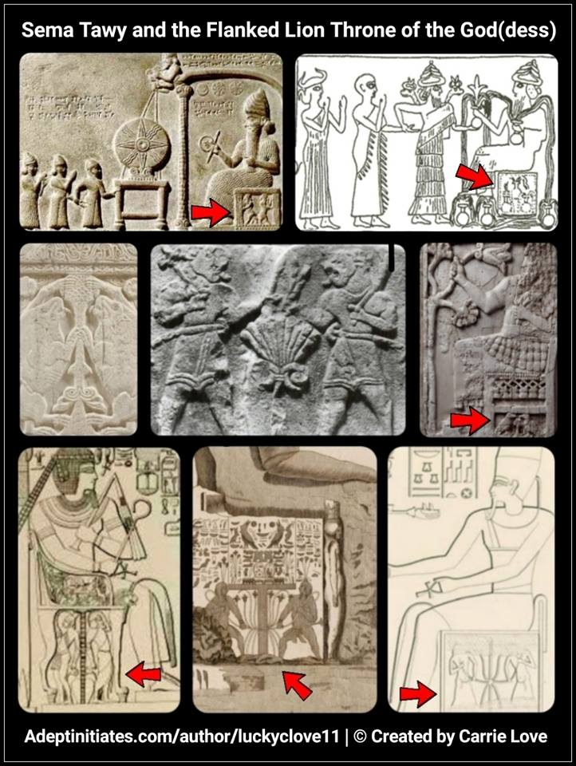
Sema Tawy is a symbol from Ancient Egypt said to represent the union of Upper and Lower Egypt, composed of two heraldic plants. One being the papyrus representing Lower Egypt, and the other a lotus flower representing Upper Egypt, tied together with the hieroglyph symbolizing their union. The act of tying the two plants together was performed by two gods, often Hapi, the double hermaphroditic divinities of the Nile, but could also be depicted with Tot (Thoth) and Horus, or the duality of the antagonistic gods Horus and Seth.

Slide 13
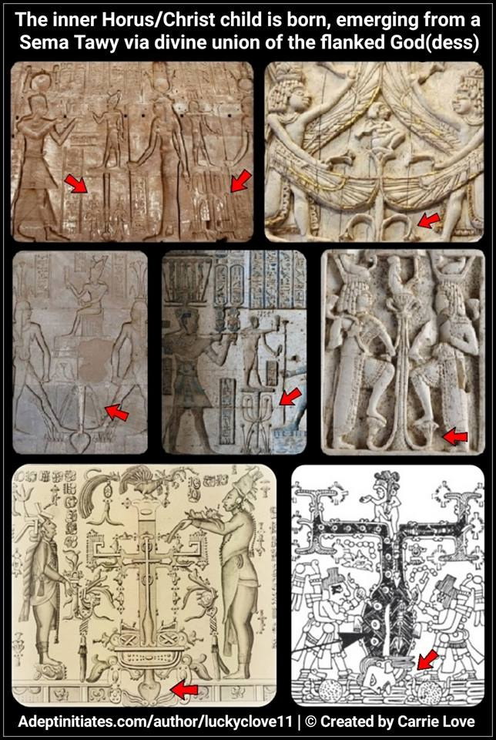
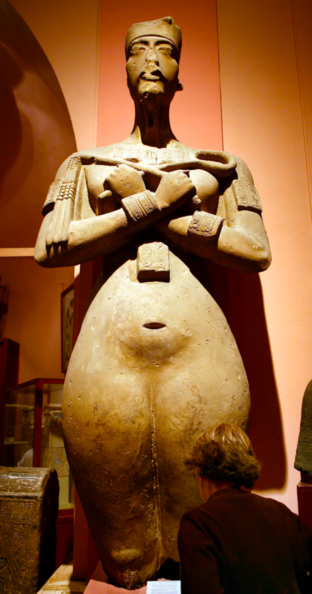
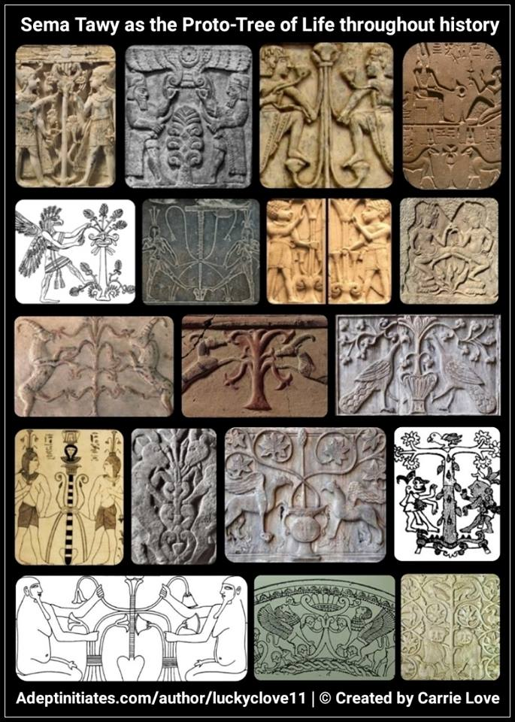

Slide 14
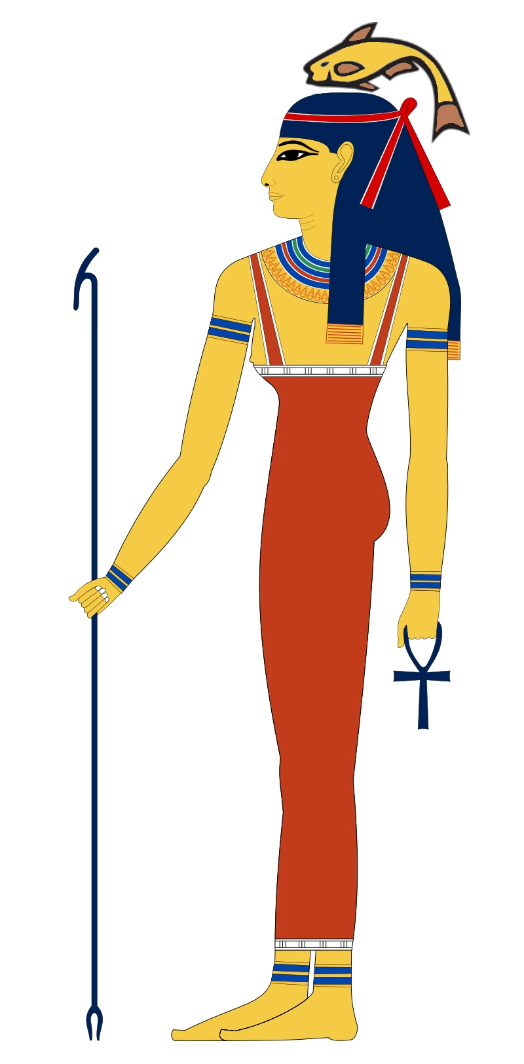
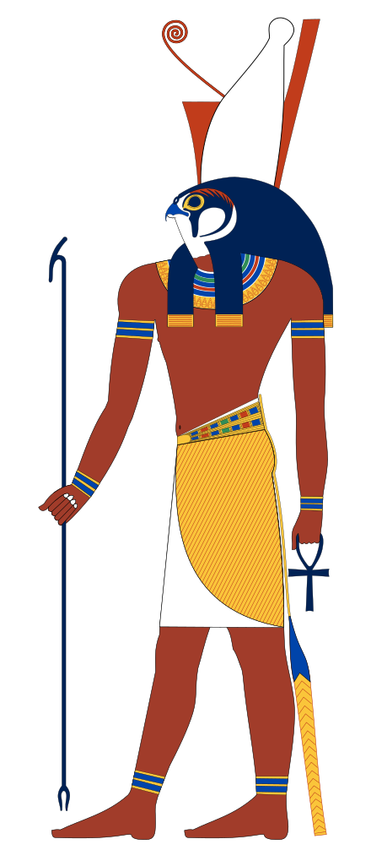
Banebdjedet was the Ba of Osiris, and his consort, the fish goddess Hatmehit. With their child Har-pa-khered ("Horus the Child"), they formed the triad of Mendes.

Slide 15
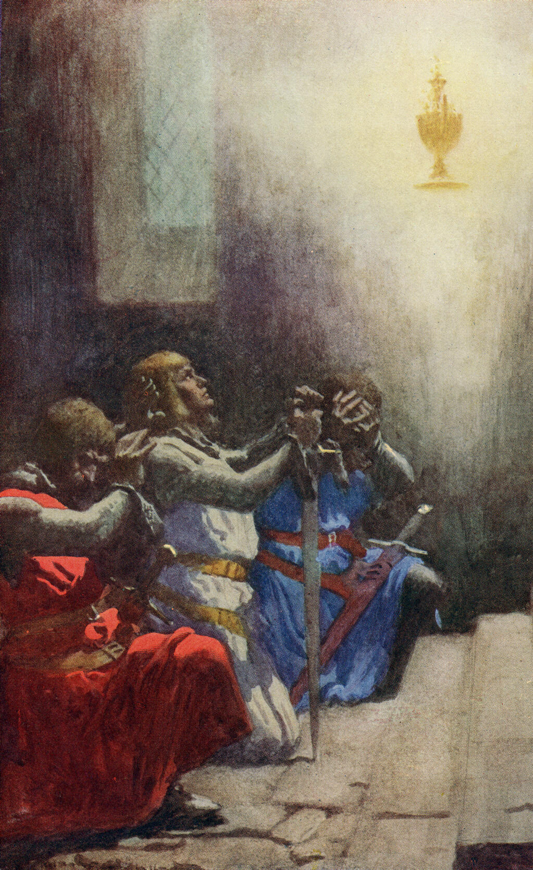
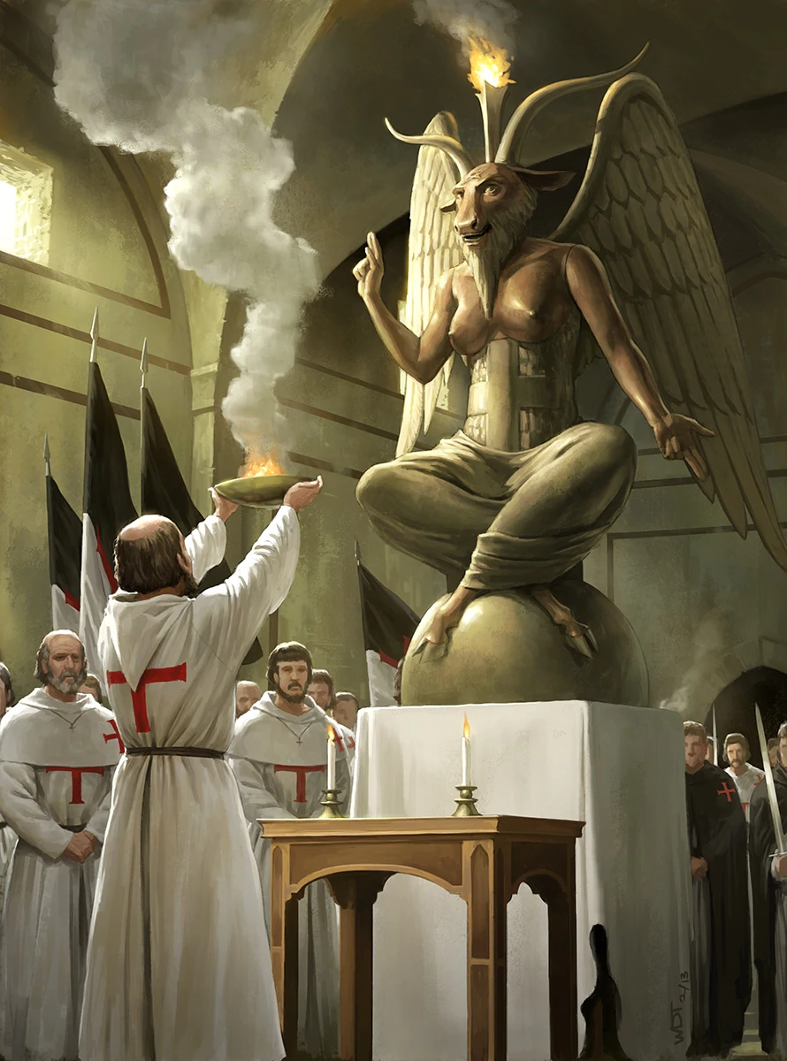
How does the Knights Templar, a group in quest for the grail of eternal life, end up worshipping the Baphomet?

Slide 16
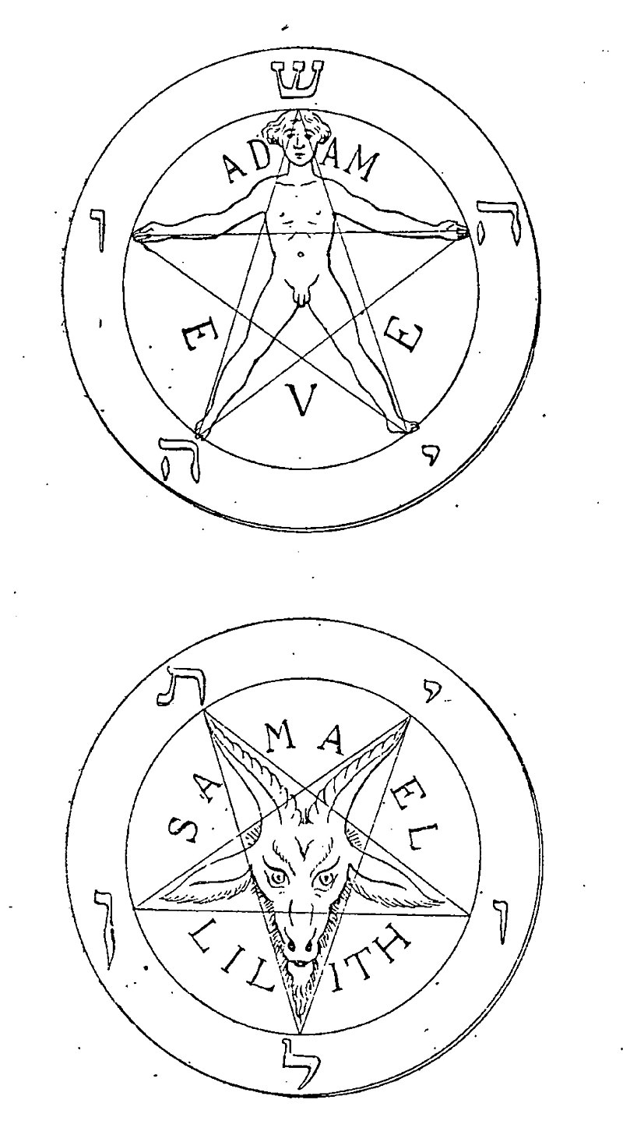
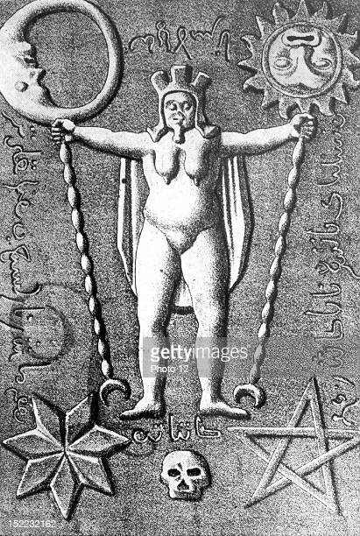
AEdam
Sun and Moon united
The sacred hermaphrodite

Slide 17
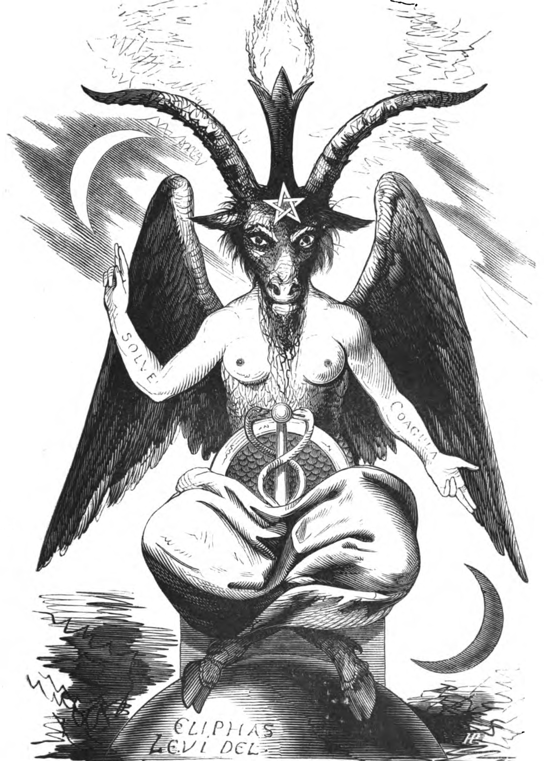

Slide 18
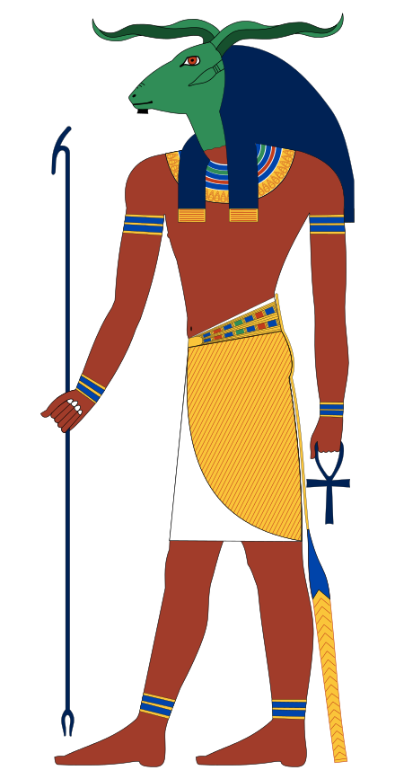
Notes:
Manasaputra is a Sanskrit title derived from two root words, viz. manasa and putra. 'Manasa' refers to the mind, and 'putra' means 'son', or 'progeny'. Manasaputra, therefore, may literally be translated as, 'mind-children' or the 'mind-born'

Slide 19
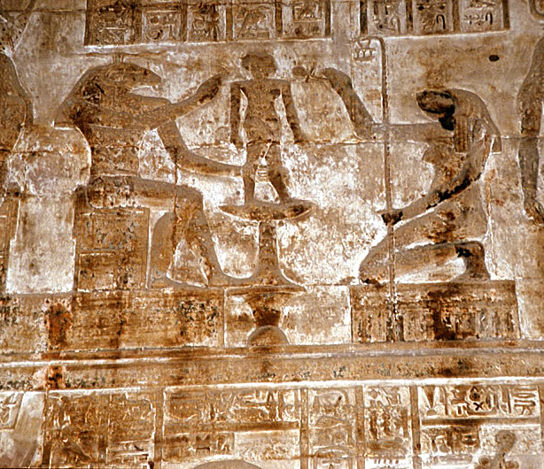
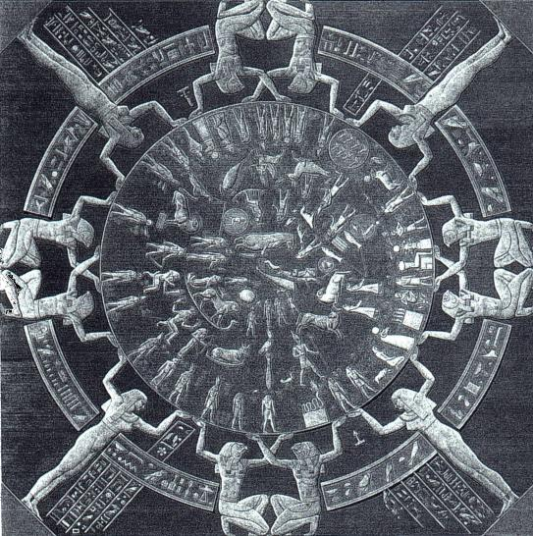
Dendera Temple. Khnum molds Adam from clay. Zodiac we use today.
Notes:
Khnum, accompanied by the goddess Heqet, moulds Ihy in a relief from the mammisi (birth temple) at Dendera Temple complex, Egypt

Slide 20
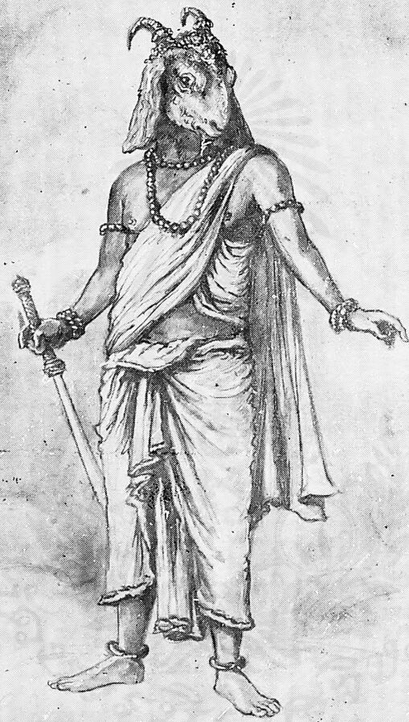
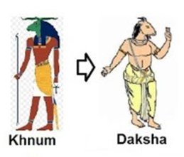
Daksha the Prajapati
"praja" (creation, procreative powers) and "pati" (lord, master)
Notes:
Manasaputra is a Sanskrit title derived from two root words, viz. manasa and putra. 'Manasa' refers to the mind, and 'putra' means 'son', or 'progeny'. Manasaputra, therefore, may literally be translated as, 'mind-children' or the 'mind-born'

Slide 21
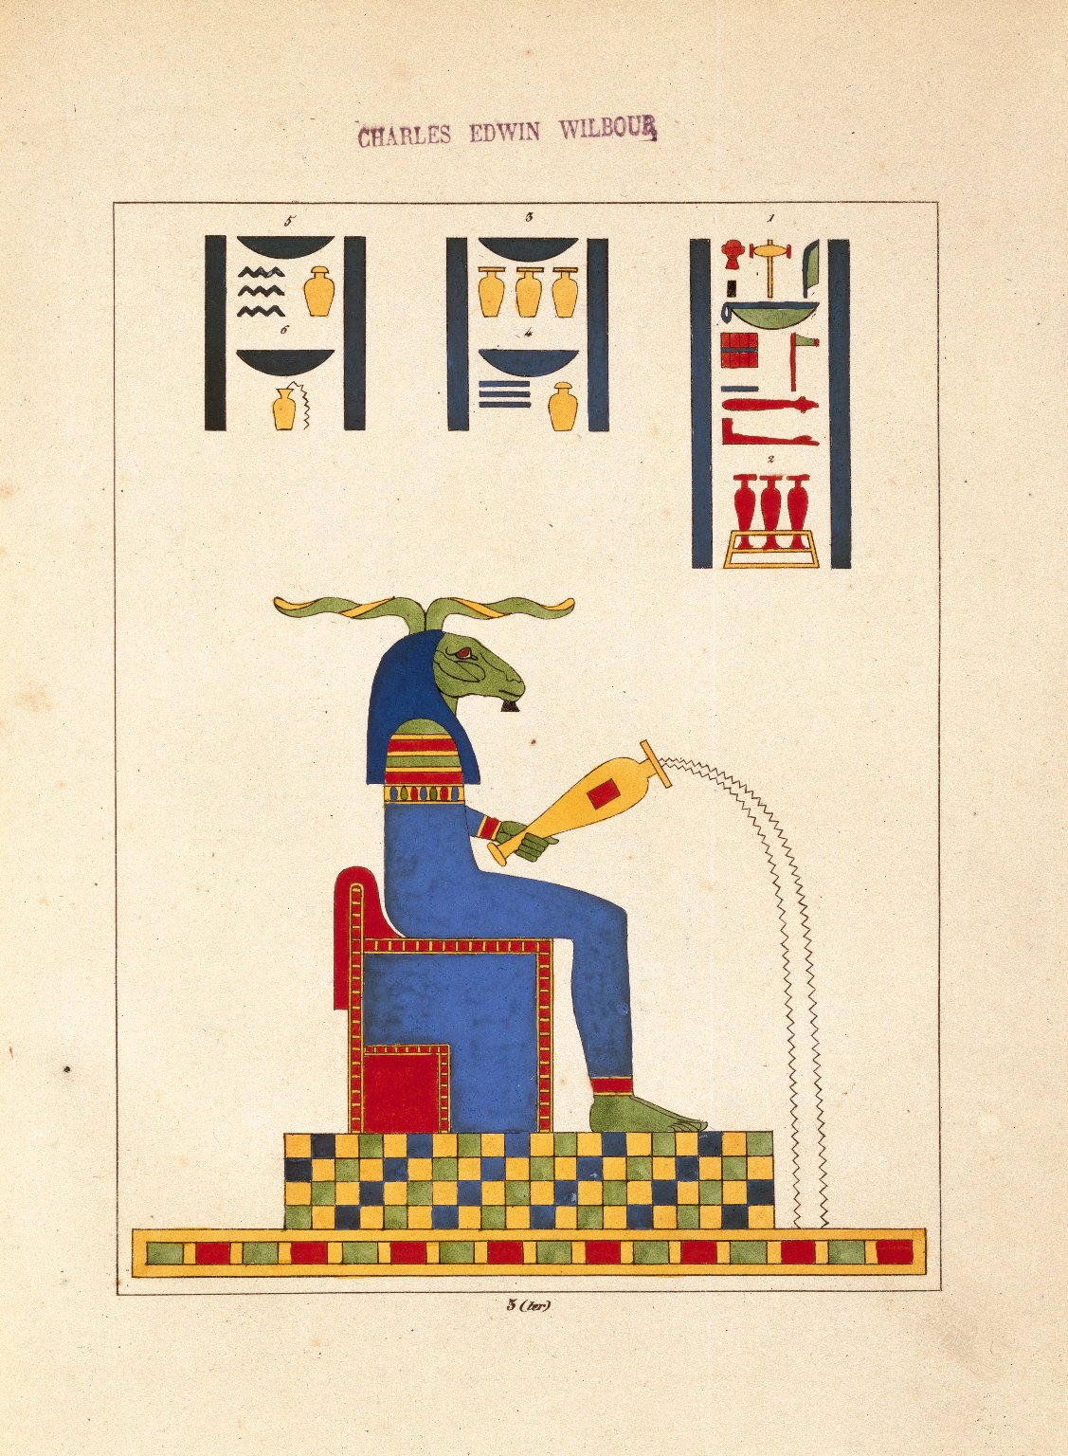
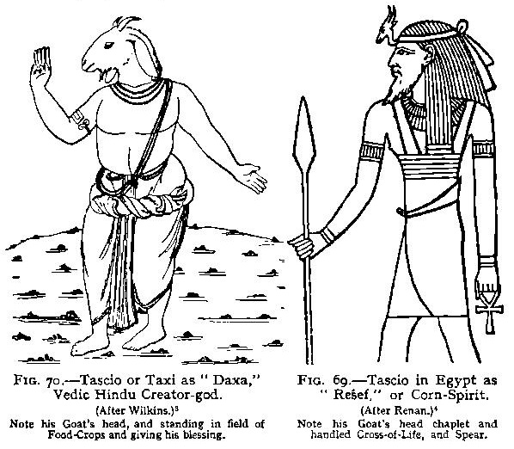
Corn / seed

Slide 22
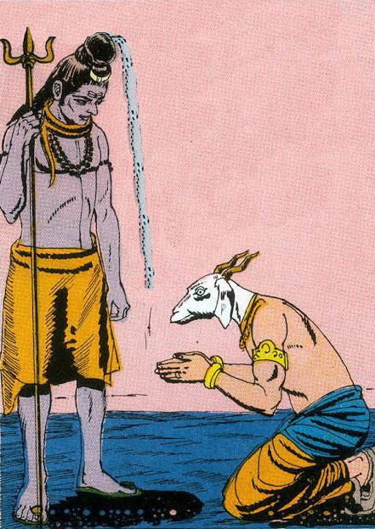
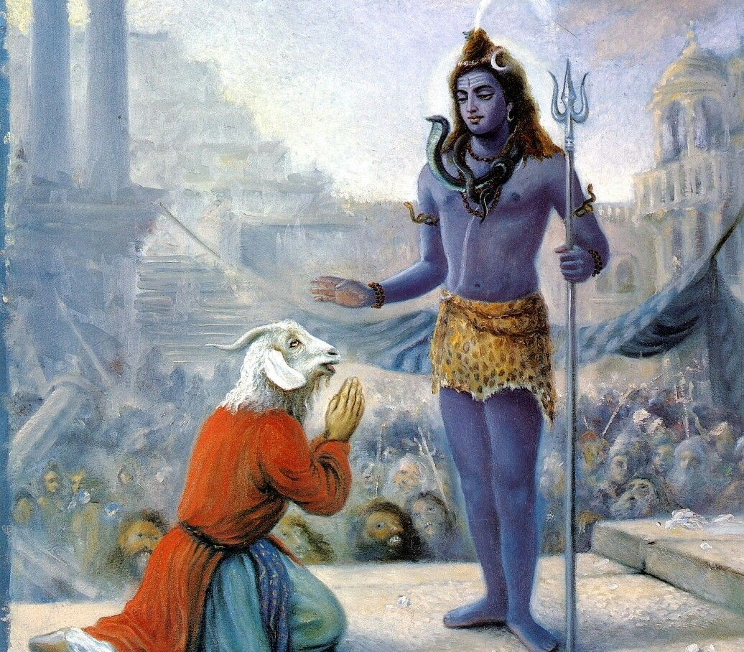
The Origin of the Lamb of God

Slide 23
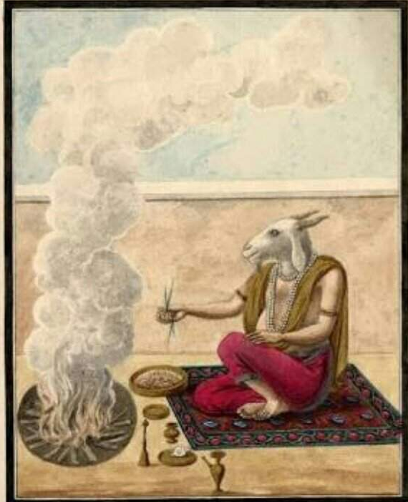
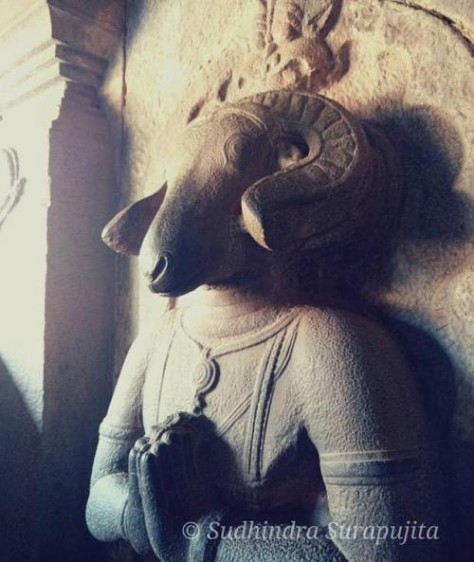

Slide 24
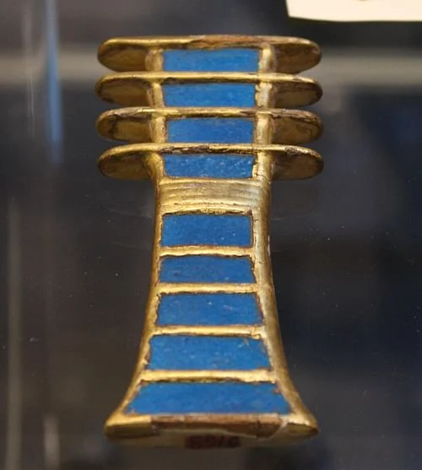
The djed is an ancient Egyptian symbol for stability which features prominently in Egyptian art and architecture throughout the country's history. `Stability' should be understood to mean not only a firm footing but immutability and permanence.

Slide 25
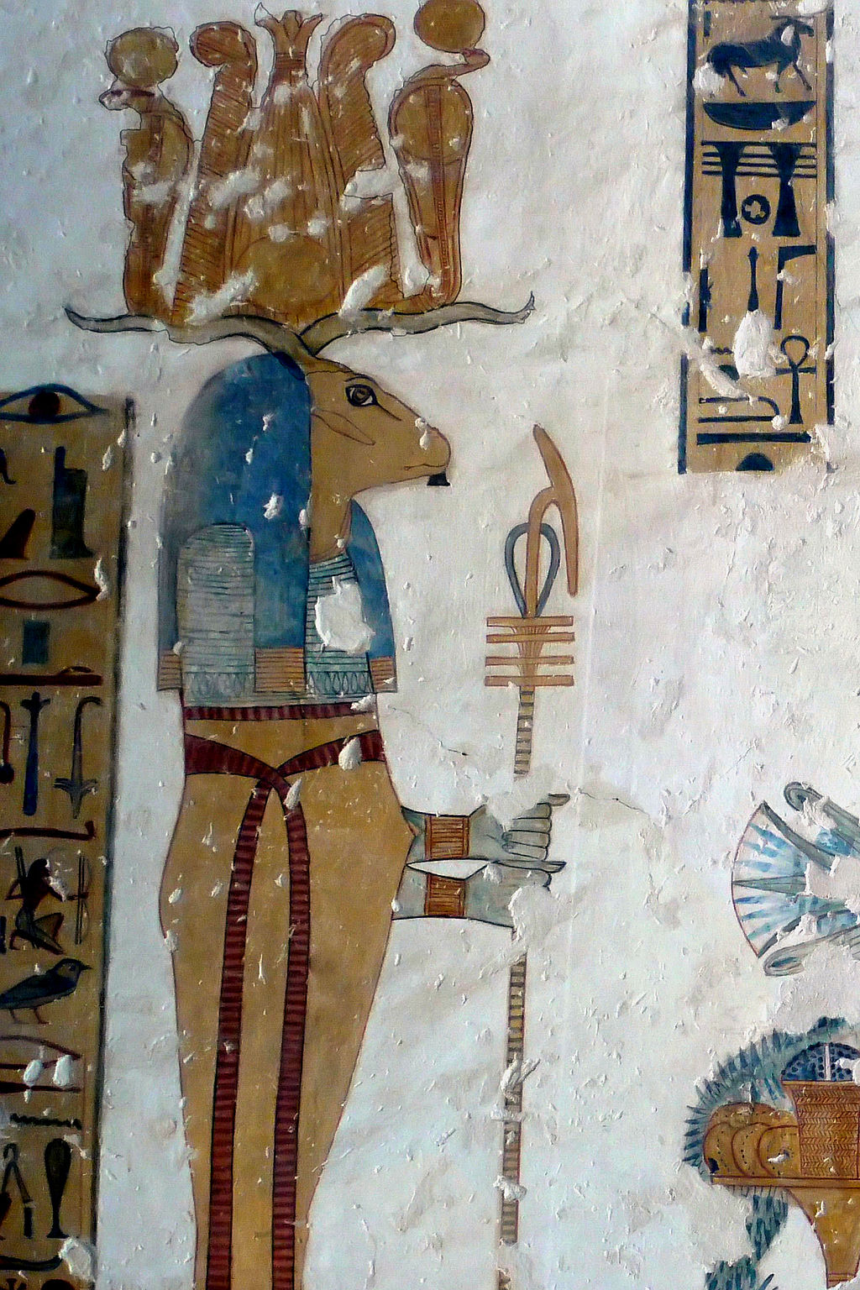
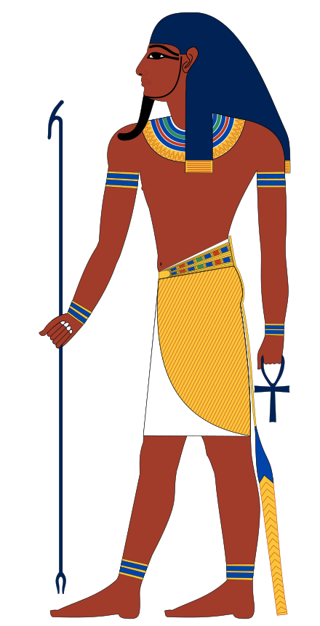
The god Banebdjedet (Baphomet) with a scepter combining the was and djed with the ankh
King’s Valley (KV) tomb No.19 belongs to Prince Mentuherkhepsef, a son of pharaoh Ramesses IX. It was originally designated to be the burial place of pharaoh Ramesses VIII until this king’s premature death aborted this plan. KV19 is only partly decorated but it features some of the finest reliefs dating to the Late New Kingdom period of Egypt.
Notes:
His wife was the goddess Hatmehit ("Foremost of the Fishes")

Slide 26
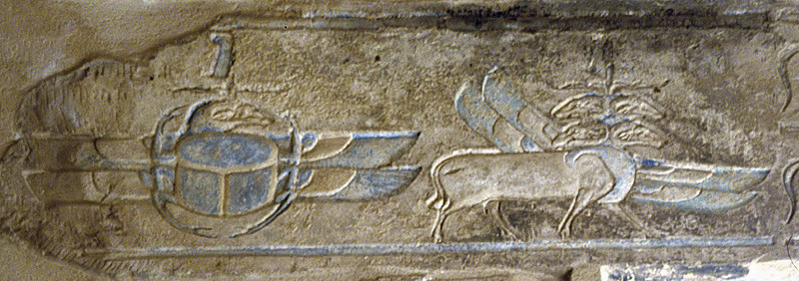
Baphomet before the Scarab
Notes:
His wife was the goddess Hatmehit ("Foremost of the Fishes")

Slide 27
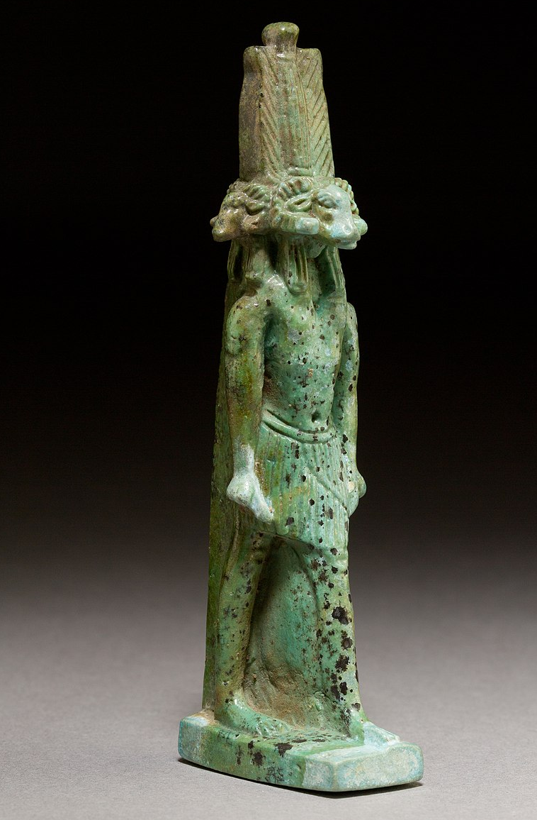
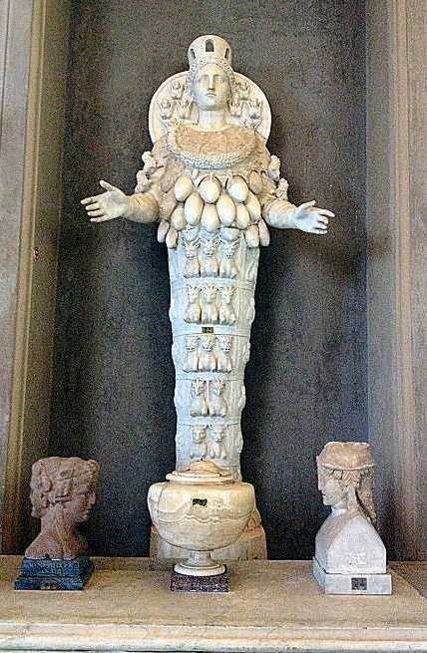
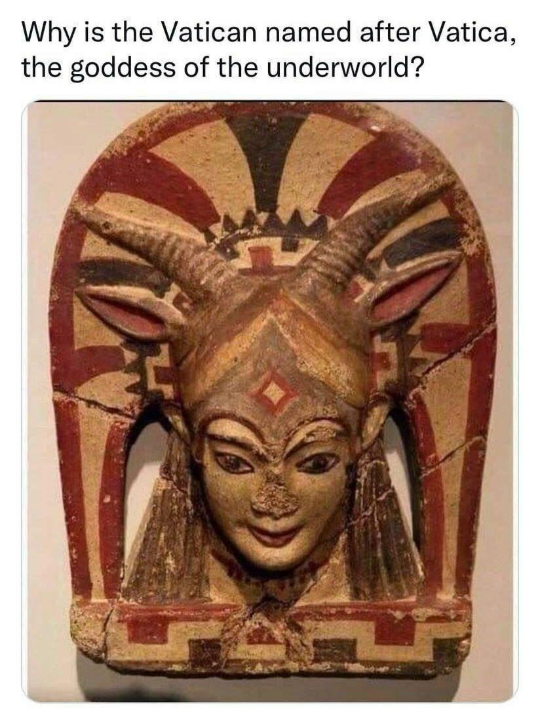
Egypt
Vatican
Greek

Slide 28
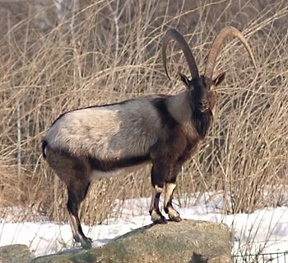
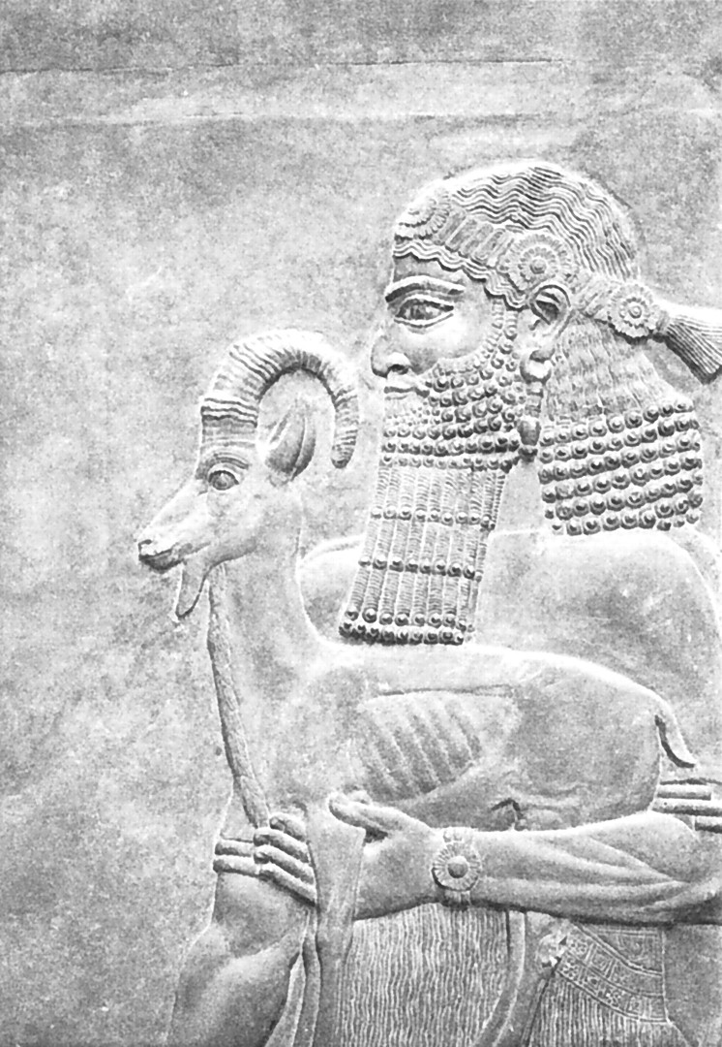

Slide 29
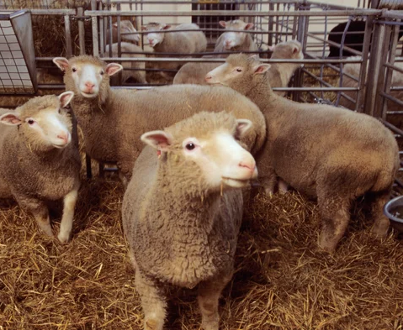

Slide 31
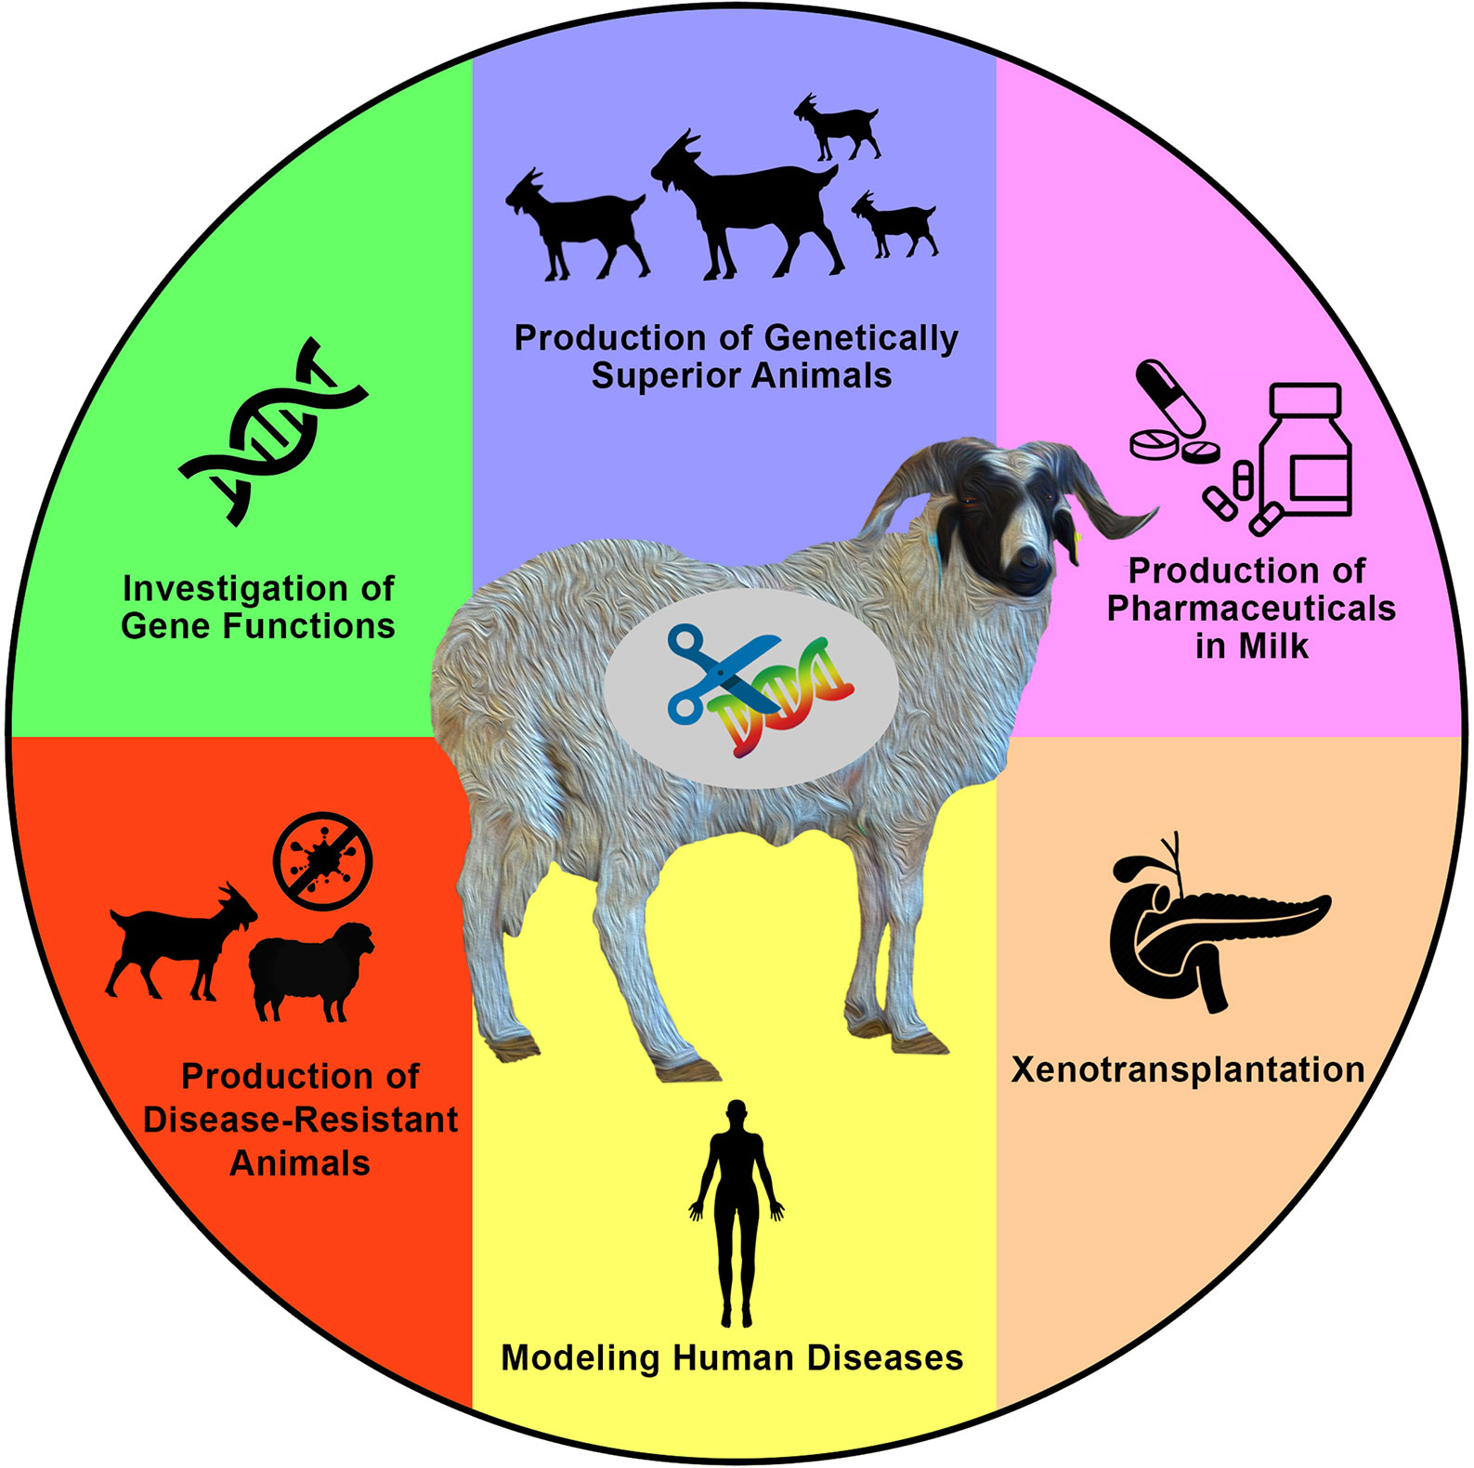
Xenotransplantation
Multiplets
Chimerism
Modeling humans
Genetically superior animals

Slide 32
God of Fertility

Slide 33
Why would a goat (Pan) be associated with fertility?

Slide 34
Pan - the son of Hermes and a wood nymph. (Hermaphrodite)
Pan in Greek means “All”
Pan's name is thought to derive from 'paean', the ancient Greek verb meaning 'to pasture'.

Slide 37
Have a nice apocalypse song

